Slide 1
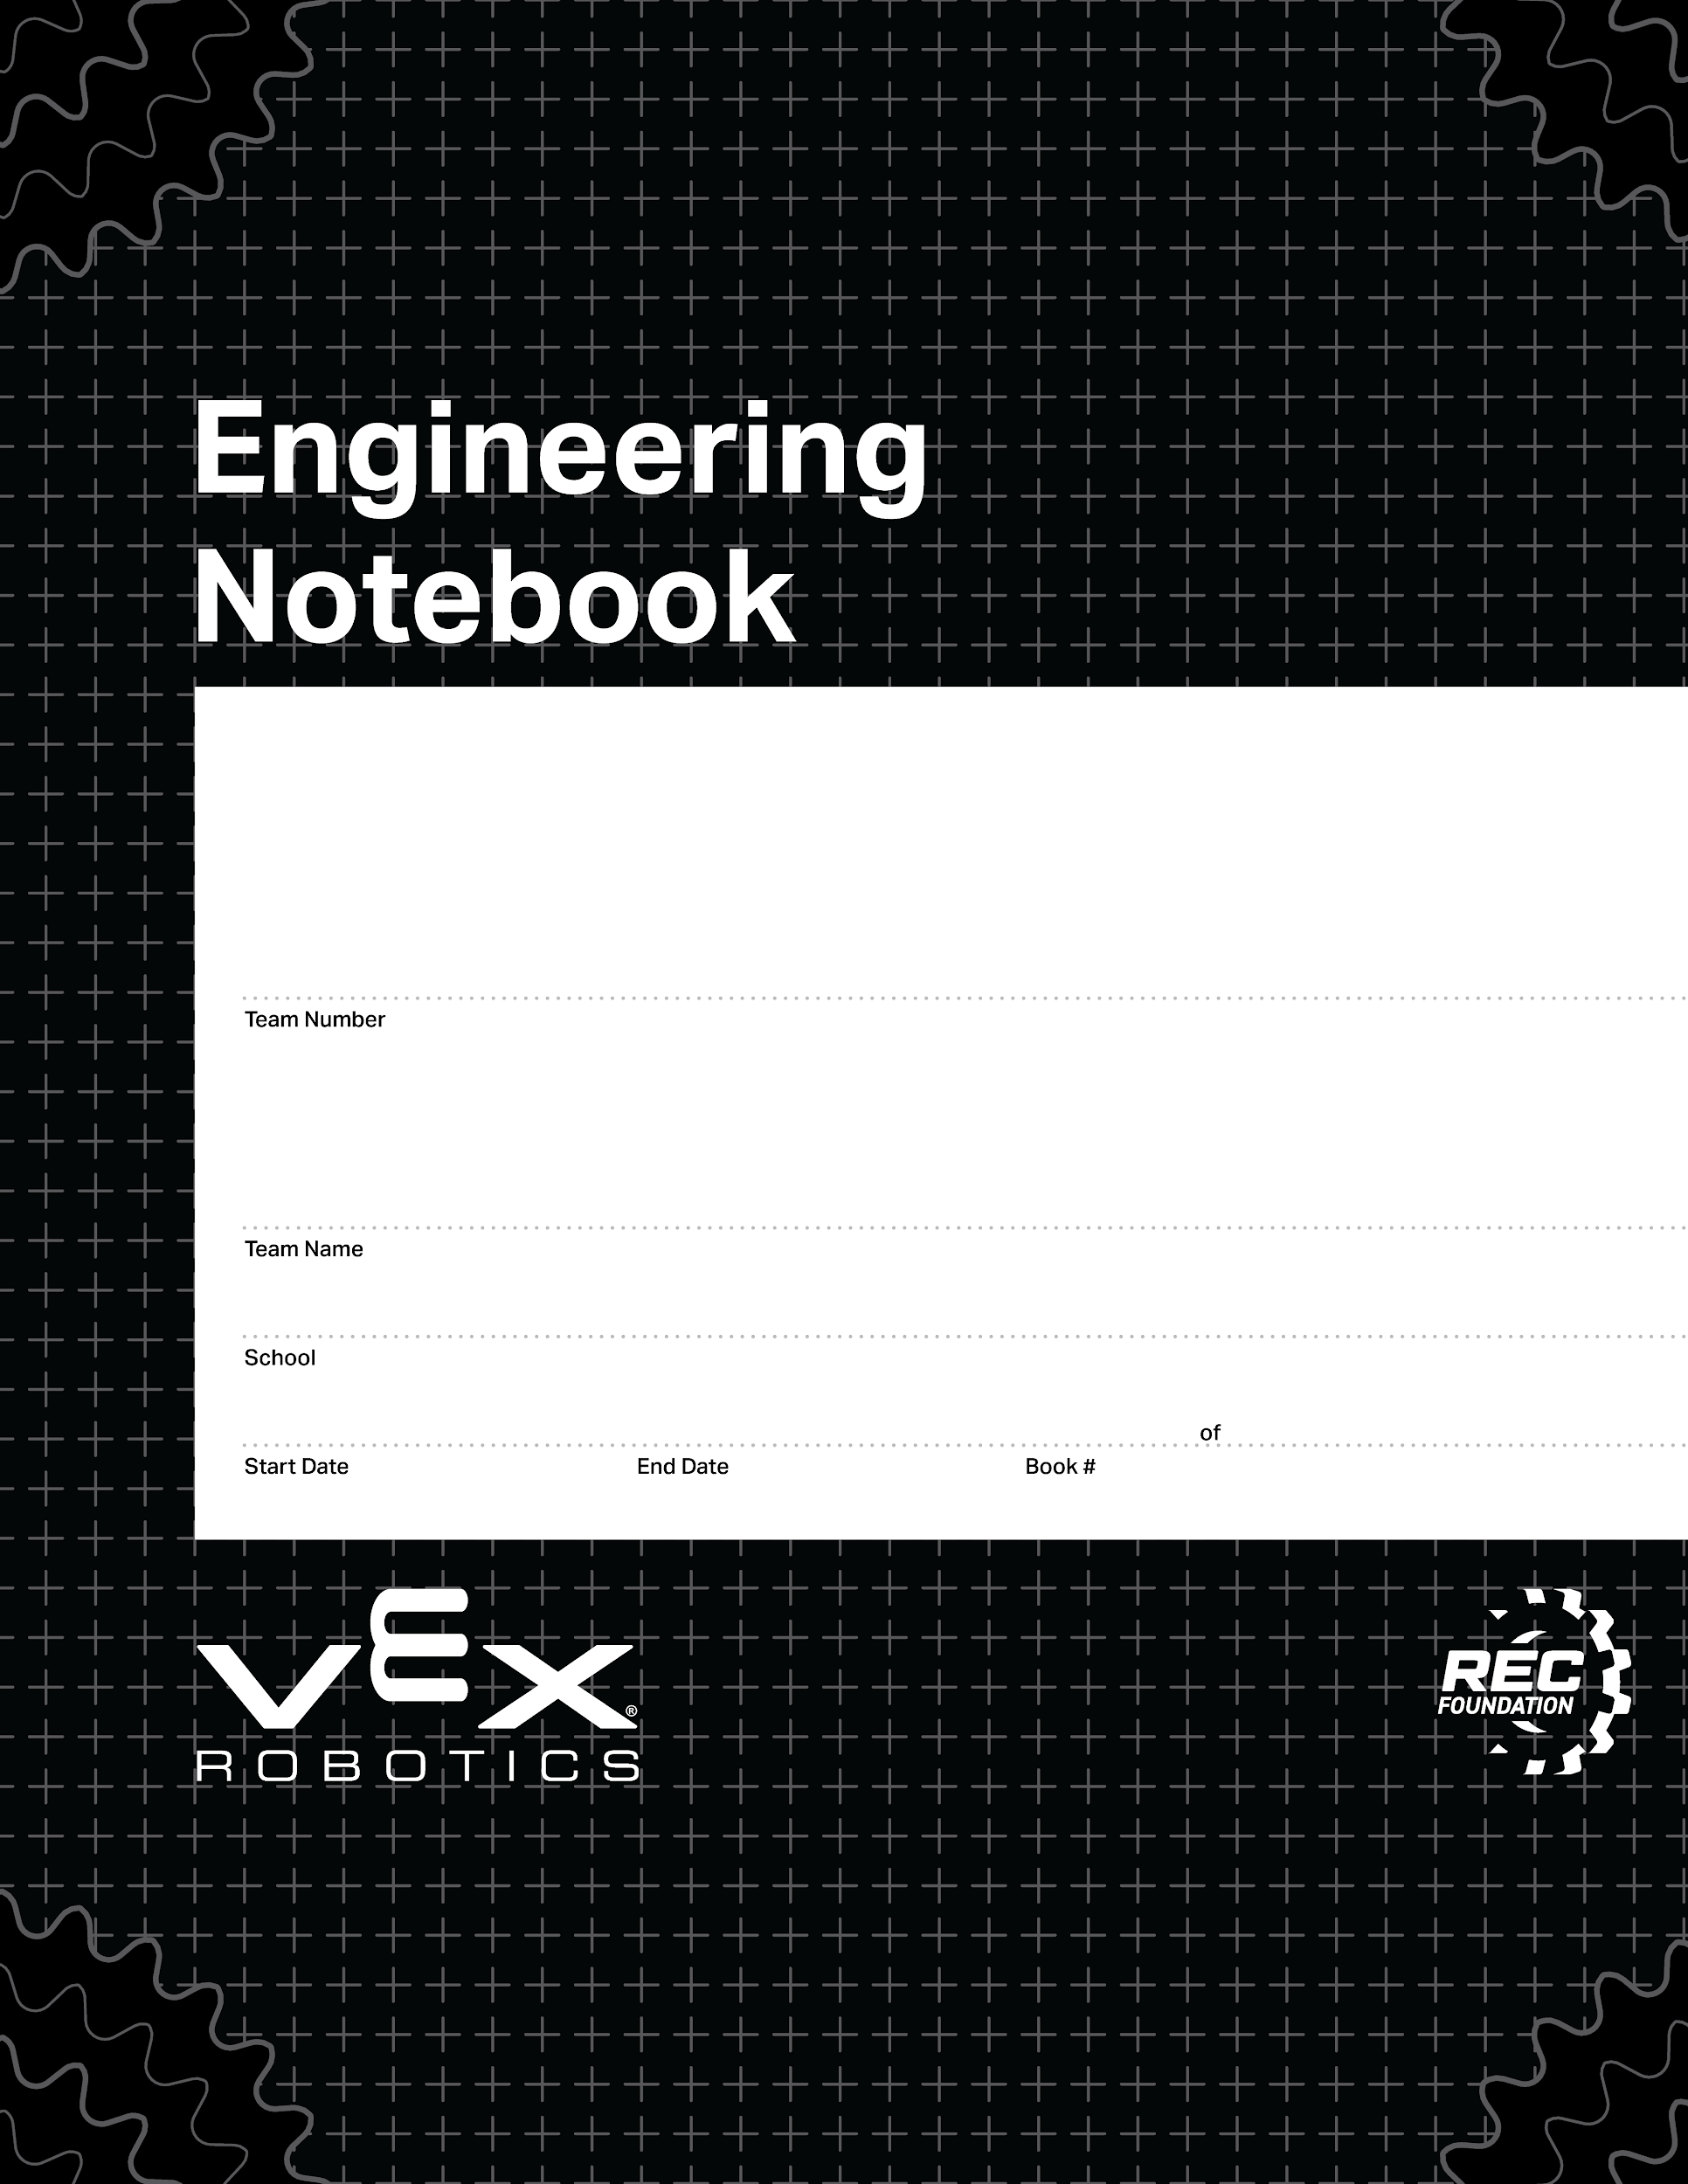
37528A
DIMAS!!!!!!!(Dee-mahs)
Colorado Early Colleges Windsor
08/27/2024
06/10/2024
1
1
V3.0 Date 6.10.24

Slide 2
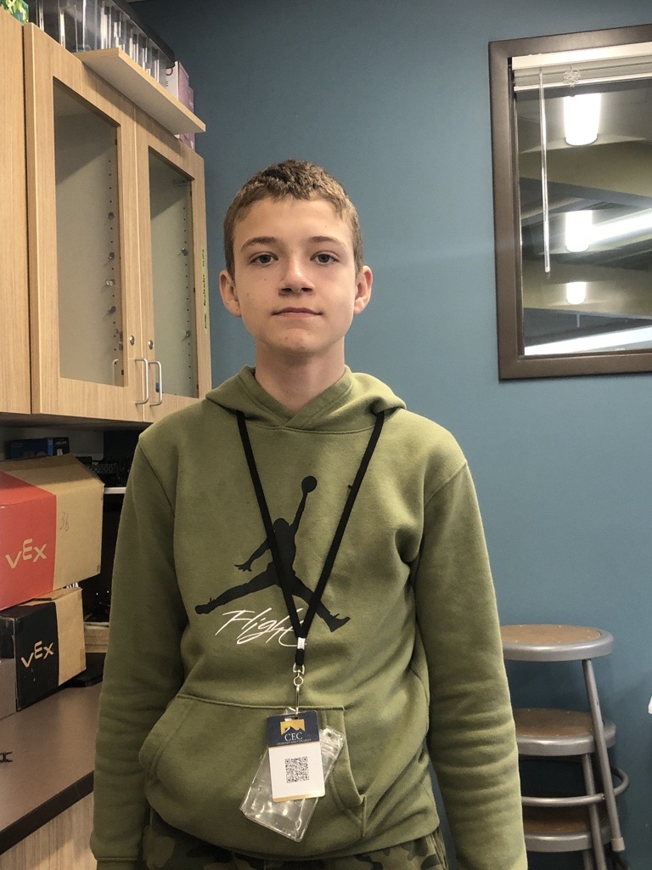
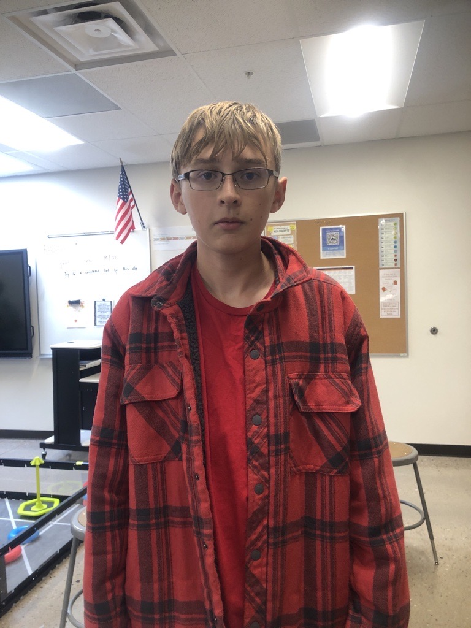
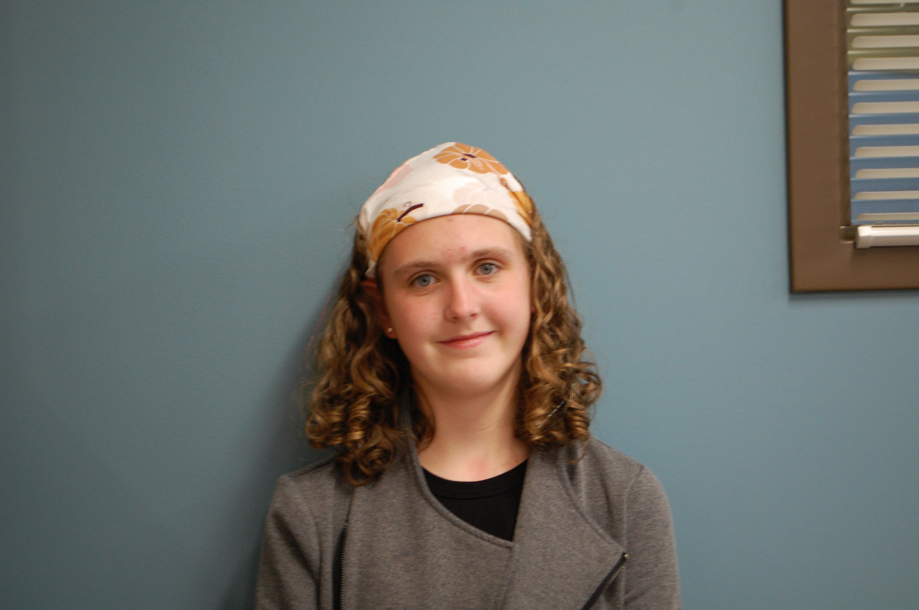
Dimas Tarin
Coder, Fixer, Designer
I am a 12-year-old who likes to code and play video games. When I grow up, I want to be an electrical engineer.
Ryder Sandstrum
Primary Driver, Builder
I am a 14-year-old airplane and I am obsessed with war thunder. When I grow up, I want be a pilot so I can fly myself.
Abigail Way
Note booker, Scrum Master, and Socializer
I am a 14-year-old who loves building things with my hands and books. When I grow up, I want to be either a biomedical or biochemical engineer.

Slide 3
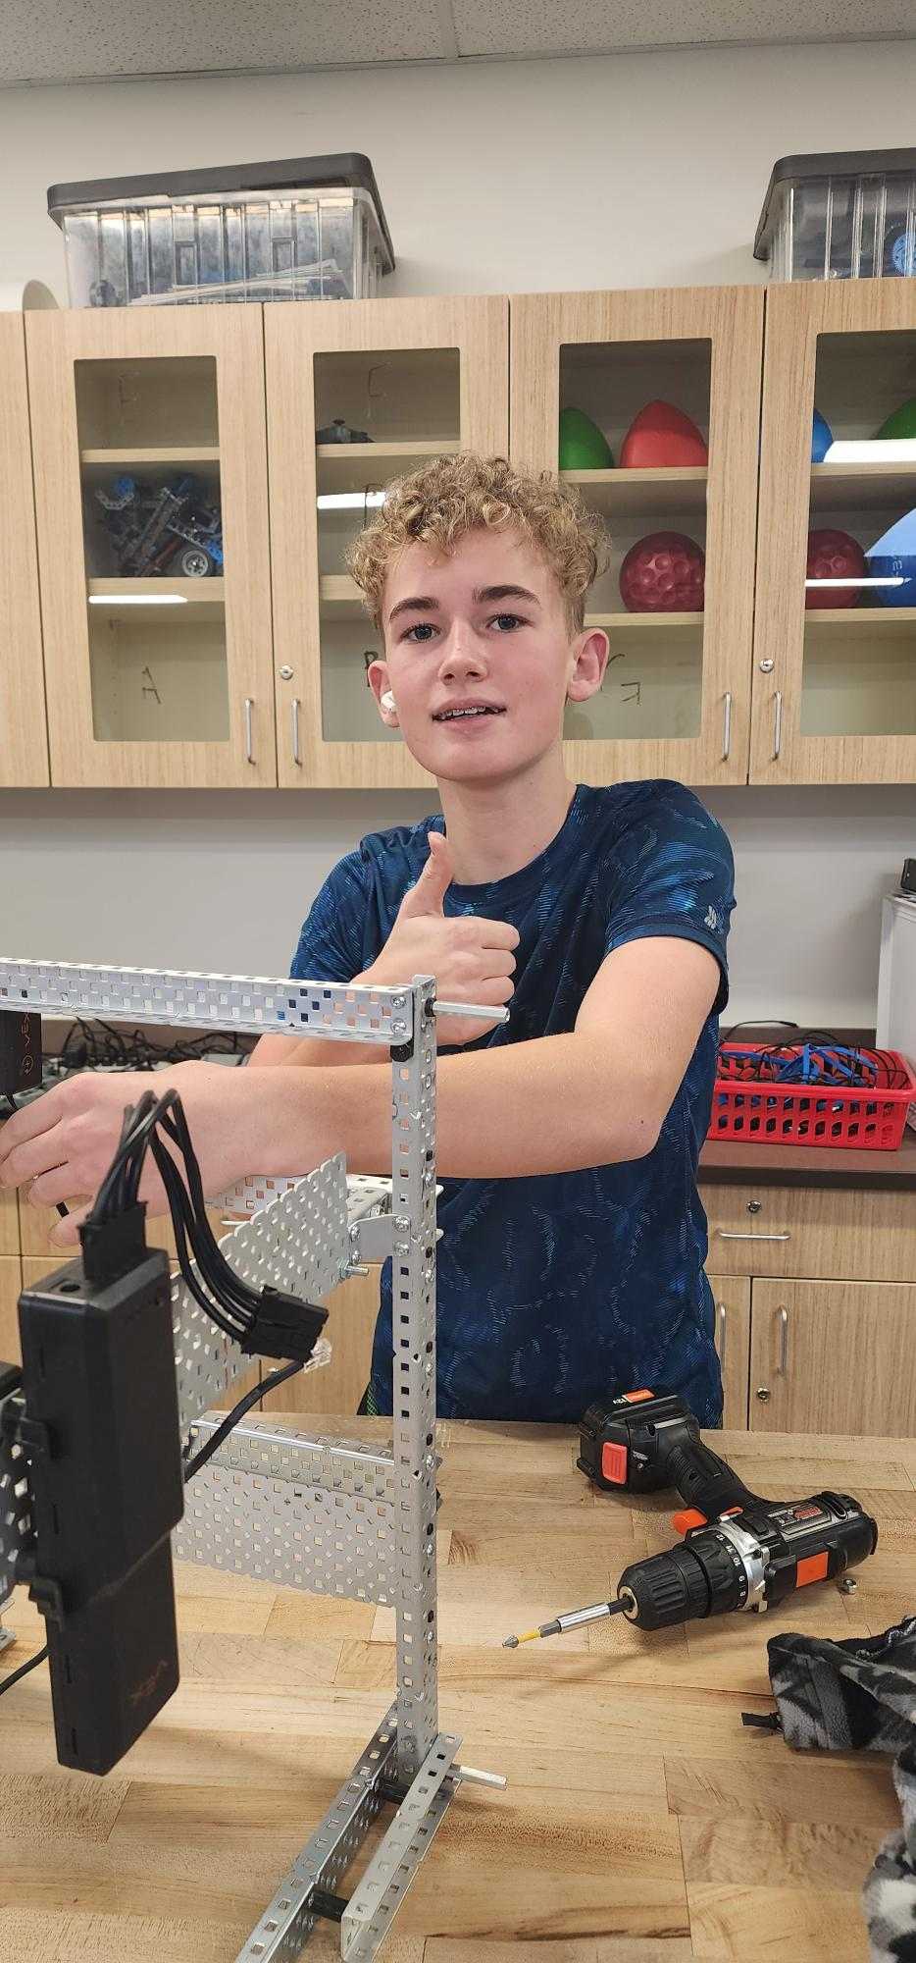
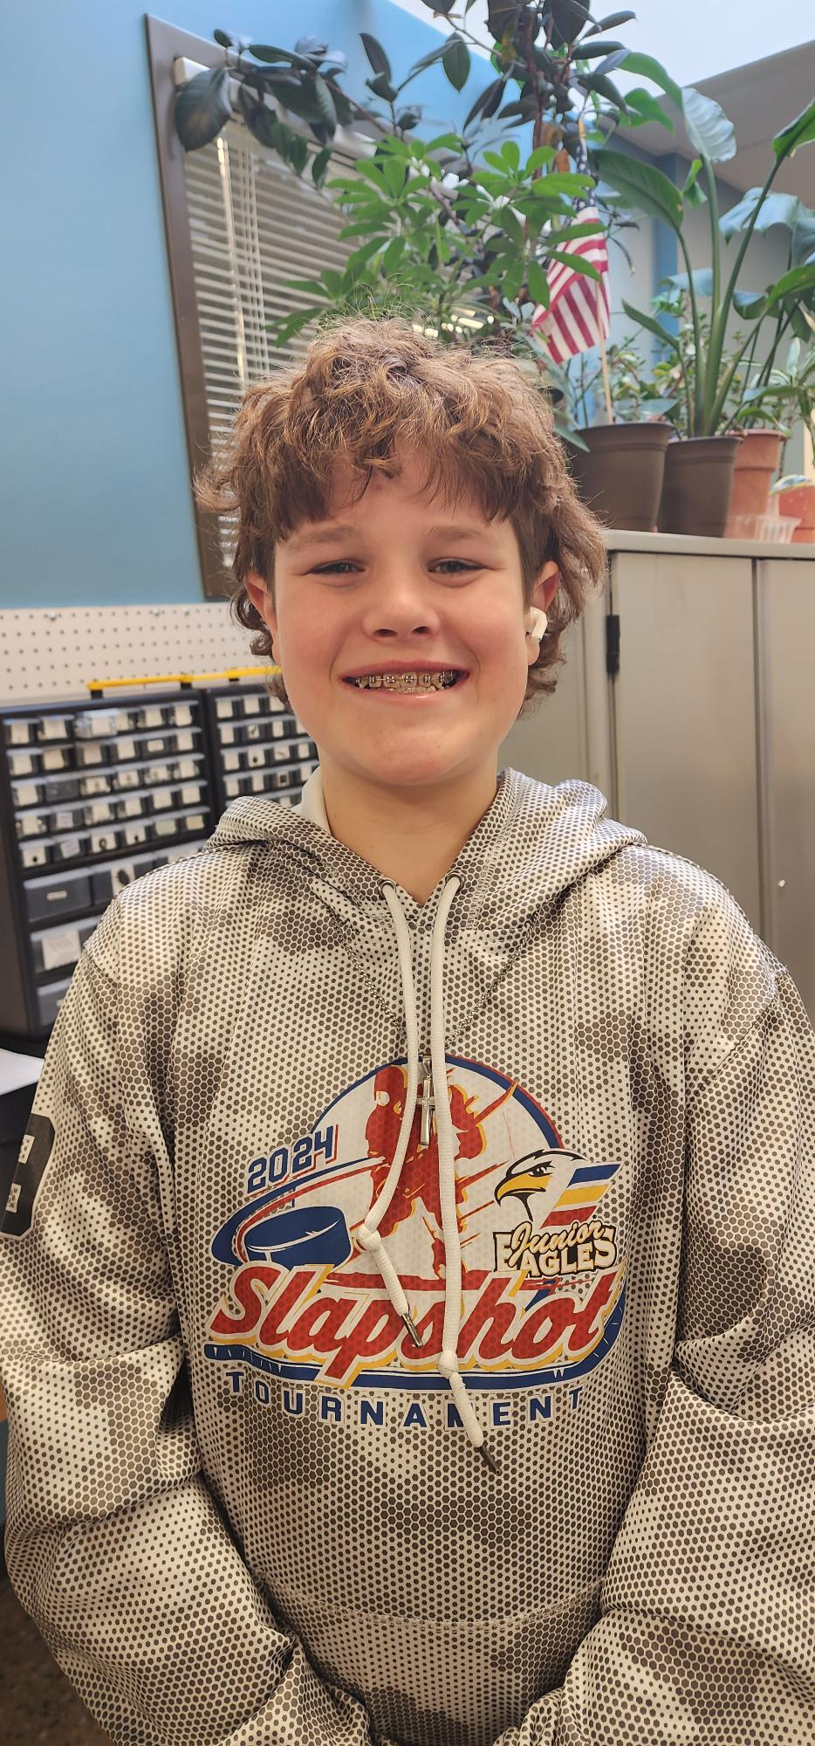
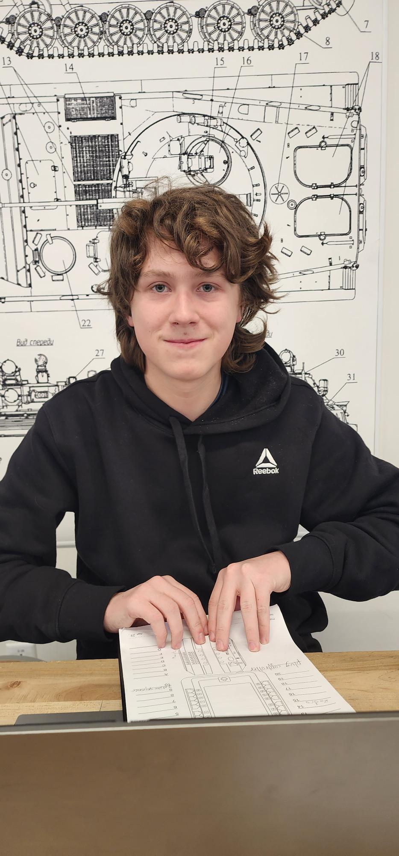
Augie Lerwick
Builder, different ideas to make it better, 3rd Driver
I am a 12-year-old who like to work with me hands and build parts to help improve our robot. When I grow up I want to be a chiropractor or engineer.
Ryker Shamley
2nd Driver, Builder
I am a 14-year-old who like to play hockey. When I grow up I want to be a professional hockey player.
Michael Hassinger
Coder and Builder
I am a 13-year-old who likes to play Brawl Stars. When I grow up I want to be a cyber security person.

Slide 4
Notes
Review Notebook Rules 8/27/2024
Competition Notes 11/12/2024
Competition Debrief 11/12/2024
Code
Code
Code
Code
Code
Drawings
Original Base Drawing 8/27/2024
First Base Drawing 9/4/24
Second Base Drawing 9/5/24
First Conveyer Belt Drawing 8/29/24
Third Base Drawing 9/6/24
Hero Bot Drawing 10/29/24
Vacuum Robot 1/8/24
Vacuum Robot 1/8/24
Vacuum Robot 1/8/24
Vacuum Robot 1/8/24
Vacuum Robot 1/8/24
Vacuum Robot 1/8/24
Vacuum Robot 1/8/24
Vacuum Robot 1/8/24
Vacuum Robot 1/8/24
Vacuum Robot 1/8/24
Vacuum Robot 1/8/24
Brain Ports/ Controller Program and Game Map
Brain Ports 10/28/2024
Remote Control Programing 10/28/2024

Slide 5
Scrum Notes/ Calendars
Product Backlog 8/28/2024
Sprint Backlog for Sprint 1 9/4/2024
Scrum Meeting #1 9/11/2024
Scrum Meeting #2 9/11/2024
Sprint Review For Sprint 1 9/11/2024
Sprint Retrospective For Sprint 1 9/11/2024
Sprint 2 Plan 9/11/2024
Scrum Meeting #3 9/11/2024
Scrum Meeting #4 9/12/24
Scum Meeting #5 10/21/24
Scrum Meeting #6 10/21/24
Sprint Review for Sprint 2 10/21/24
Sprint Retrospective for Sprint 2 10/21/24
Sprint 3 Plan 10/21/24
Scrum Meeting #7 10/21/24
Scrum Meeting #8 10/21/24
Scrum Meeting #9 10/21/24
Scrum Meeting #10 10/21/24
Scrum Meeting #11 10/21/24
Sprint Review for Sprint 3 10/21/24
Sprint Review for Sprint 3 10/21/24
Sprint 4 Plan 10/24/24
Scrum Meeting #12 10/29/24
Scrum Meeting # 13 10/31/24
Scrum Meeting #14 11/4/24
Scrum Meeting #15 11/6/24
Scrum Meeting #16 11/8/24
Scrum Meeting # 17 11/12/24
Scrum Meeting #18 11/14/24
Scum Meeting #19 11/18/24
Scrum Meeting #20 11/20/24
Scrum Meeting #21 11/22/24
. Scrum Meeting #22 12/2/24
Scrum Meeting #23 12/4/24
Scrum Meeting #24 12/6/24
Scrum Meeting #25 12/13/24
Scrum Meeting #26 1/7/25
Scrum Meeting #27 1/7/25

Slide 6
Scrum Meeting #28 1/7/25
Scrum Meeting #29 1/7/25
Scrum Meeting #30 1/7/25
Scrum Meeting #31 1/7/25
August Calendar 8/29/24
September Calendar 9/6/24
October Calendar 10/31/24
November Calendar 1/7/25
December Calendar 1/7/25
January Calendar 1/7/25

Slide 7
Notes and Code

Slide 8
Review notebook requirement
Abigail Way
8/27/2024
1

Slide 9
Competition notes
Before Competition: We are all feeling the pressure of our first competition and noticing that we aren’t really prepared, that we should have been practicing way more than what we have been doing. While noticing this we went into panic made and really started powering through as many things as possible. We also notice on how our robot was outside the size limit and we needed to shorten some things to fit the requirements. Along with noticing how our code didn’t work (hoping to get this fix before the competition.) We have high hopes for the competition that everything will go smoothly and easily as things can go.
During Competition: The nerves are everything as we are waiting for others to arrive. Problems are occurring, our brain will not turn on and we don’t know why. Luckly, we figured it out and it was just the battery. There are a lot of different and cool robots. Now that inspection is over, we are all a lot calmer and more relaxed. We had a surprise guest arrive with the name of Augie. First competition was a bust, things kept breaking, we were up against high schoolers who had way better robots. The robot first-time failed things kept falling apart. Hoping to talk to some other high schoolers on what they have done and what they recommend. Looking at things we need to find a better way to pick up rings because the flaps keep coming off. We made it into an alliance don’t know how far we will go but its great for a first-time team! Along with a ton of good ideas from some of the best teams here. We lost our first alliance game but nothing surprising there…. We hope to redesign our robot to look more like some of the high school teams.
Talking with one of the high schoolers they said that more time on the robot can result in a better robot Pneumatics can be useful. Worry fist about the metal and motors and motors, sensors, and everything else first. Sensors can be helpful but not necessarily necessary. Inertial sensor. Working extra time can be helpful. Things will go wrong!
What would you recommend to a first-time team? Have time dedicated to code, don’t build the day before unless minor. Observe the teams around you. Trying to make an algorithms that works, build your knowledge. Work on things slowly, having one person work on specific things. Get good at doing one thing.
What are somethings you did that were helpful? Talking too couches, communication (outside of school) Work outside of class, Having another set of eyes. Many people helped get used to thing work. Trying to make the hardware as reliable as possible, make sure everything is reliable, if something breaks then don’t fix it the way you normally would, make it better, analyze the game, reliability. Team dynamics, people have specific jobs that they are good at. Modular systems
Abigail Way
11/2/24
2

Slide 10
Competion Debrief
Competion Debrief:
Robot design: would we like to do a “Vacuum” robot or one that can climb
Team size:
Competion in general:
Team size: What thoughts did we have bigger teams smaller teams
A bigger a team could be better to get more done along with a two robots to work and practice on, funding,
A big team could be better to get more done
Leaning to one big team of six
One big team, two identical robots, Vacuum robot!
11/5/2024
Agreements:
Rules/ Jobs:
Abby: Note booker, Builder, Filler, Socializer, Scrum Master
Dimas: Coder 2nd Builder, things notice amiss, designer
Ryder: Primary Driver 2nd Flexible
Augie:3rd Driver, Builder, coming up with different ideas to make it better/ designer, fixer at competition
Ryker: 2nd Secondary Drive Builder
Mike: Coder, 2nd Build
Role Swap: Understanding of each other and changing roles flip a coin
Conflict and design: Voting accept the out come no pouting/ sourpuss/ no poopy head
Efficiency: When someone isn’t doing there job- Mr. Lyon (impartial) decides!
All committing to reading the rules and understanding them
Freedom to work alone: All committed to getting this done
All other conflicts determined by a vote if a tie Mr. Lyon breaks the tie.
If you aren't working on anything/don’t know what to do: Set up Pit, Organize, Drawing, Read game manual
Sign: Abigail Way, Augie lerwick, Mike. J. Hassinger, Ryder Sandstrum, Ryker Shamley, Dimas S. Tarin, son of Carlos, son of Jose,
Abigail Way
11/5/2024
3

Slide 11
Code
4

Slide 12
Code
5

Slide 13
Code
6

Slide 14
Skills challenge code
7

Slide 15
Skills challenge code
8

Slide 16
Drawings

Slide 17
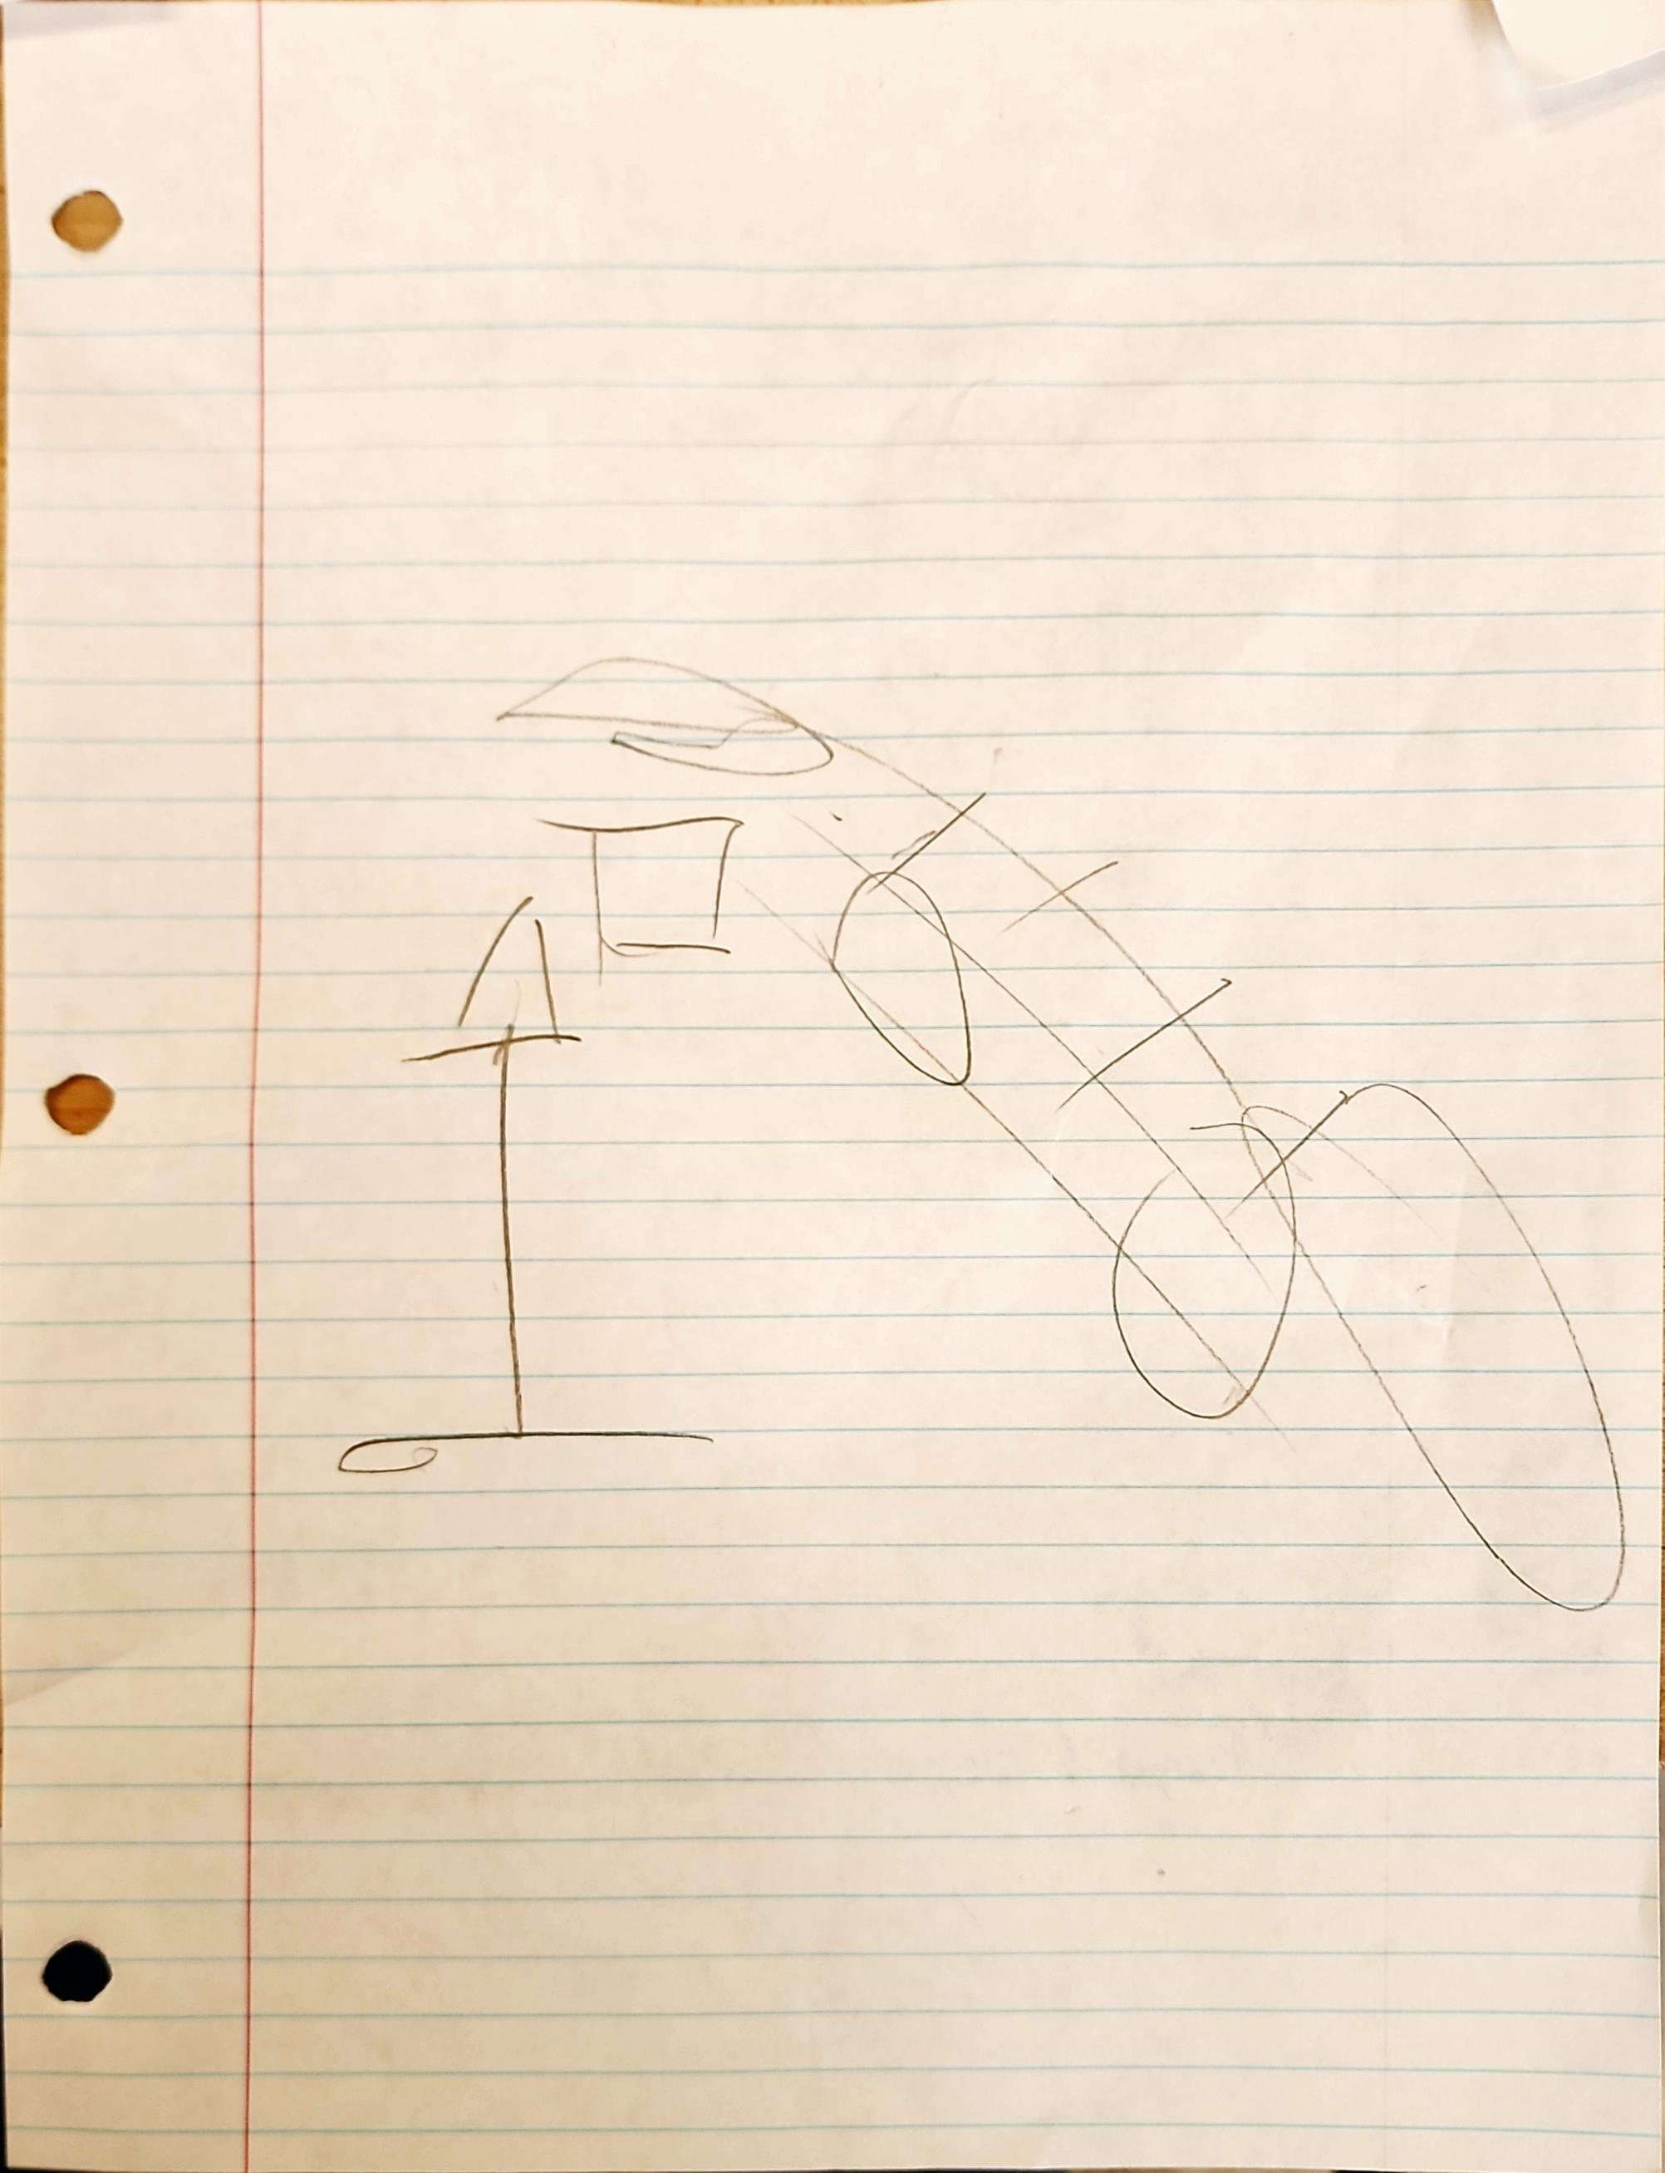
Aurora
Dimas
8/
9

Slide 18
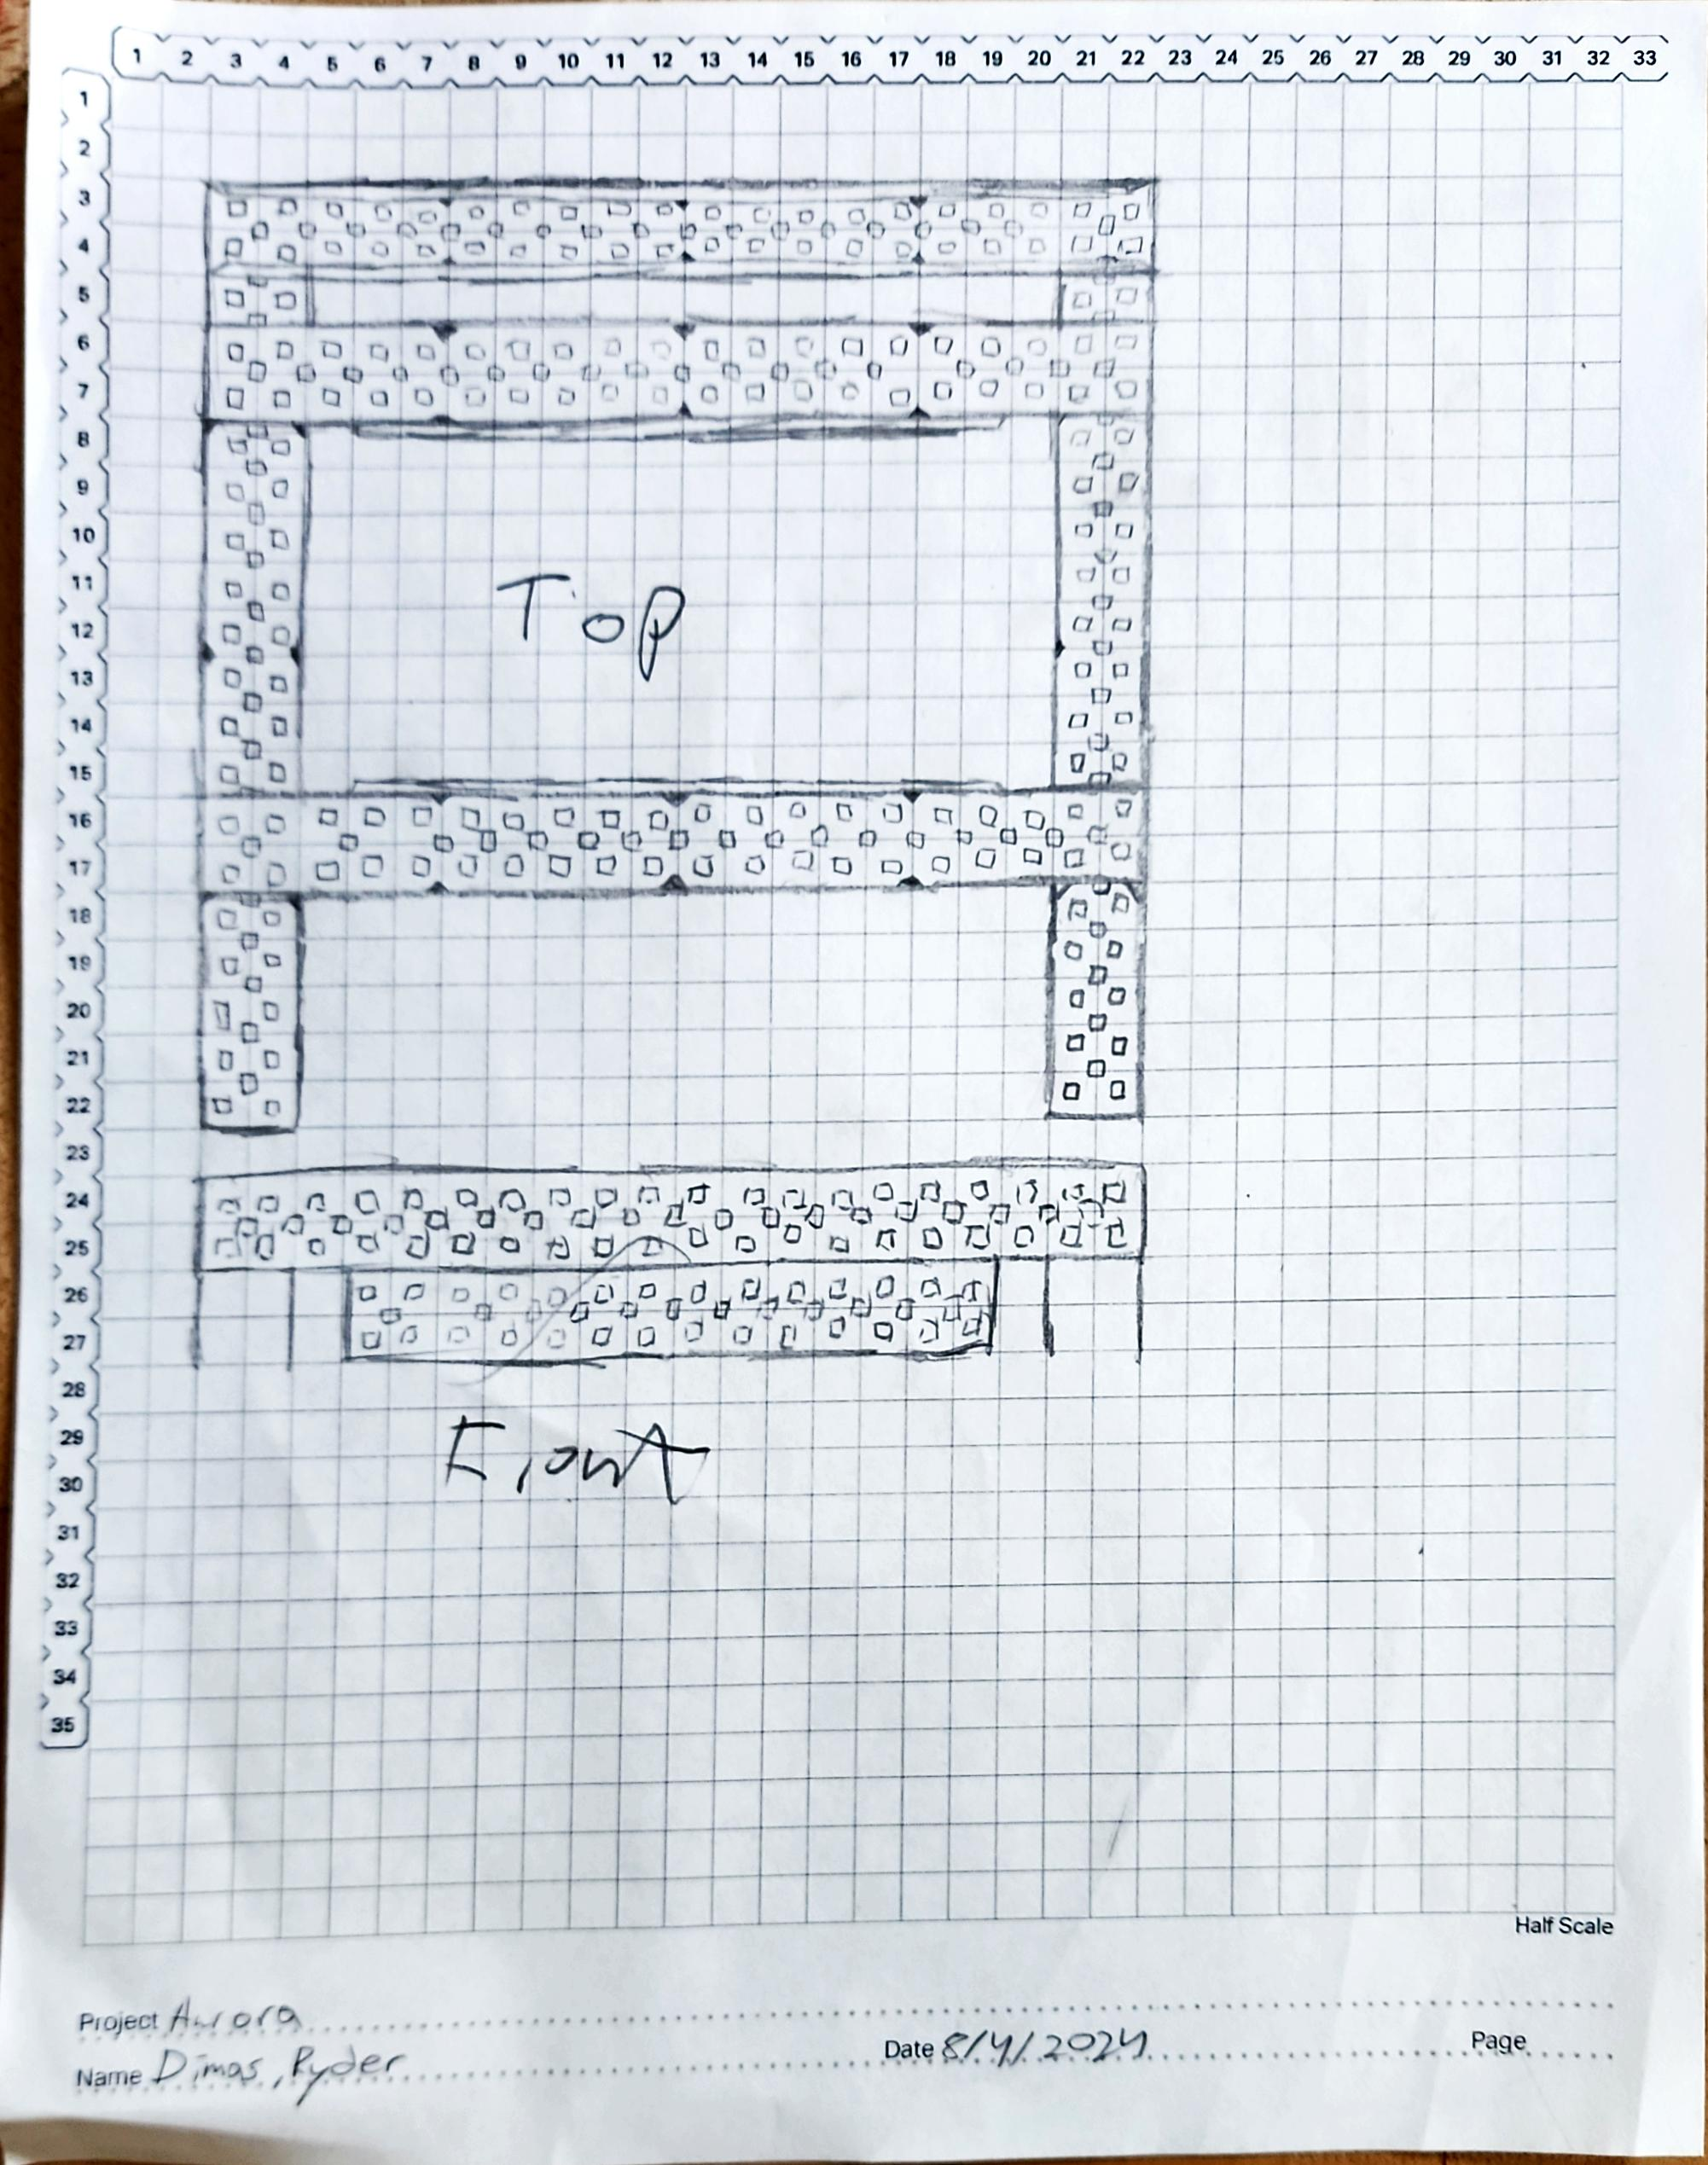
10
Notes:
First Base Drawing

Slide 19
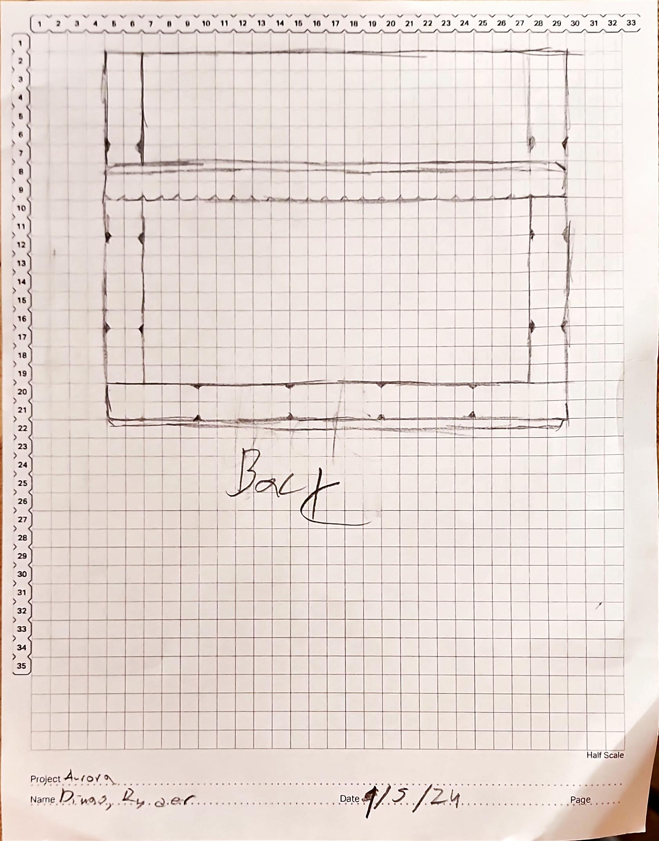
11
Notes:
Second Base Drawing

Slide 20
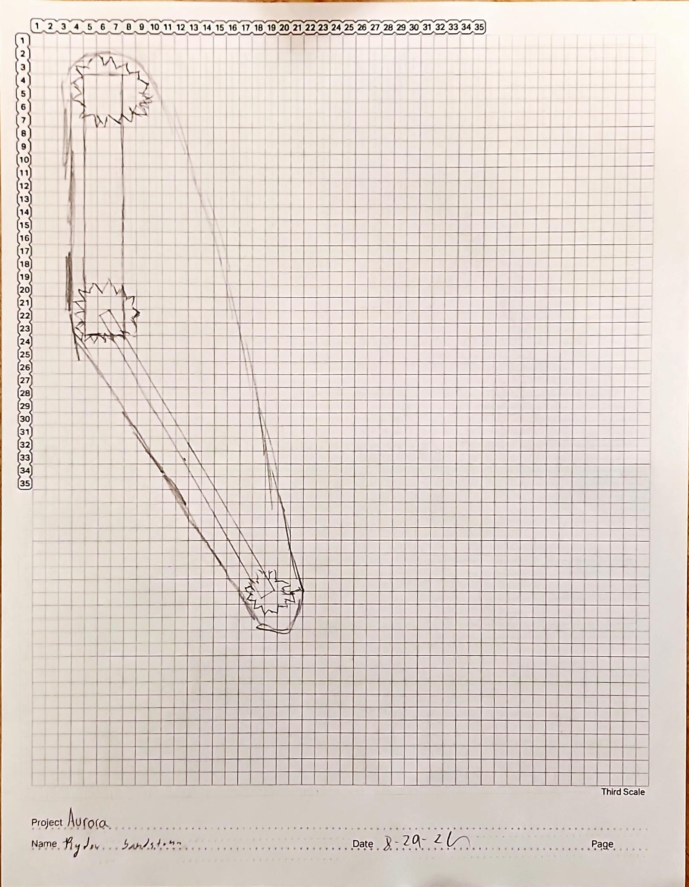
12
Notes:
First Conveyer Belt Drawing

Slide 21
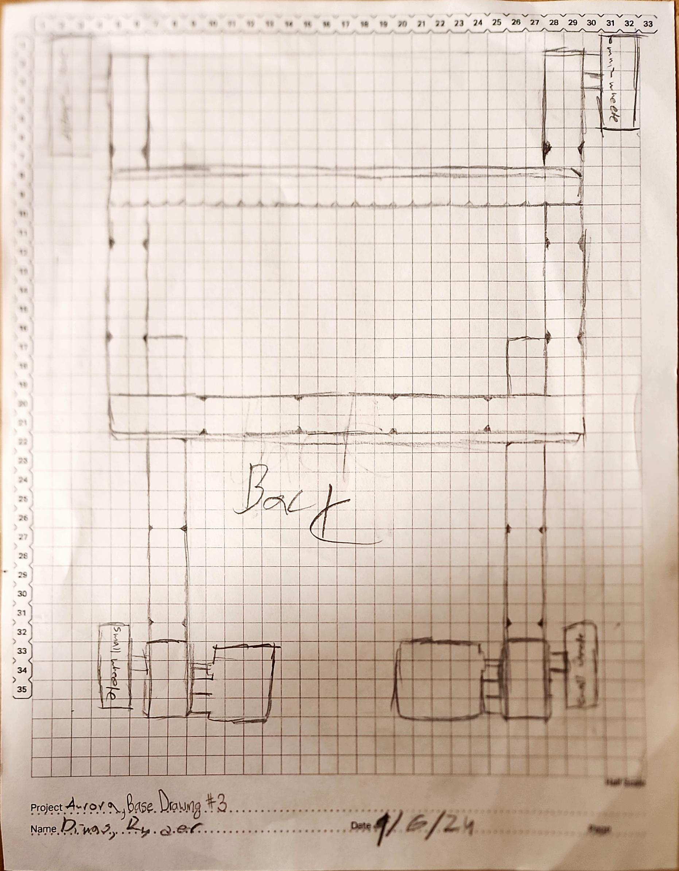
13

Slide 22
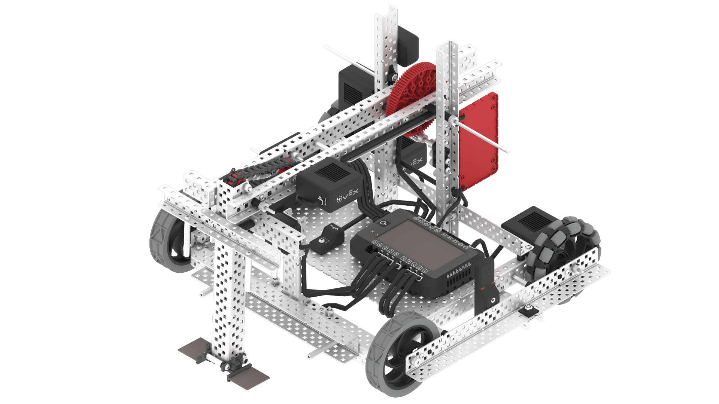
Hero Bot Drawing
Abigail Way
10/29/30
14

Slide 23
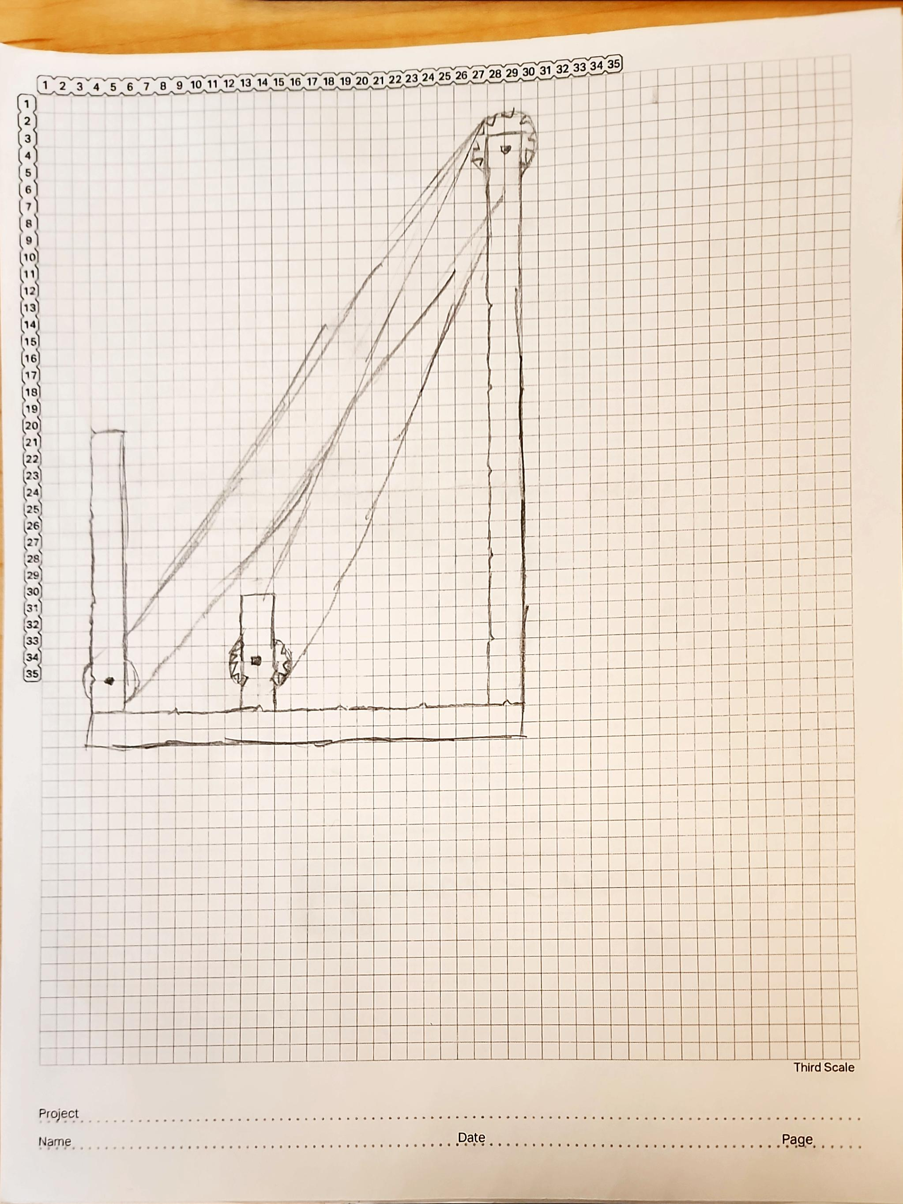
15

Slide 24
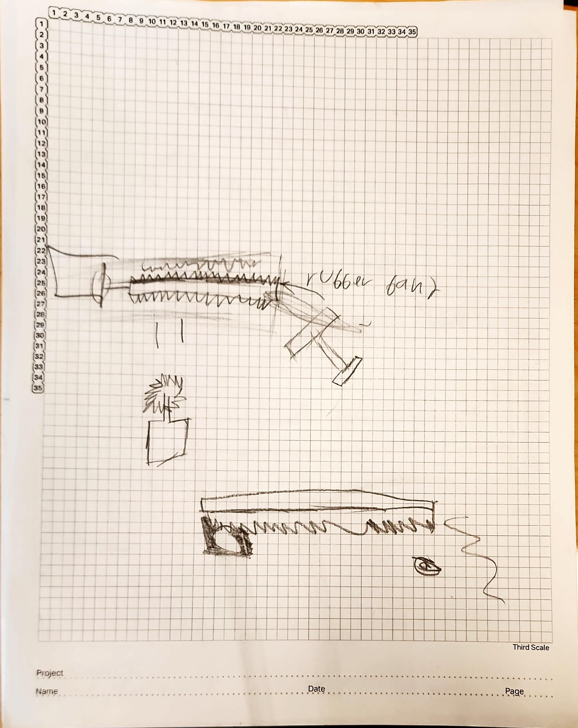
16

Slide 25
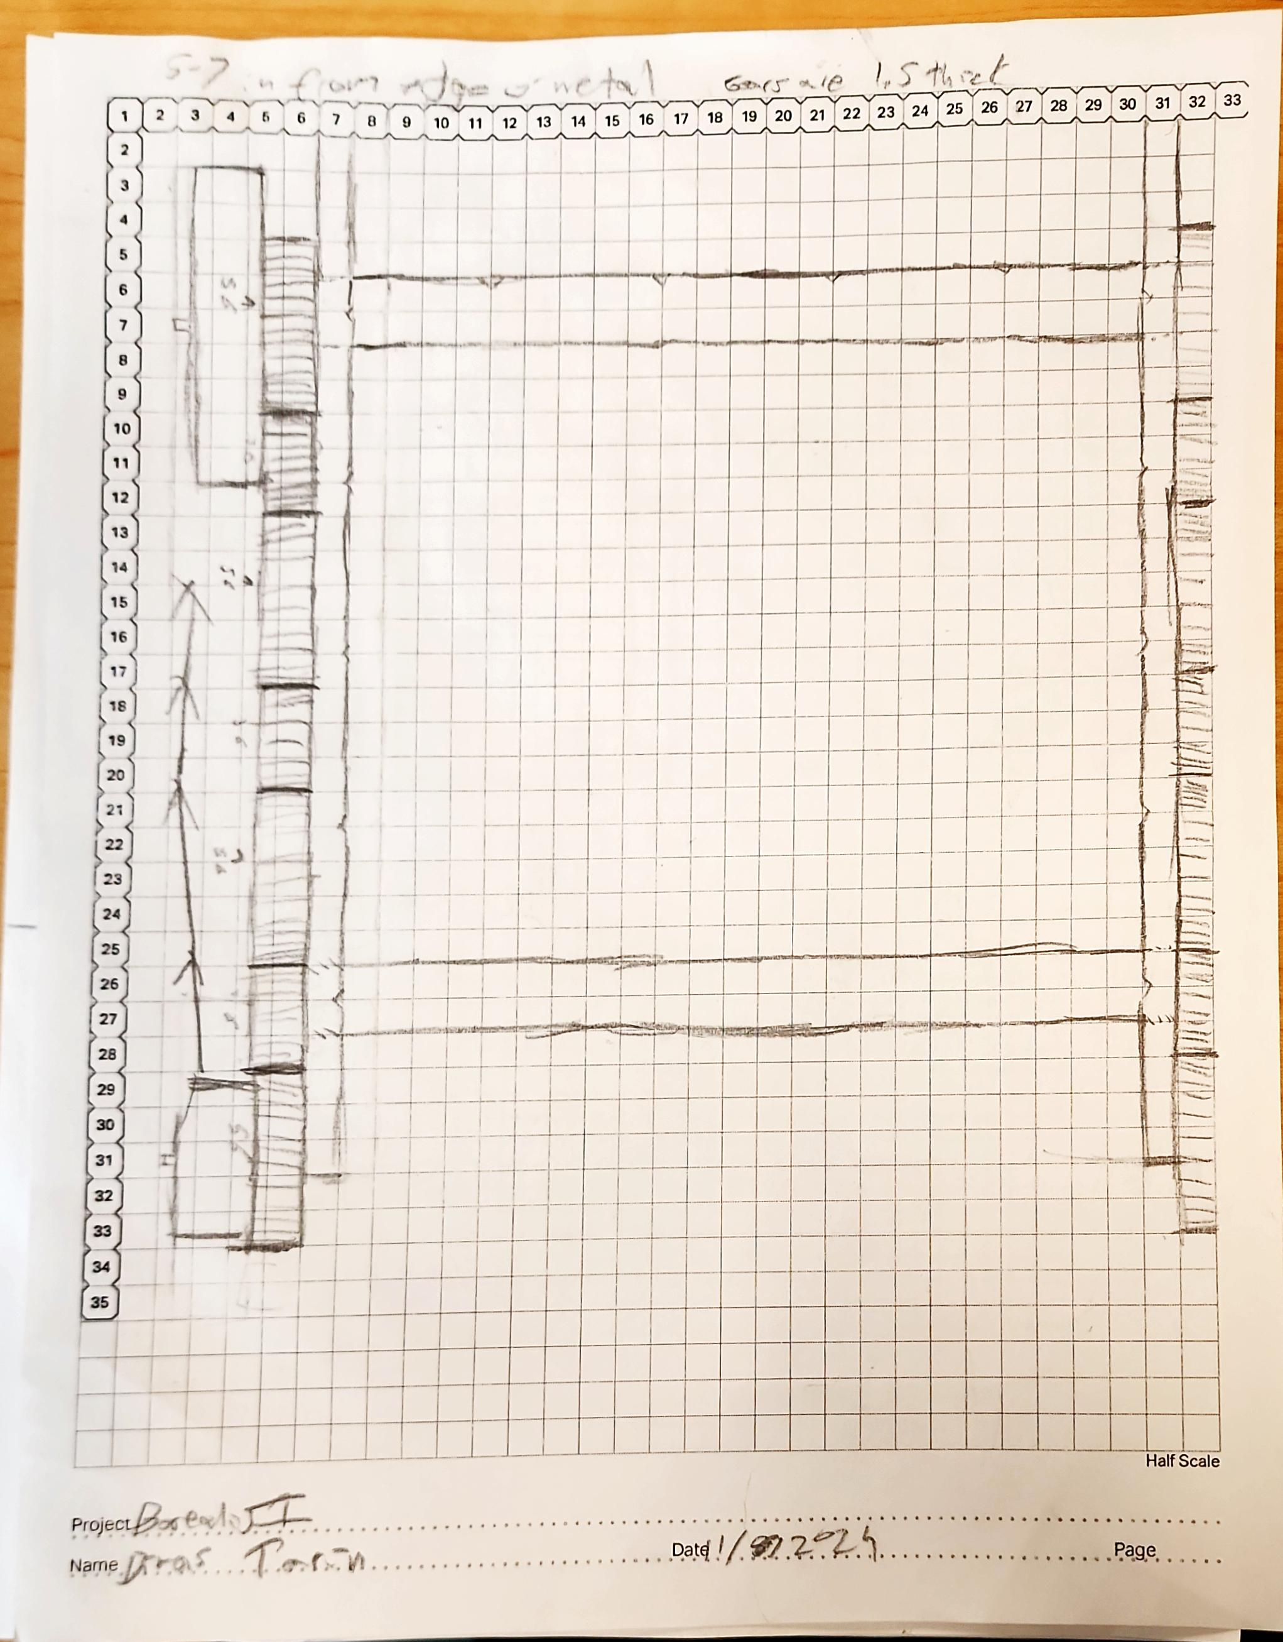
17

Slide 26
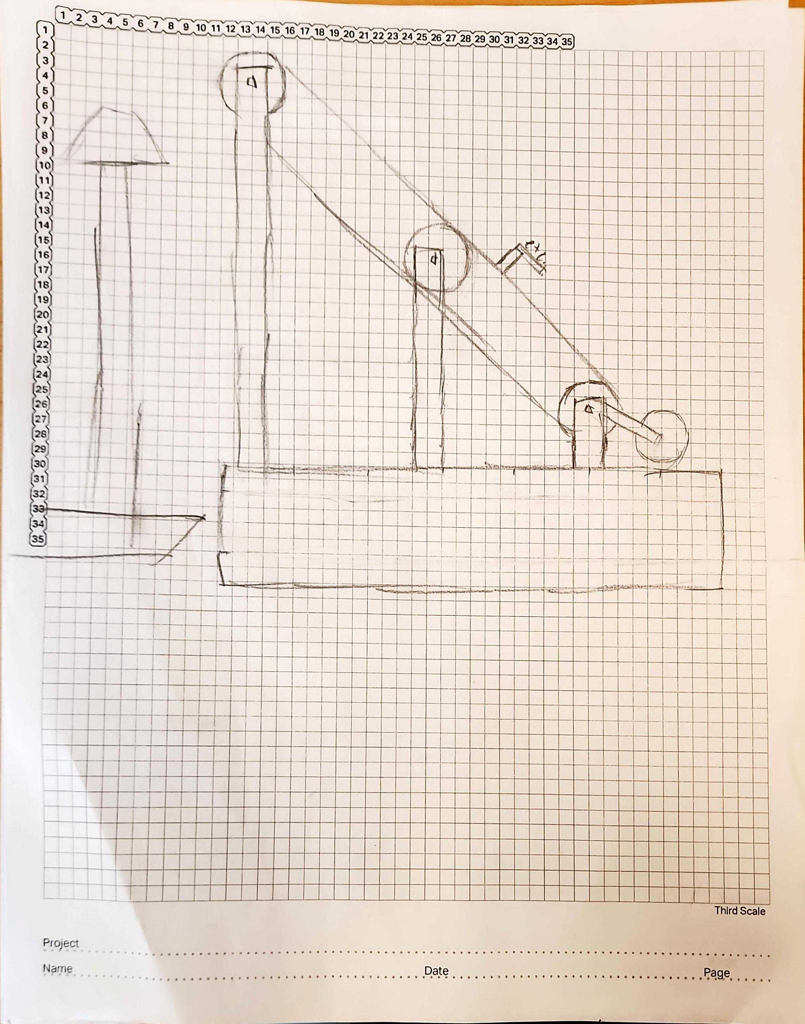
18

Slide 27
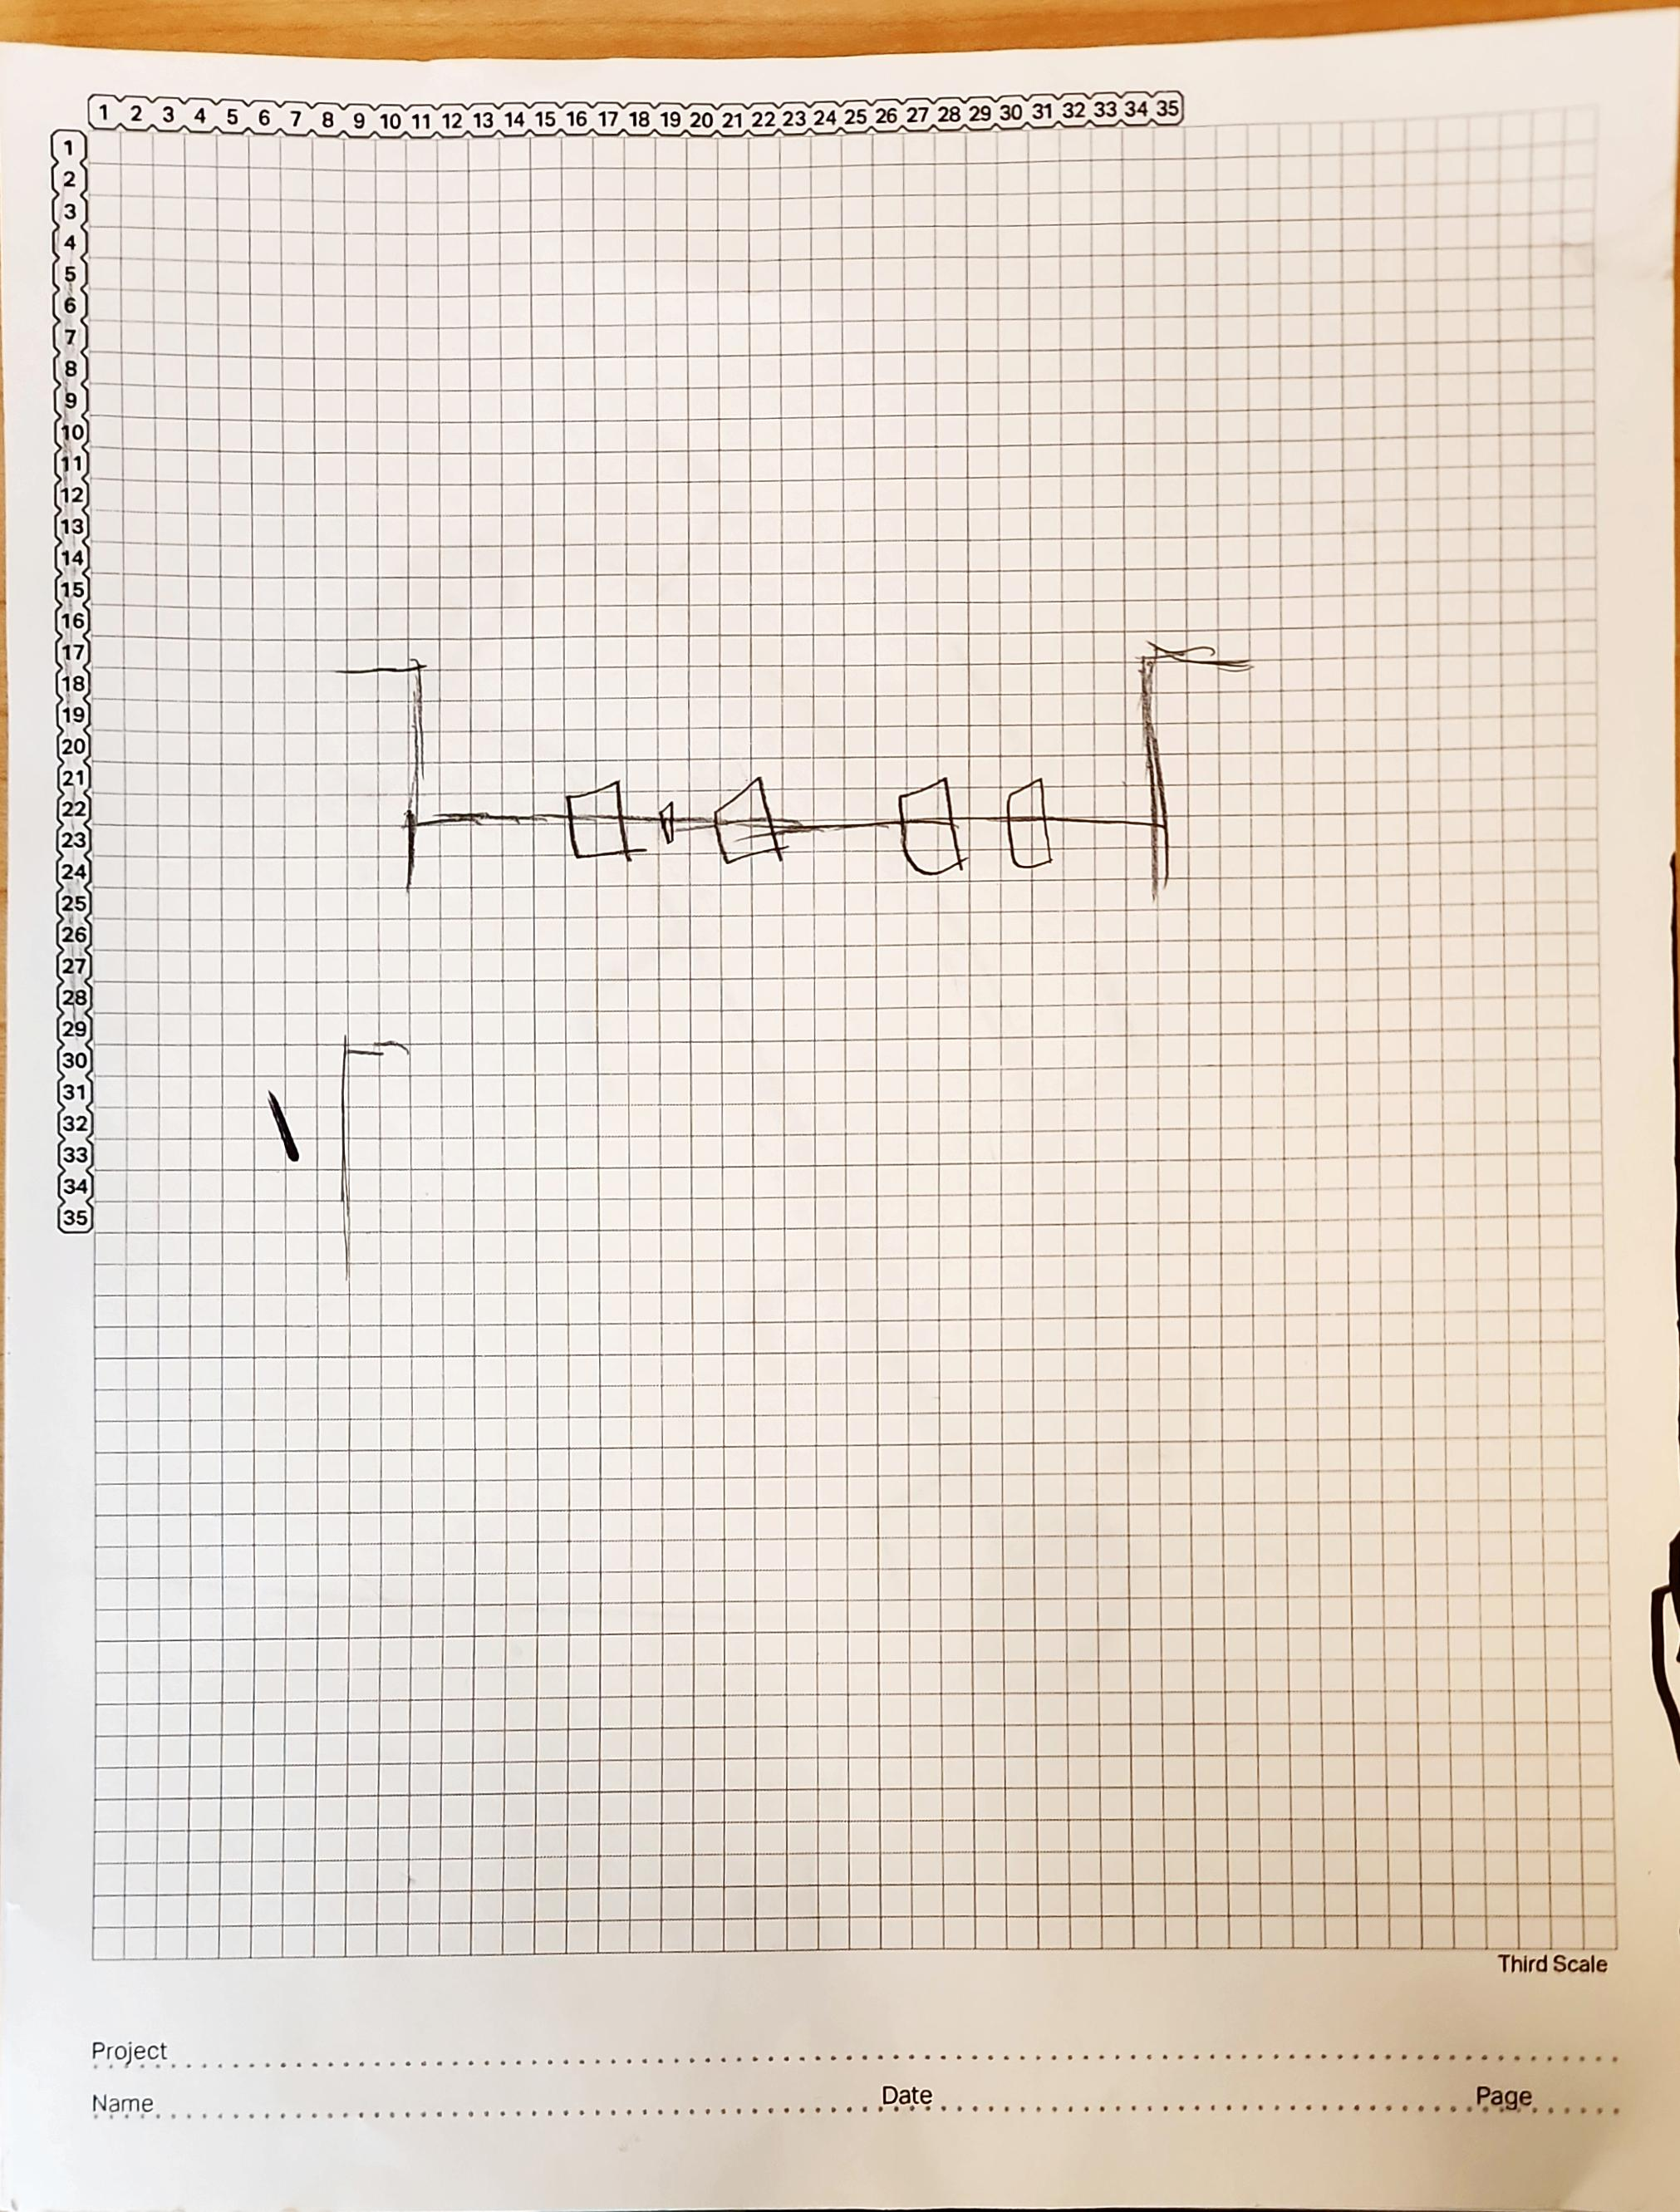
19

Slide 28
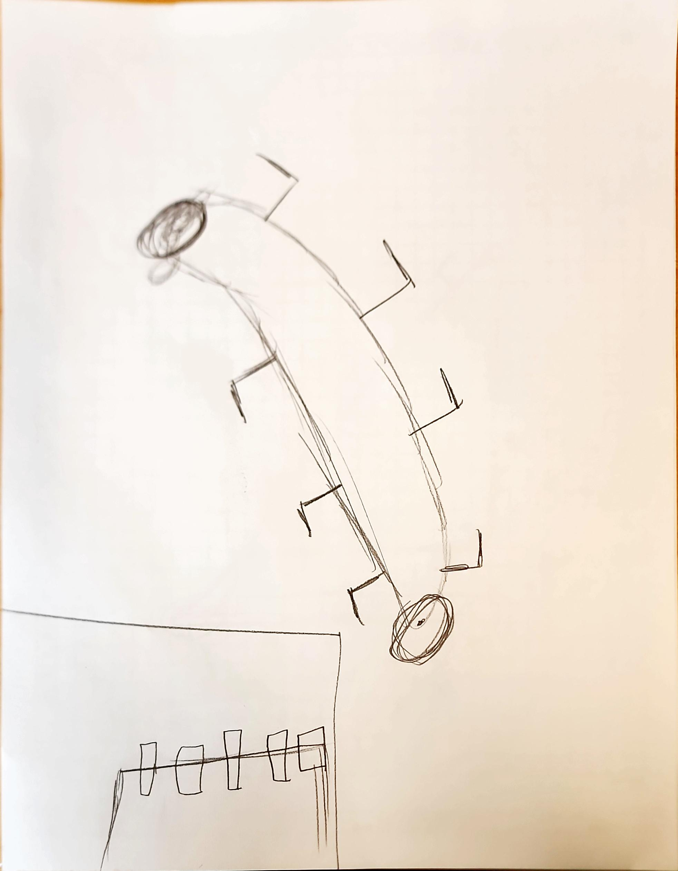
20

Slide 29
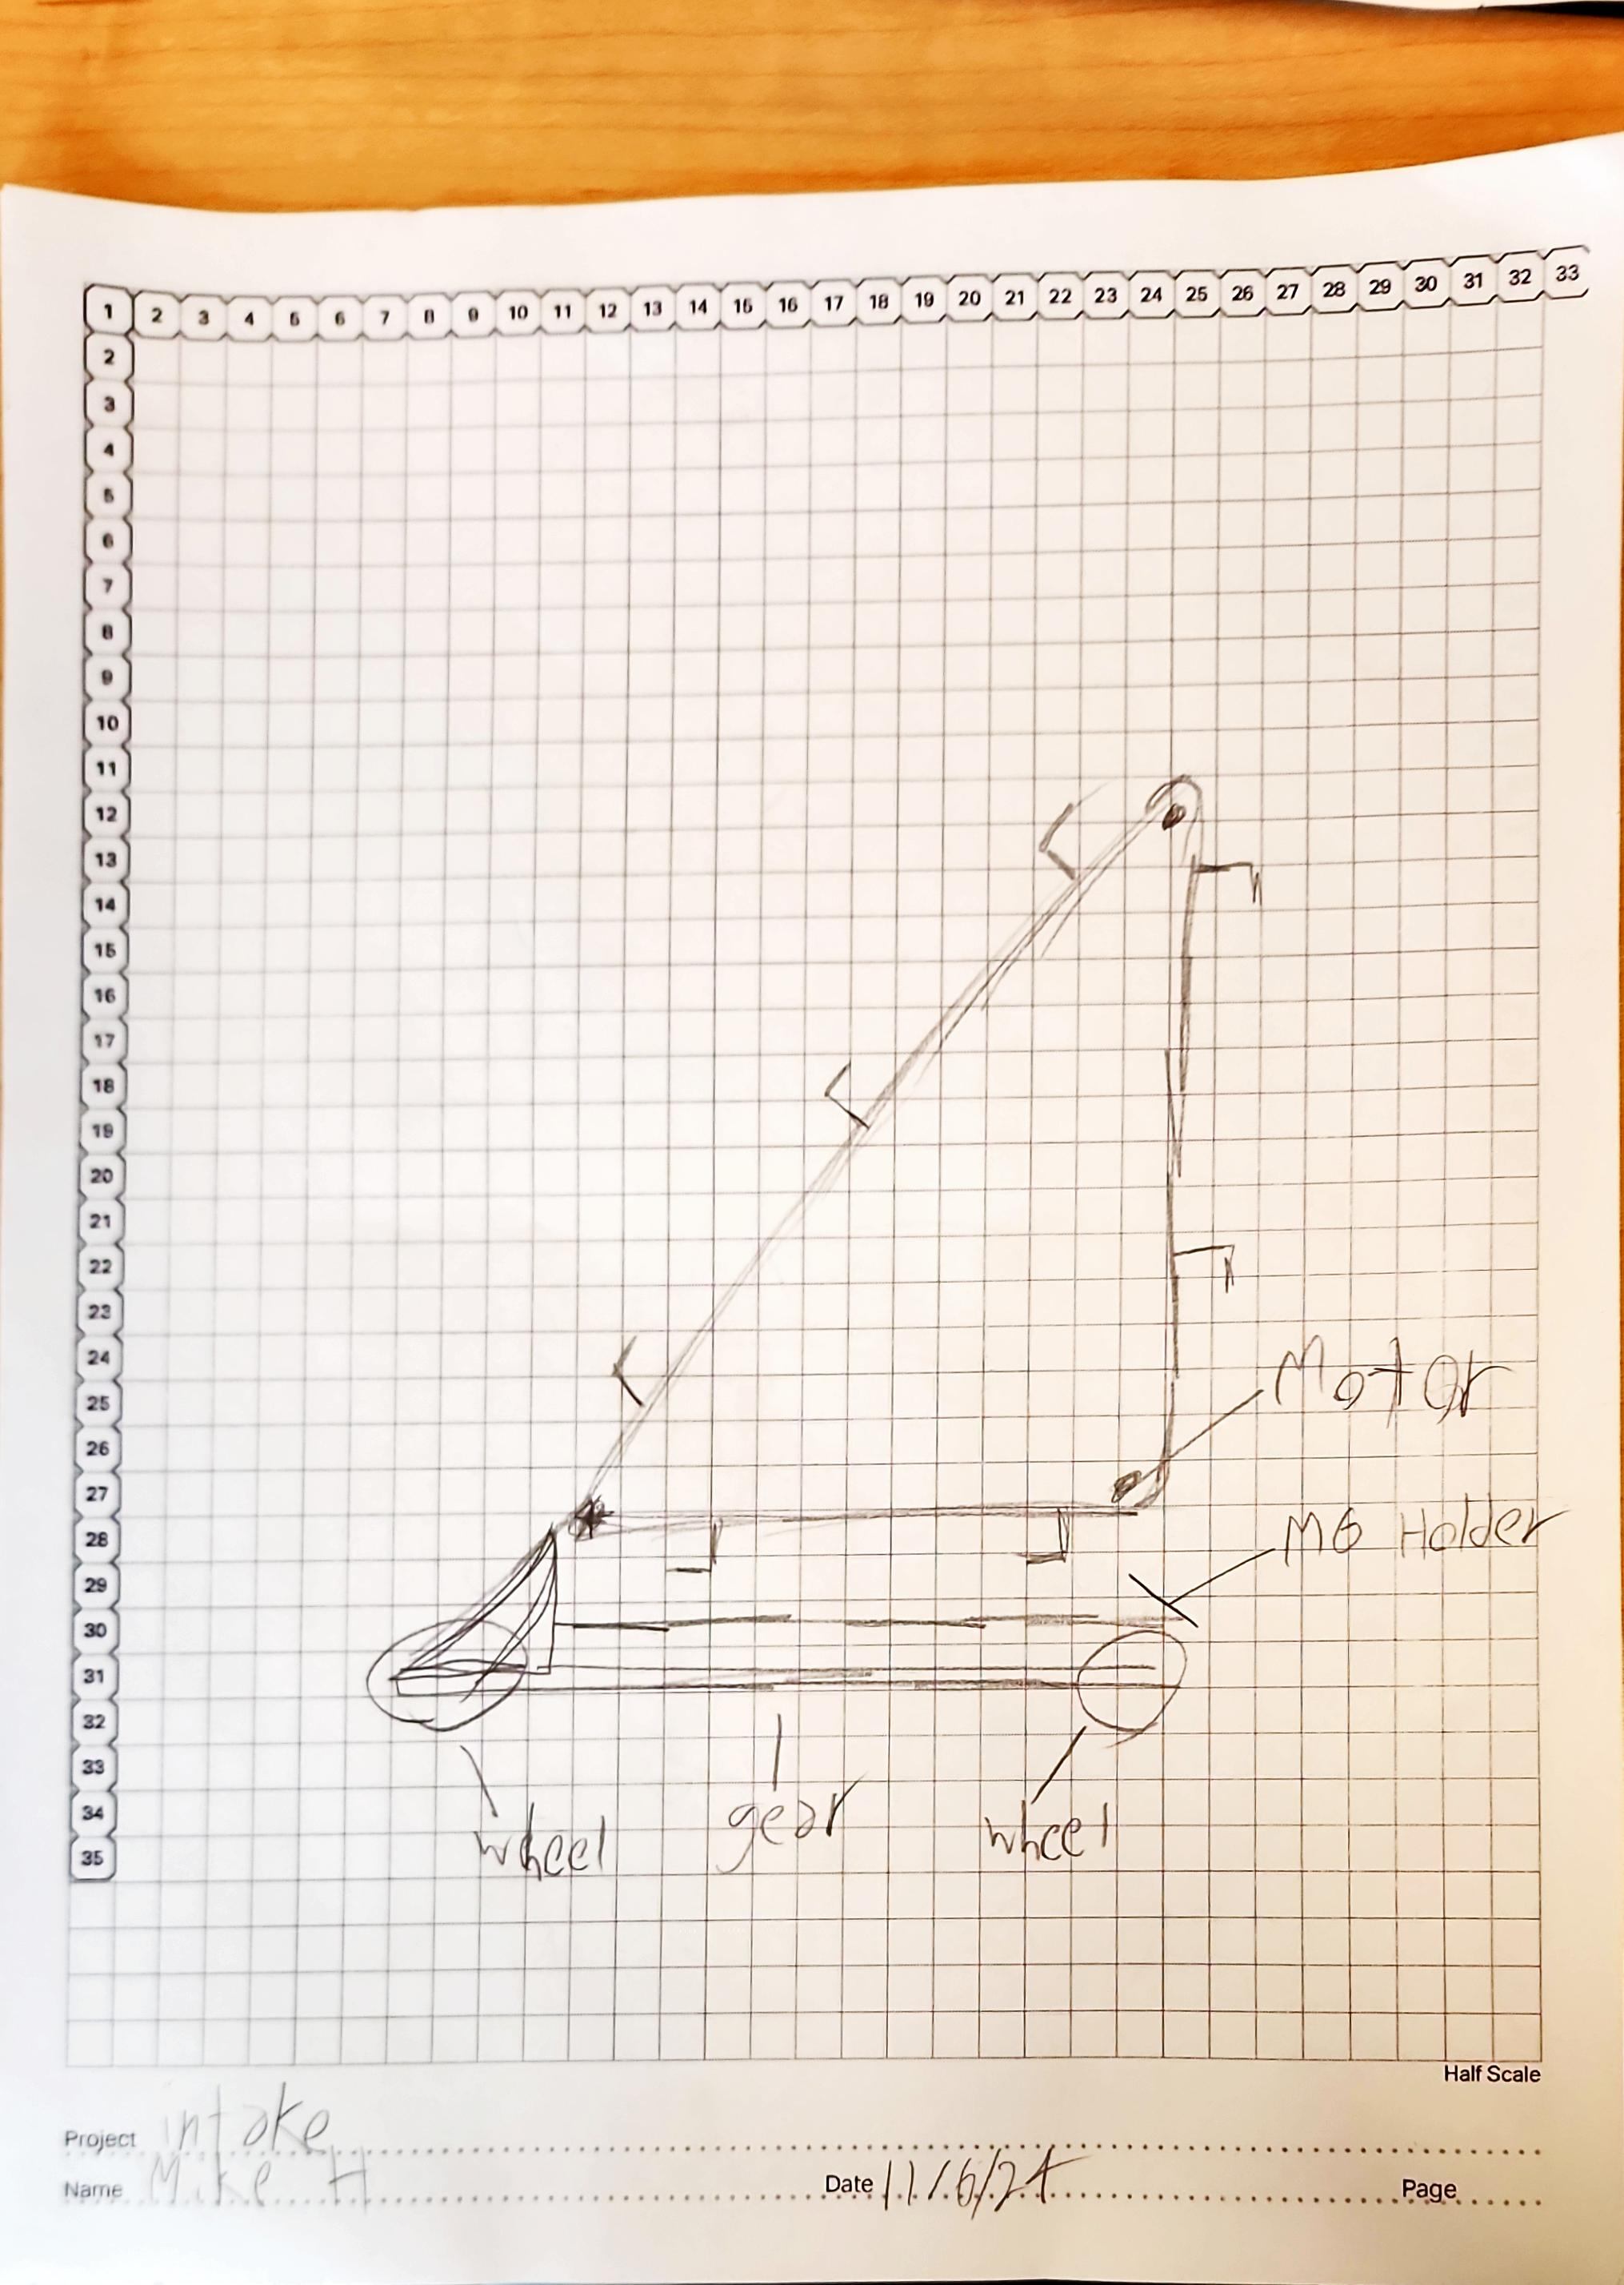
21

Slide 30
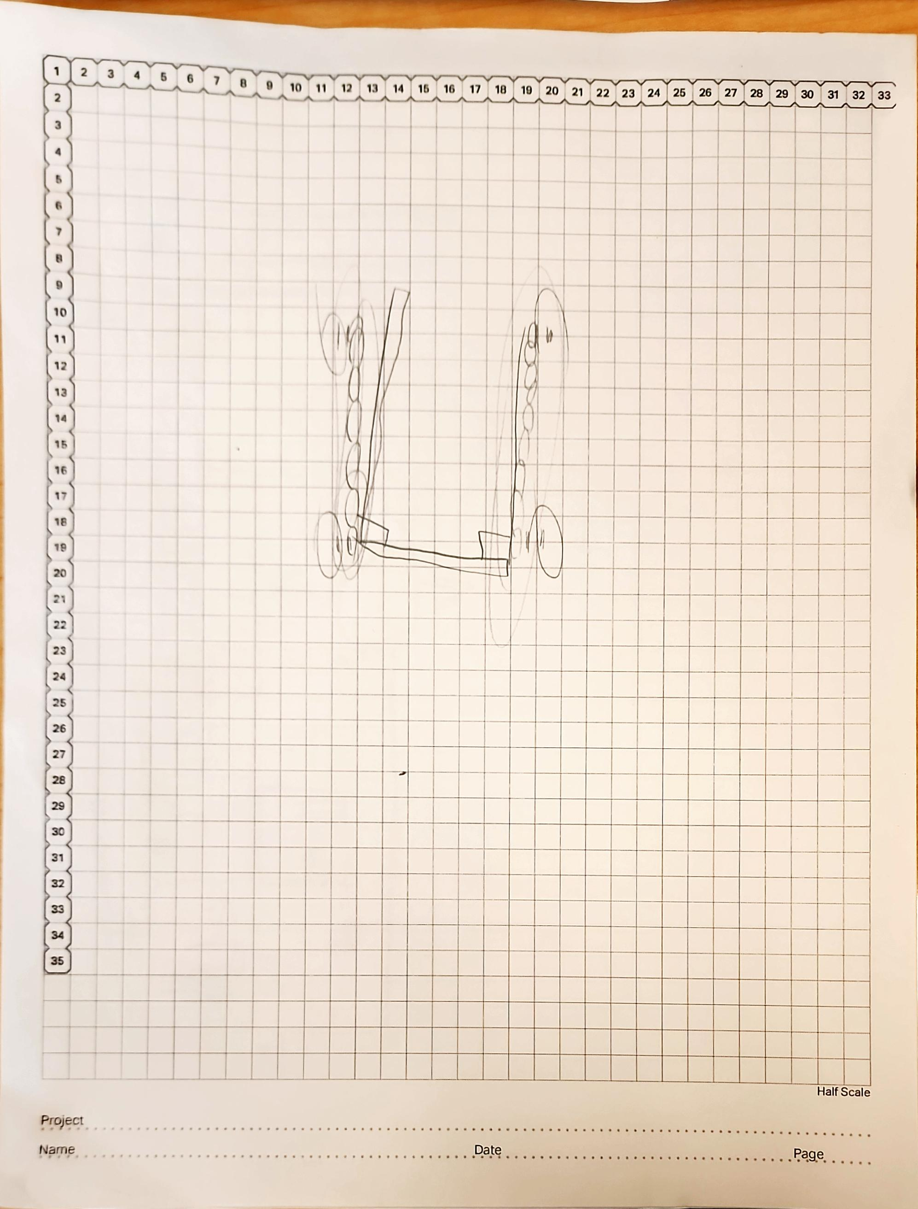
22

Slide 31
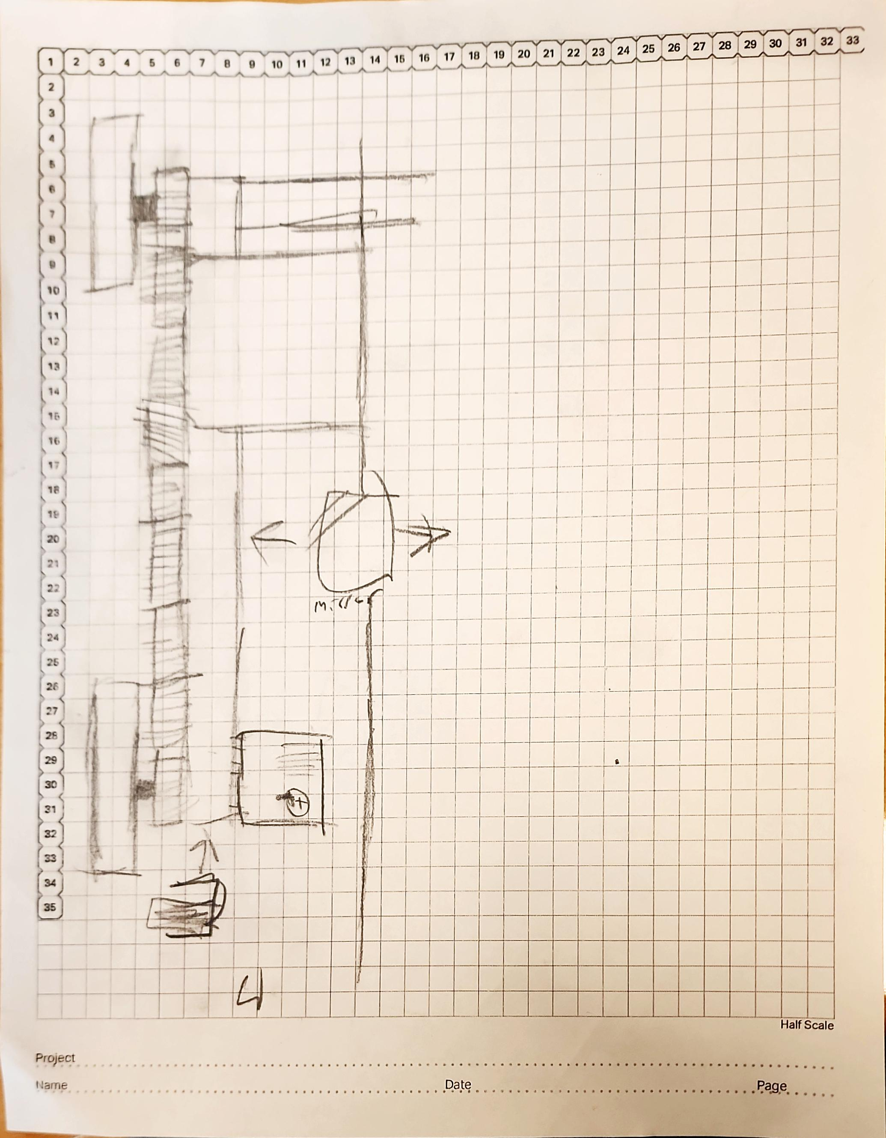
23

Slide 32
24

Slide 33
Brain Ports/ Controller Program and Game Map

Slide 34
Brain Ports
PORT
Right motorT
Radio
Left motor
PORT
PORT
PORT
PORT
PORT
PORT
PORT
PORT
PORT
PORT
PORT
PORT
PORT
Claw motor
Arm motor
PORT
Inertial
PORT
PORT
PORT
PORT
PORT
PORT
PORT
PORT
Abigail Way
10/28/24
25

Slide 35
Ryder remote control program
Arm up
Claw down
Arm down
Claw up
Robot forward
STICK
Robot turn
STICK
BUTTON
Half speed
BUTTON
BUTTON
BUTTON
BUTTON
BUTTON
BUTTON
Abigail Way
10/28/24
26

Slide 36
Abby remote control program
Arm Up
Claw Up
Arm Down
Claw Down
Robot Forward
Stick
Stick
Robot Turn
Button
Button
Button
Button
Button
Button
Button
Button
Abigail Way
11/1/24
27

Slide 37
Brain Ports
Grabber
Right motorT
Inertial
Left motor
PORT
PORT
PORT
Intake Lift
Radio
PORT
PORT
PORT
PORT
PORT
PORT
PORT
PORT
Claw motor
Intake spinner
Inertial
PORT
PORT
PORT
PORT
PORT
PORT
PORT
PORT
Dimas Tarin
12/11/24
28

Slide 38
Blank High Stakes Field
29

Slide 39


“High Stakes” Starting Field with Moveable Game Objects
30

Slide 40
“High Stakes” Starting Field with Frozen Game Objects
31

Slide 41
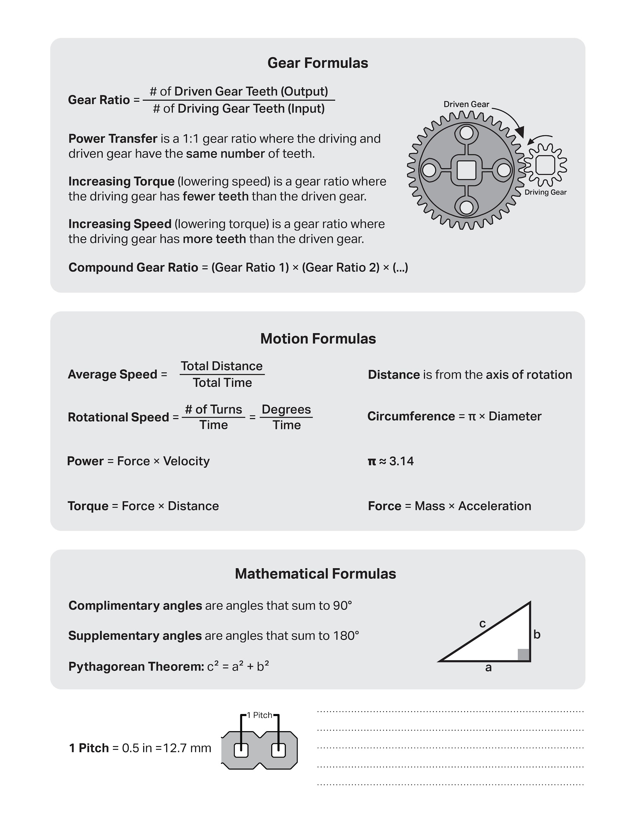

Slide 42
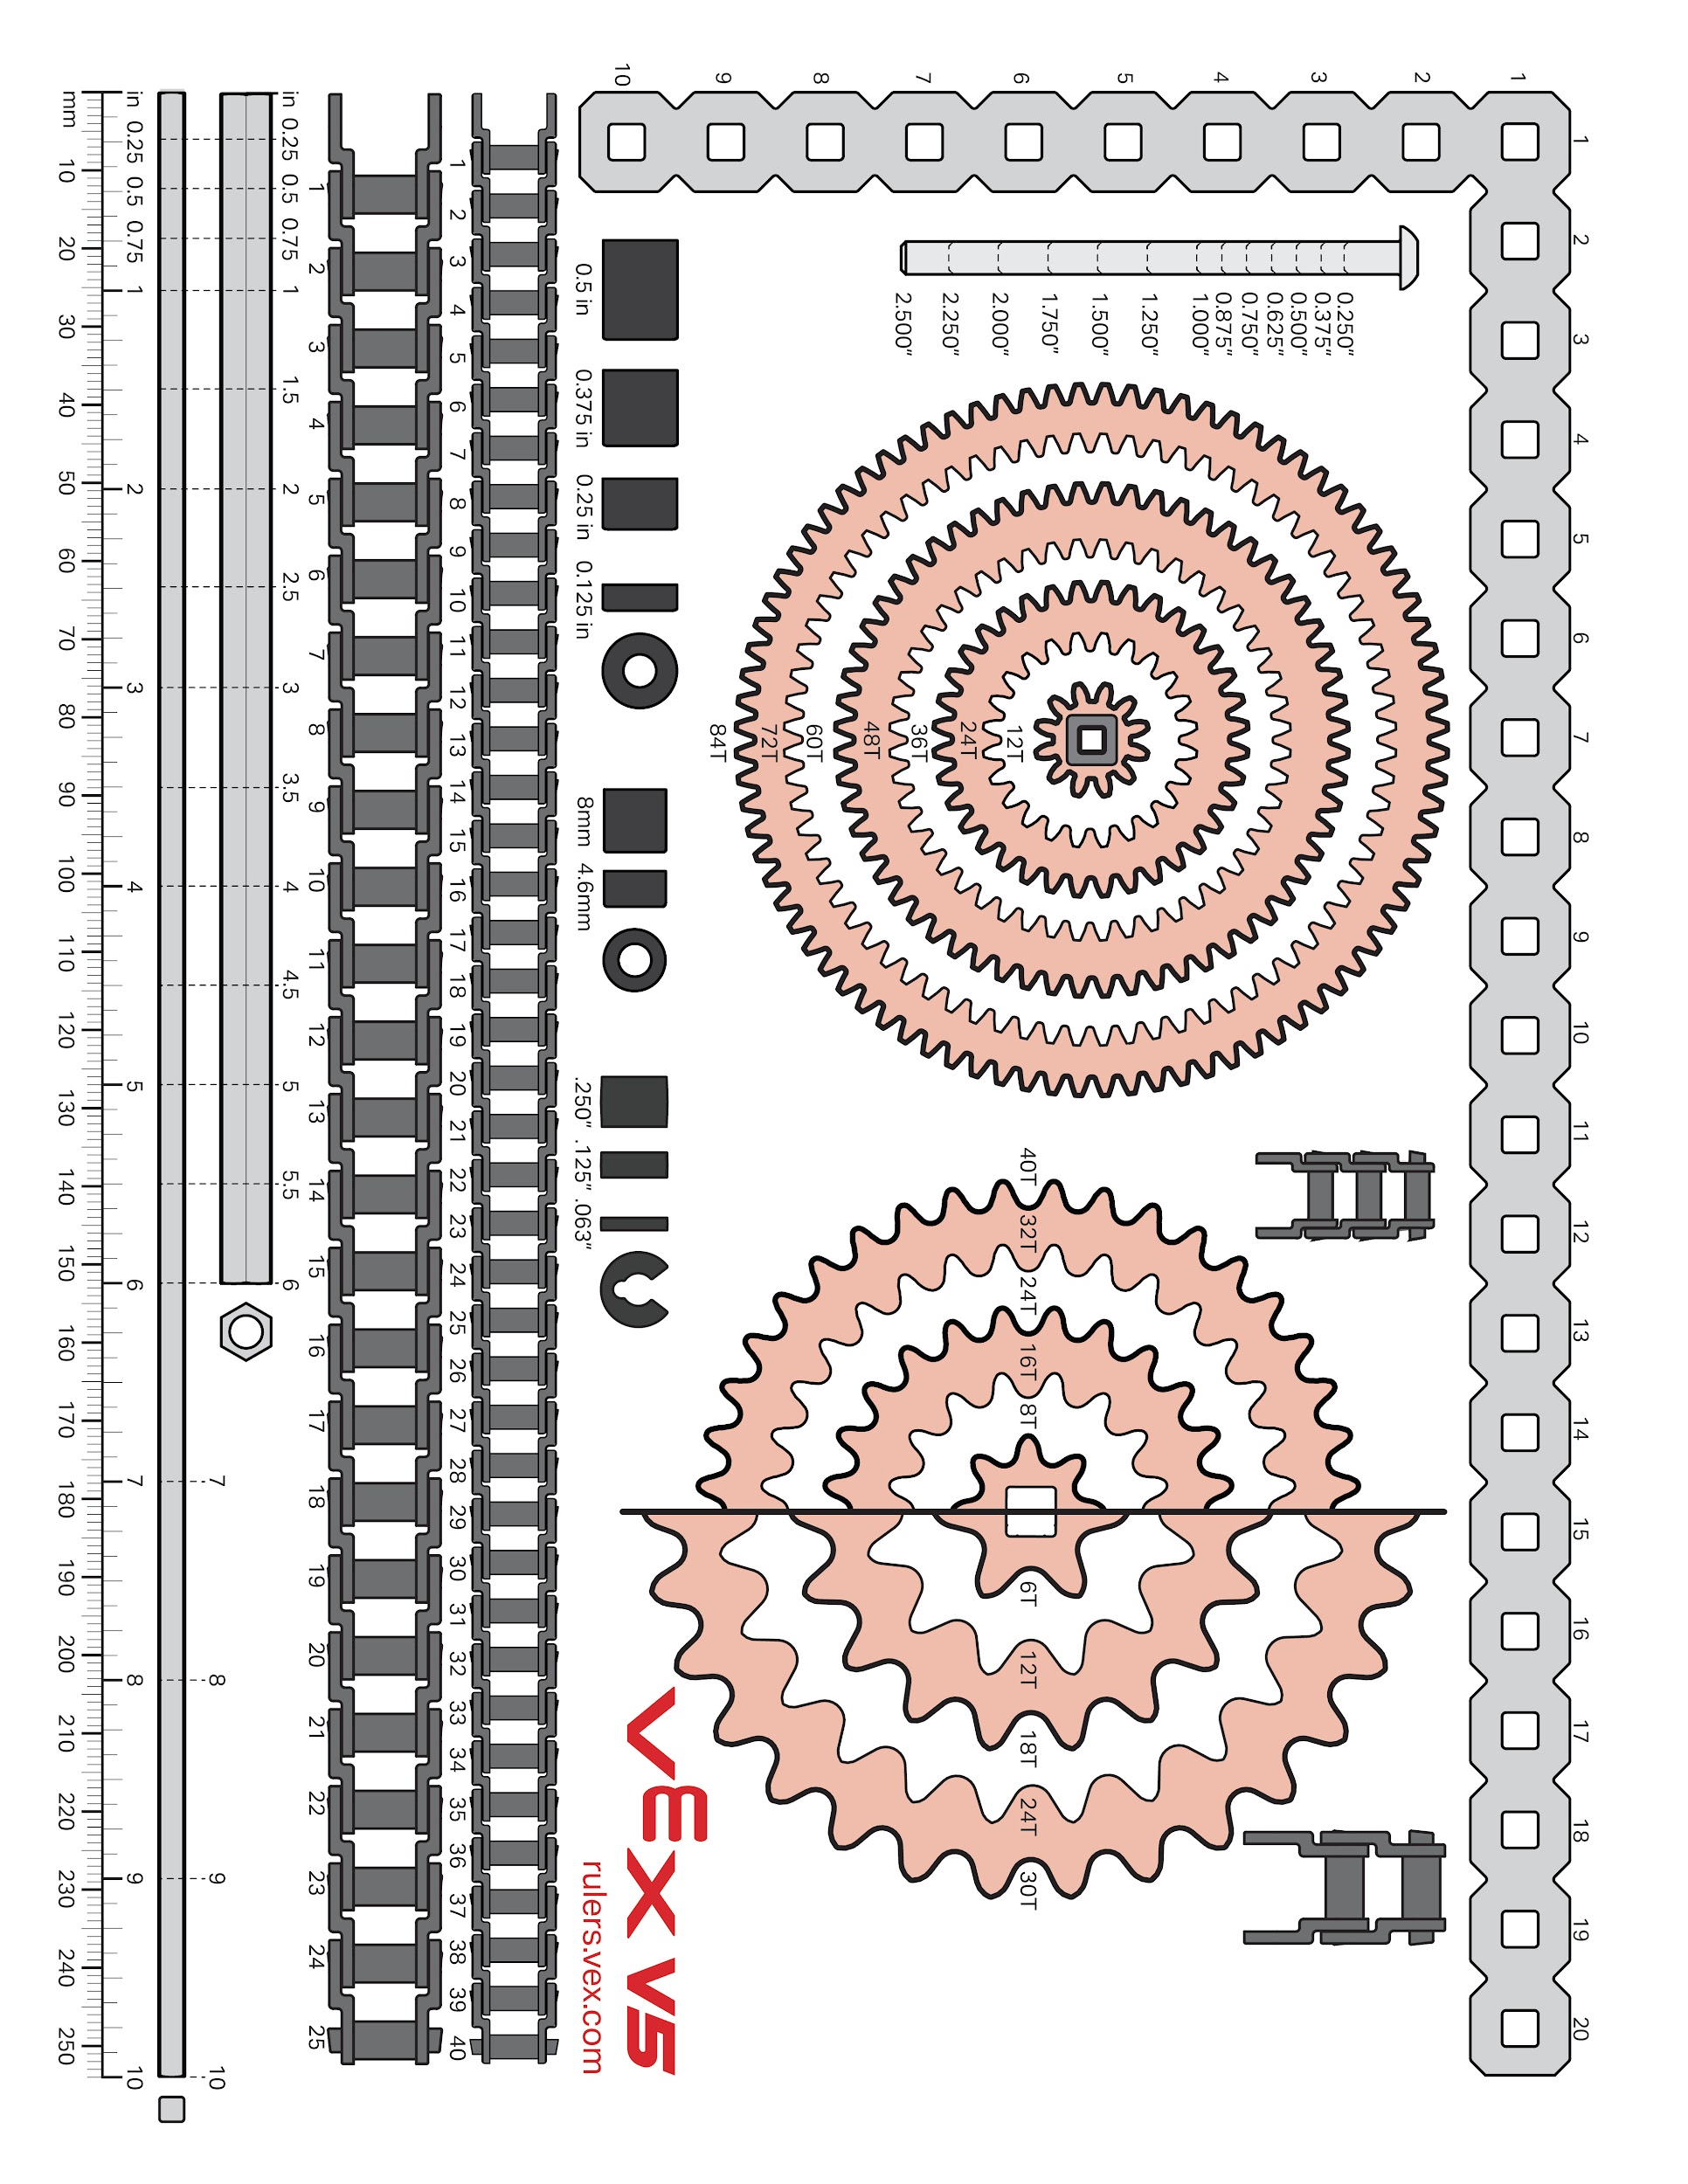

Slide 43
Scrum Notes/ Calenders

Slide 44
Product Backlog
Product Backlog for Competition Bot:
Review and Understand the Rules
Identify any limiting rules
Make sure design within the size limit.
2. Design the robot
a. Generate ideas
b. Draw out ideas
c. Test ideas
2. Build the Robot
a. Build Conveyer Belt
b. Build Base
3. Code the Robot
a. Code for the main bot
b. Code for attachment
c. Code for controller
i. Code for secondary controller
d. Code for sensors
4. Test the Robot
5. Practice the Challenge
6. Evaluate our challenge results
Abigail Way
8/28/2024
34

Slide 45
Sprint Backlog
Sprint Backlog For Sprint #1
Building:
Build Base
Coding
Get familiar with the coding
Abigail Way
8/28/2024
35

Slide 46
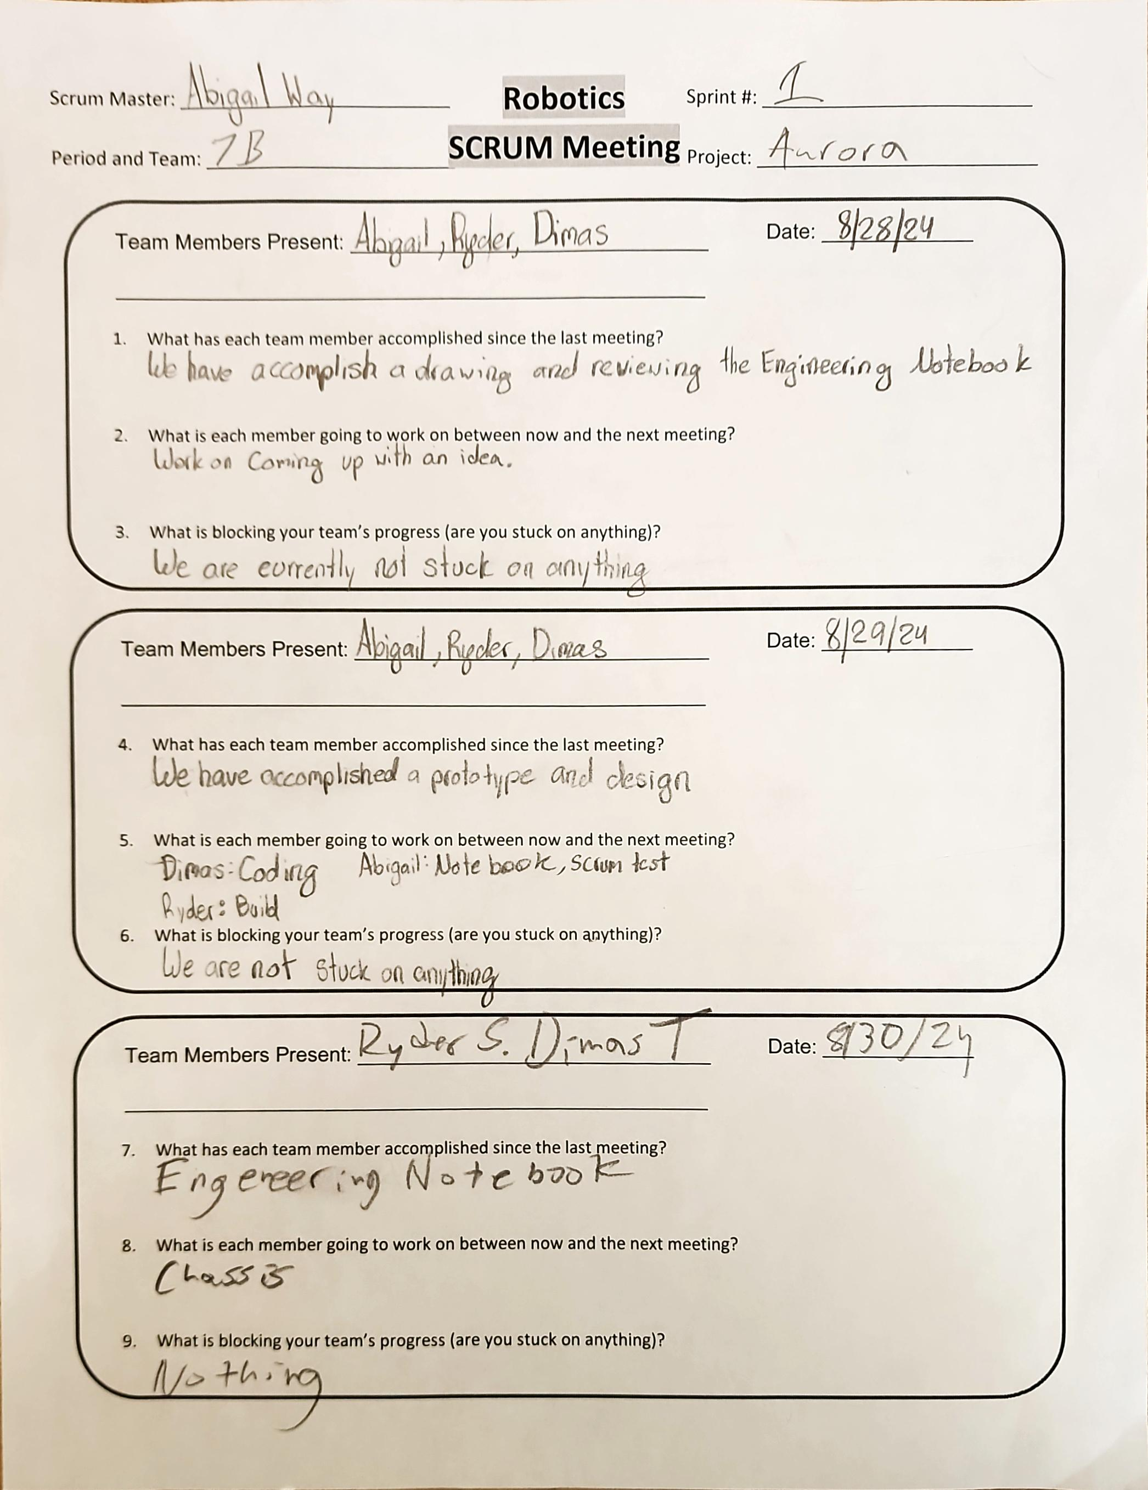
Project: Scrum Meeting
Name: Abigail Way Date:9/11/24 Page:36

Slide 47
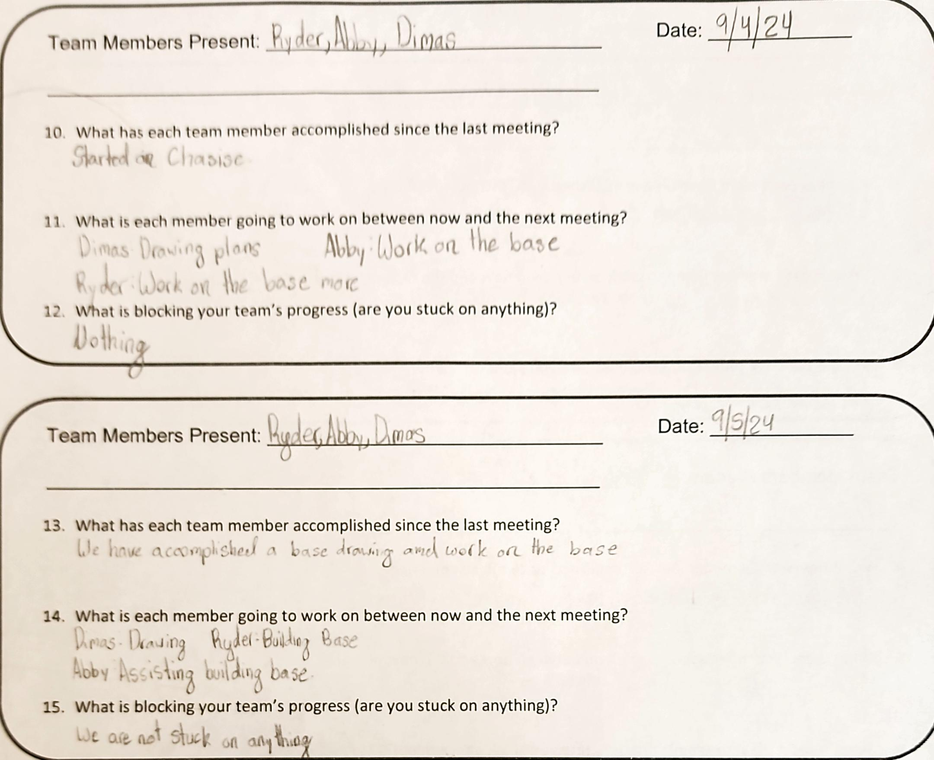
Project: Scrum Meeting
Name: Abigail Way Date:9/11/24 Page: 37

Slide 48
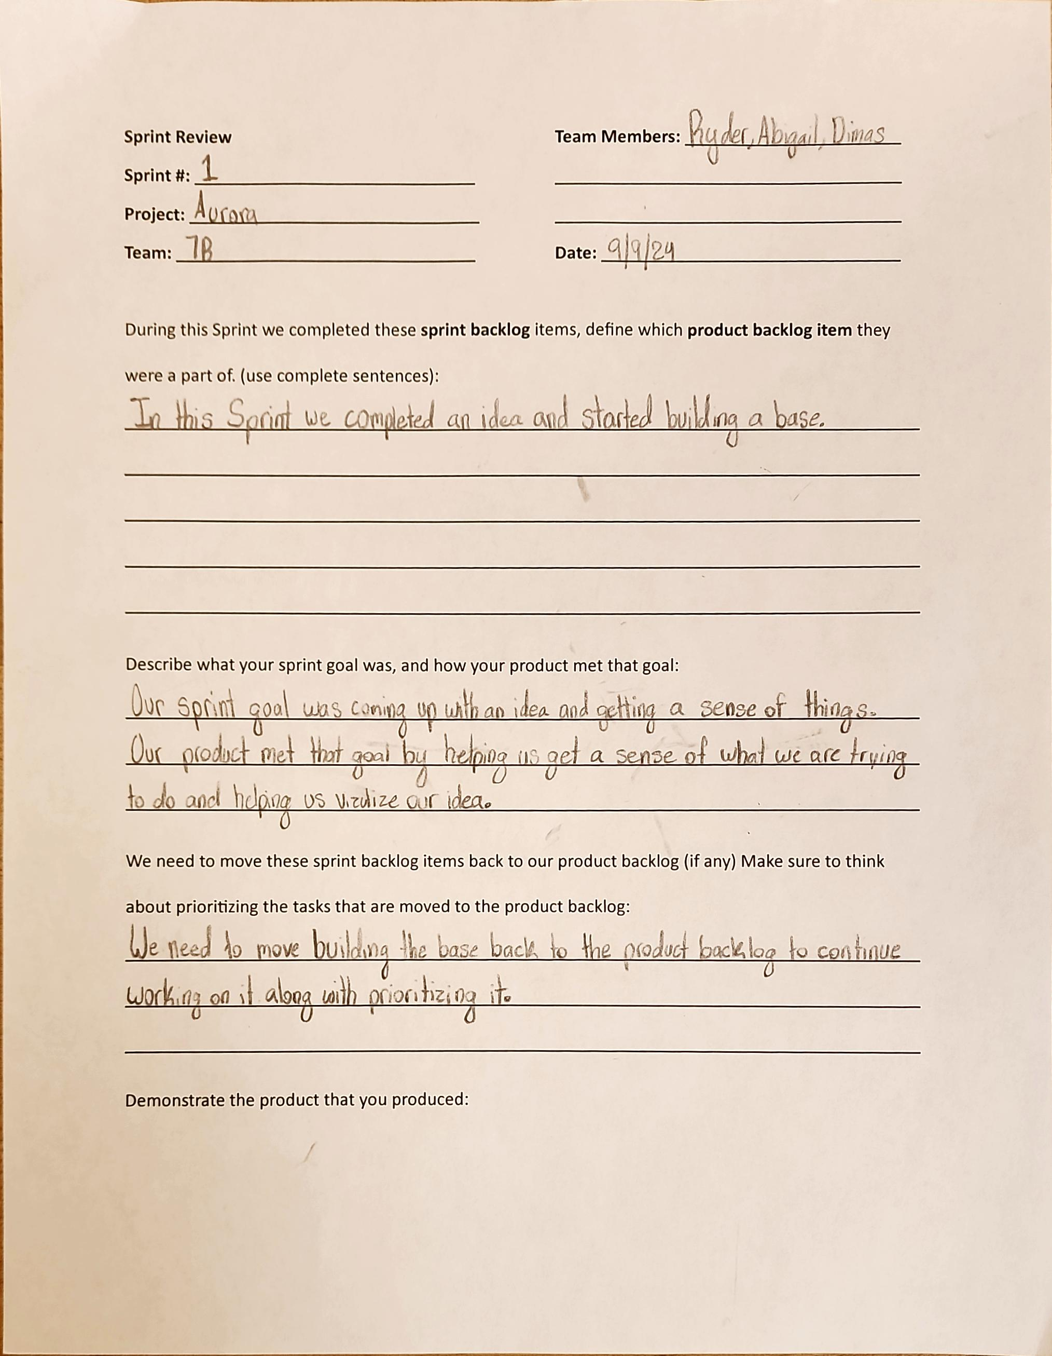
Project: Sprint Review
Name: Abigail Way Date:9/11/24 Page: 38

Slide 49
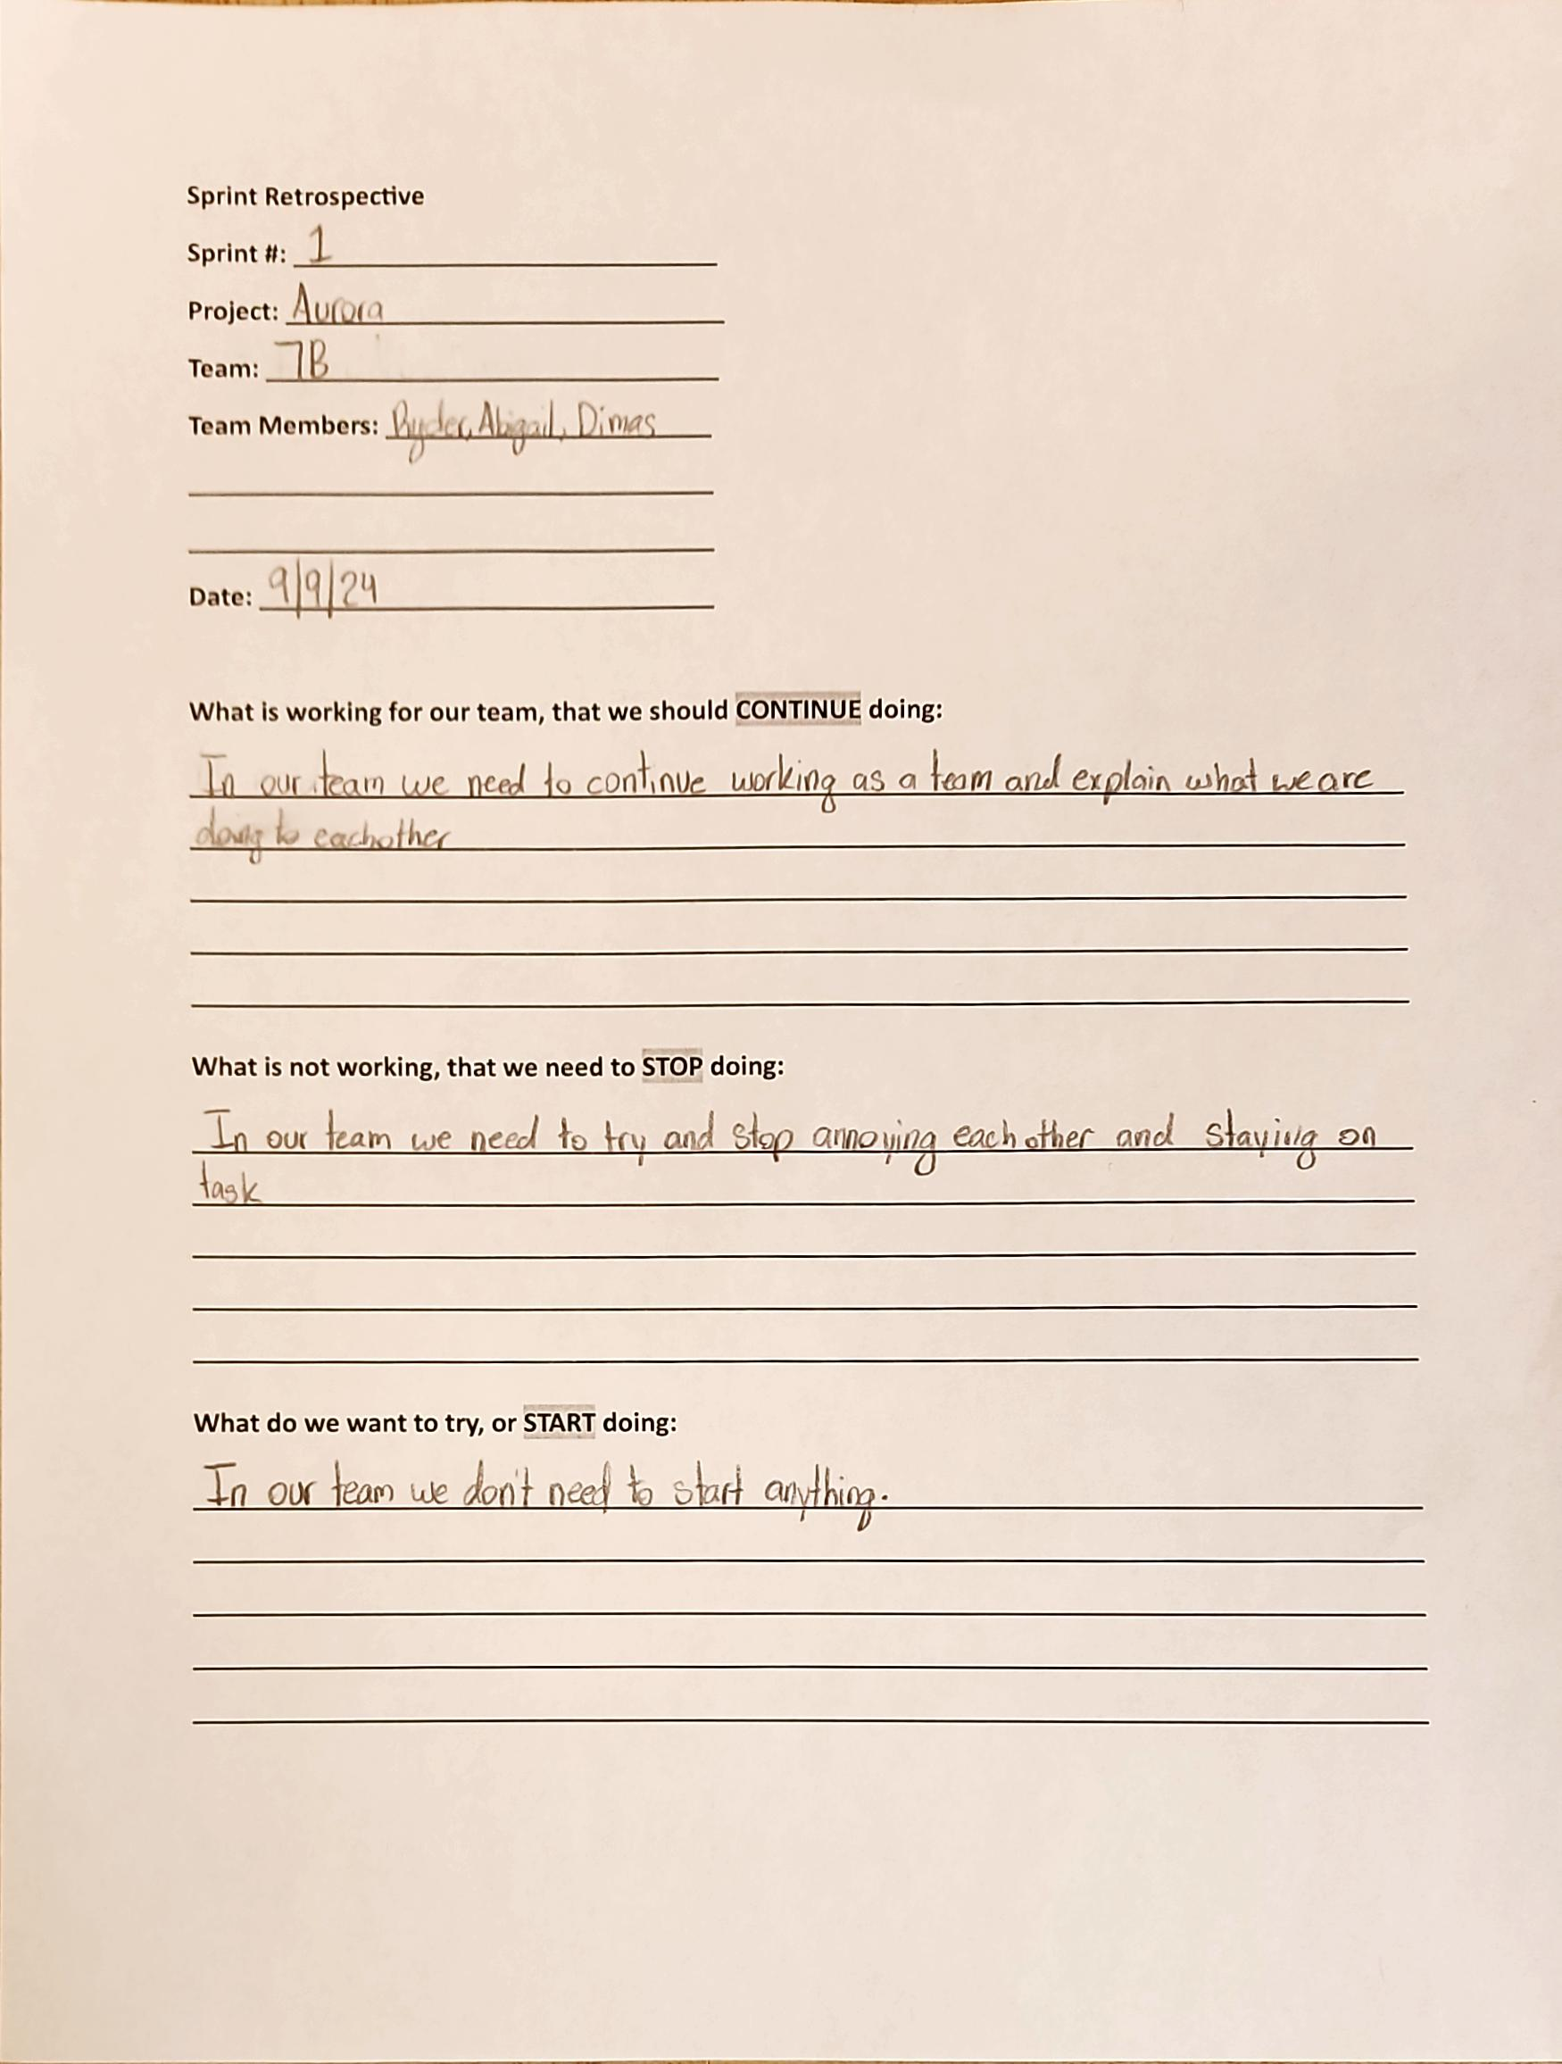
Project: Sprint Retrospective
Name: Abigail Way Date:9/11/24 Page: 39

Slide 50
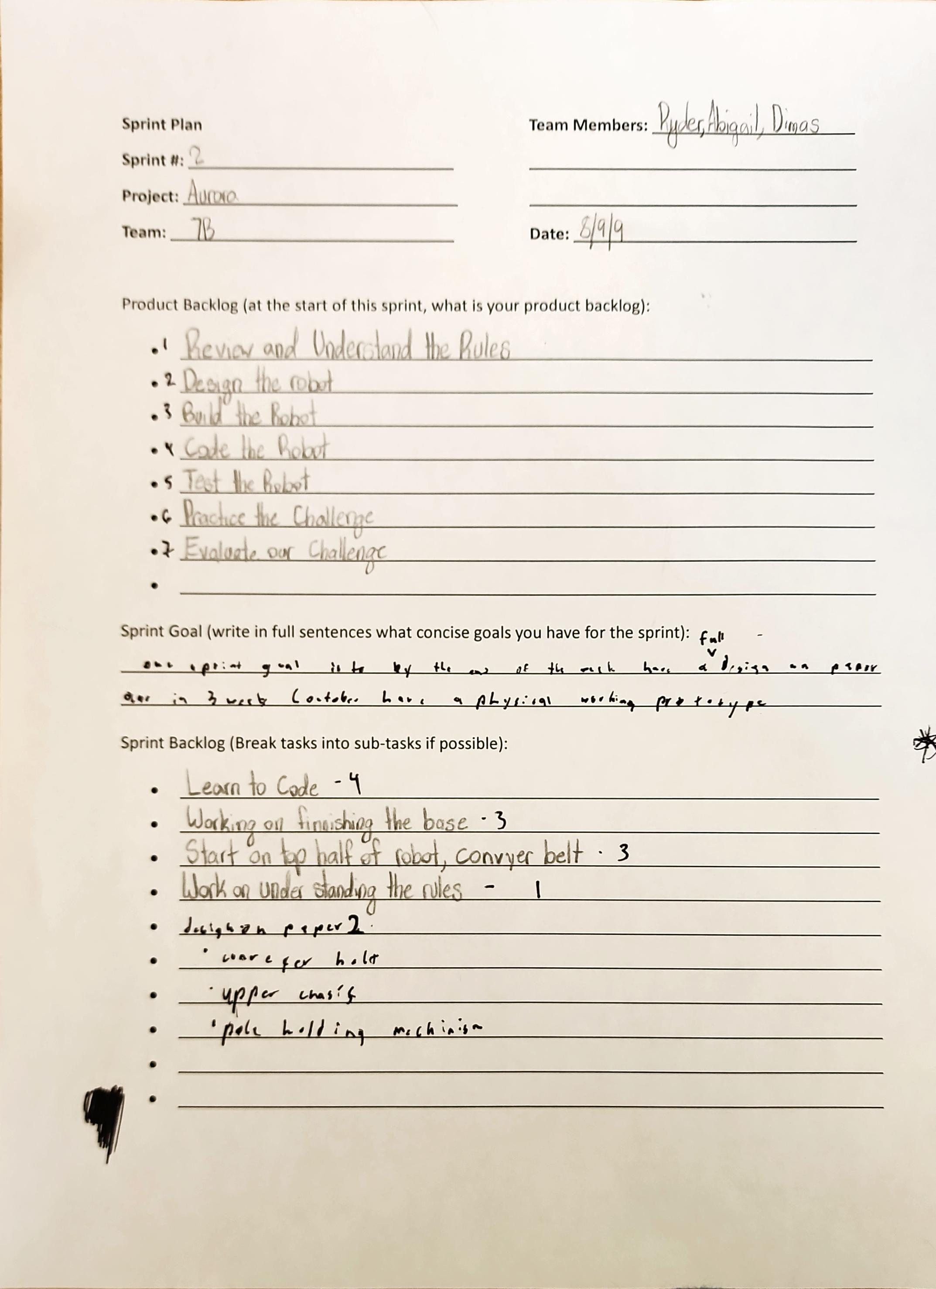
Project: Sprint Plan
Name: Abigail Way Date:9/11/24 Page: 40

Slide 51
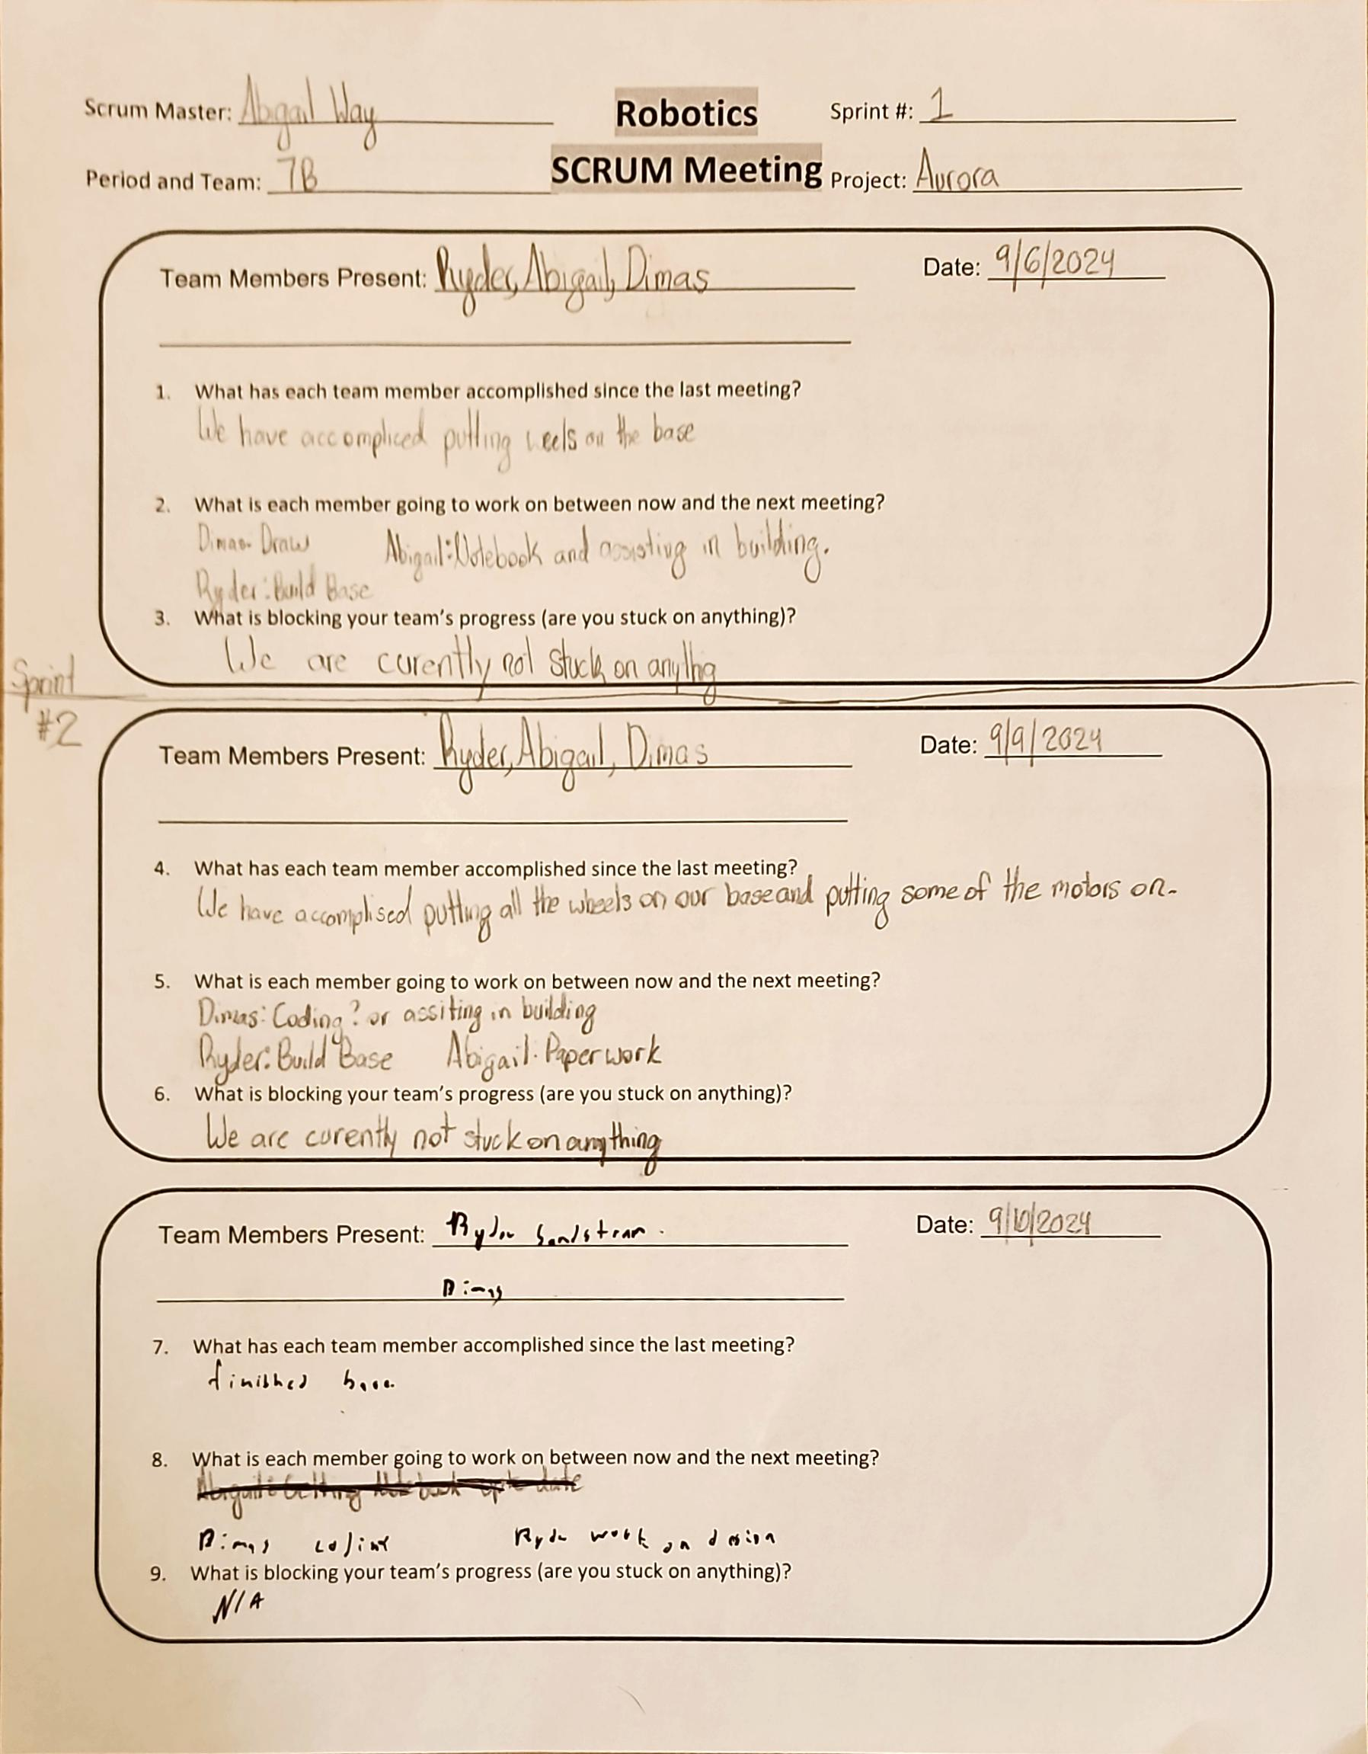
Project: Scrum Meeting
Name: Abigail Way Date:9/11/24 Page: 41

Slide 52
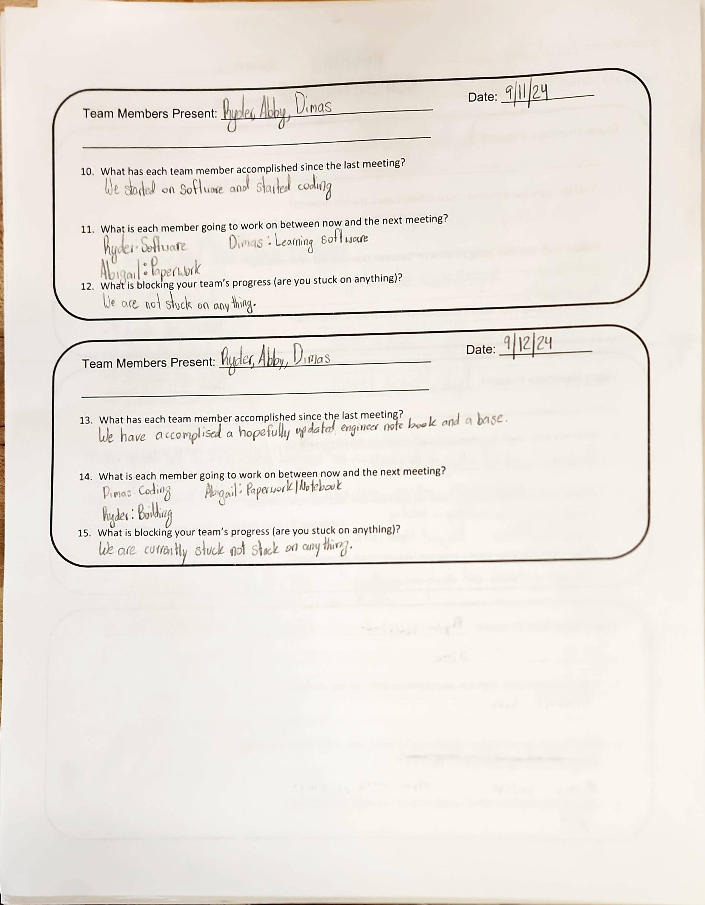
Project: Scrum Meeting
Name: Abigail Way Date:9/11/24 Page: 42

Slide 53
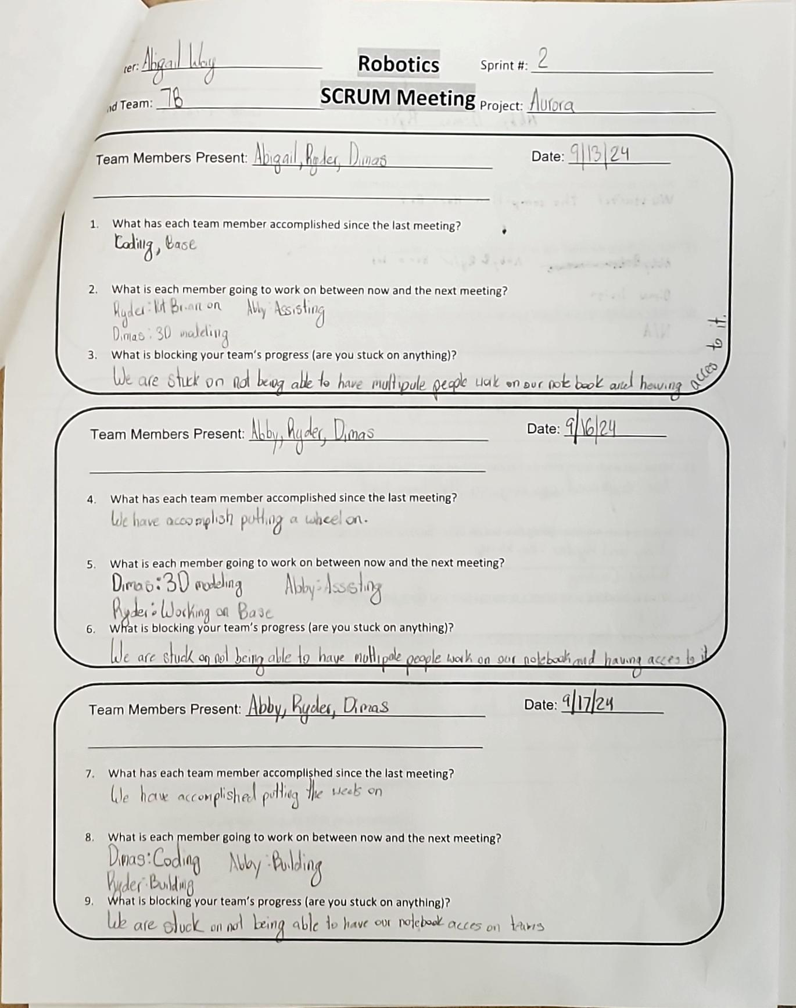
Project: Scrum Meeting
Name: Abigail Way Date:10/21/24 Page: 43

Slide 54
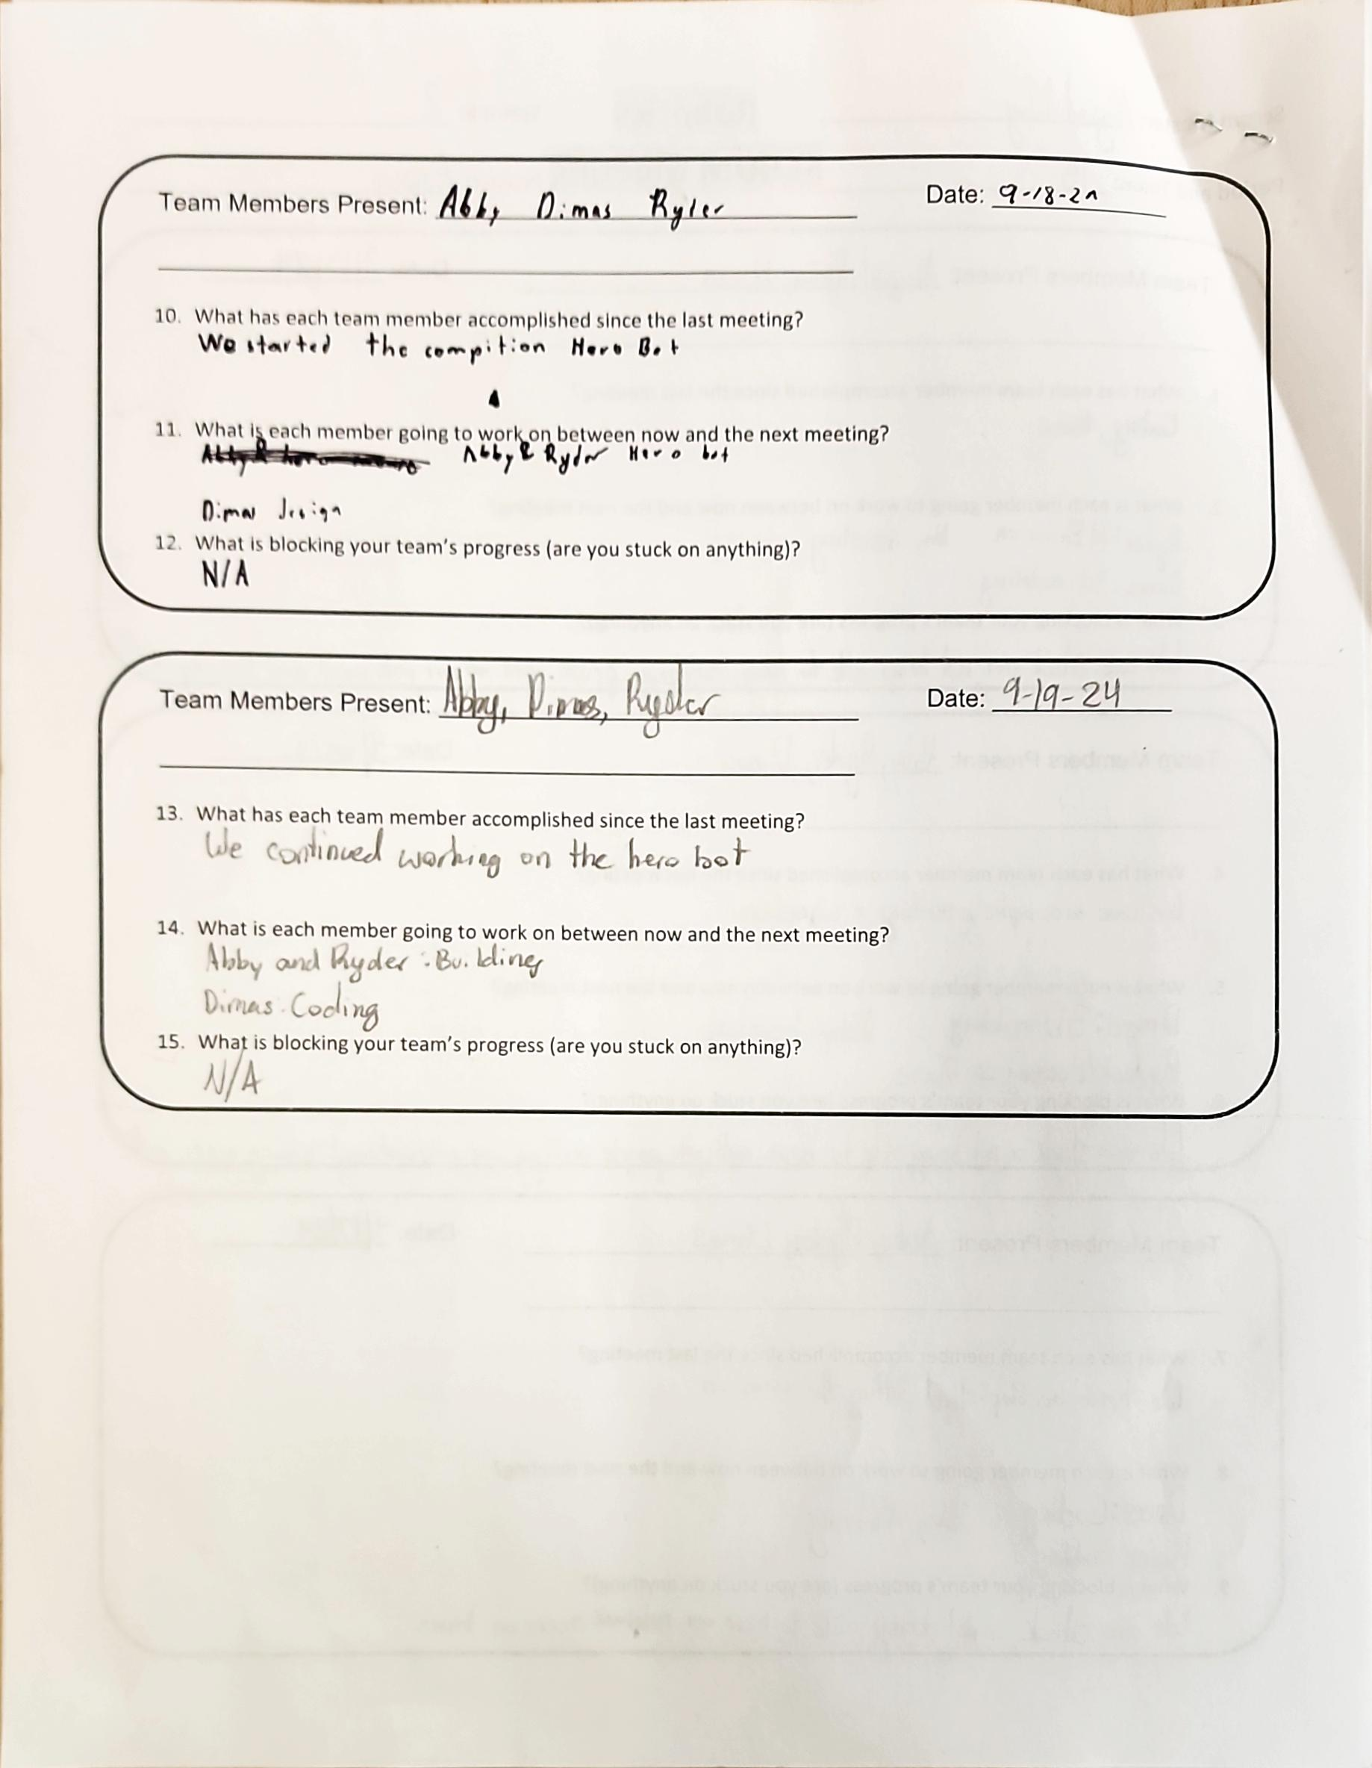
Project: Scrum Meeting
Name: Abigail Way Date:10/21/24 Page: 44

Slide 55
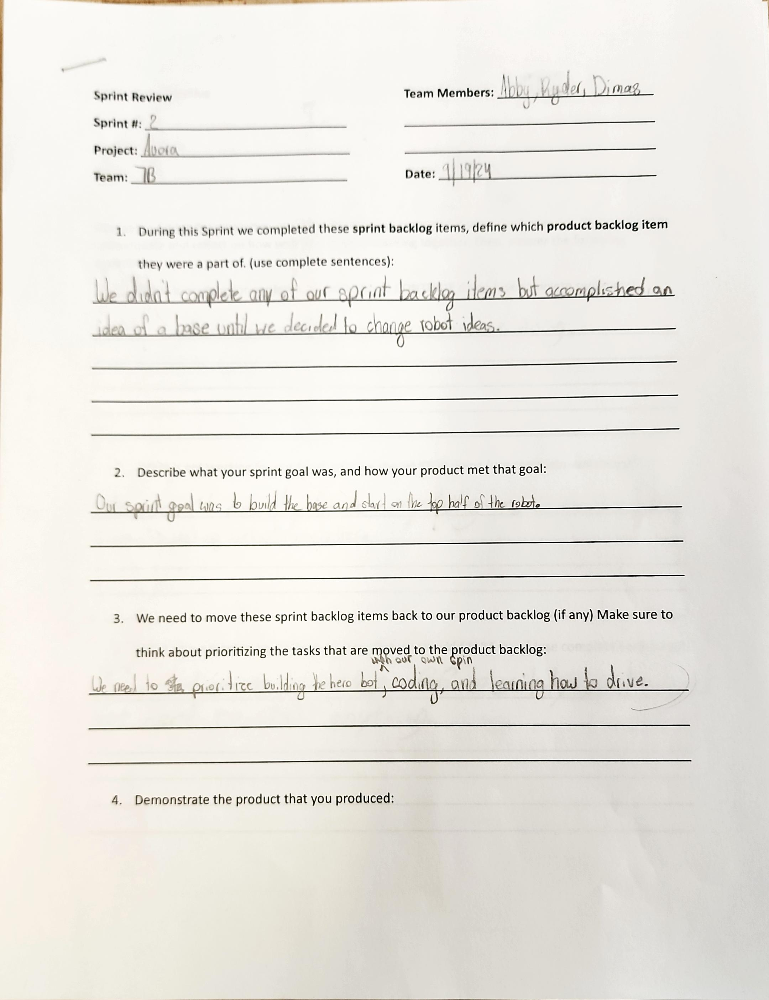
Project: Sprint Review
Name: Abigail Way Date:10/21/24 Page: 45

Slide 56
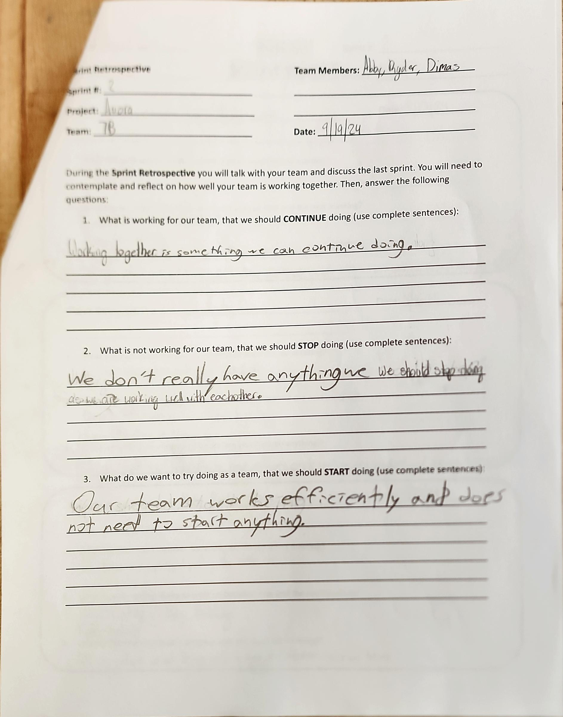
Project: Sprint Retrospective
Name: Abigail Way Date:10/21/24 Page:46

Slide 57
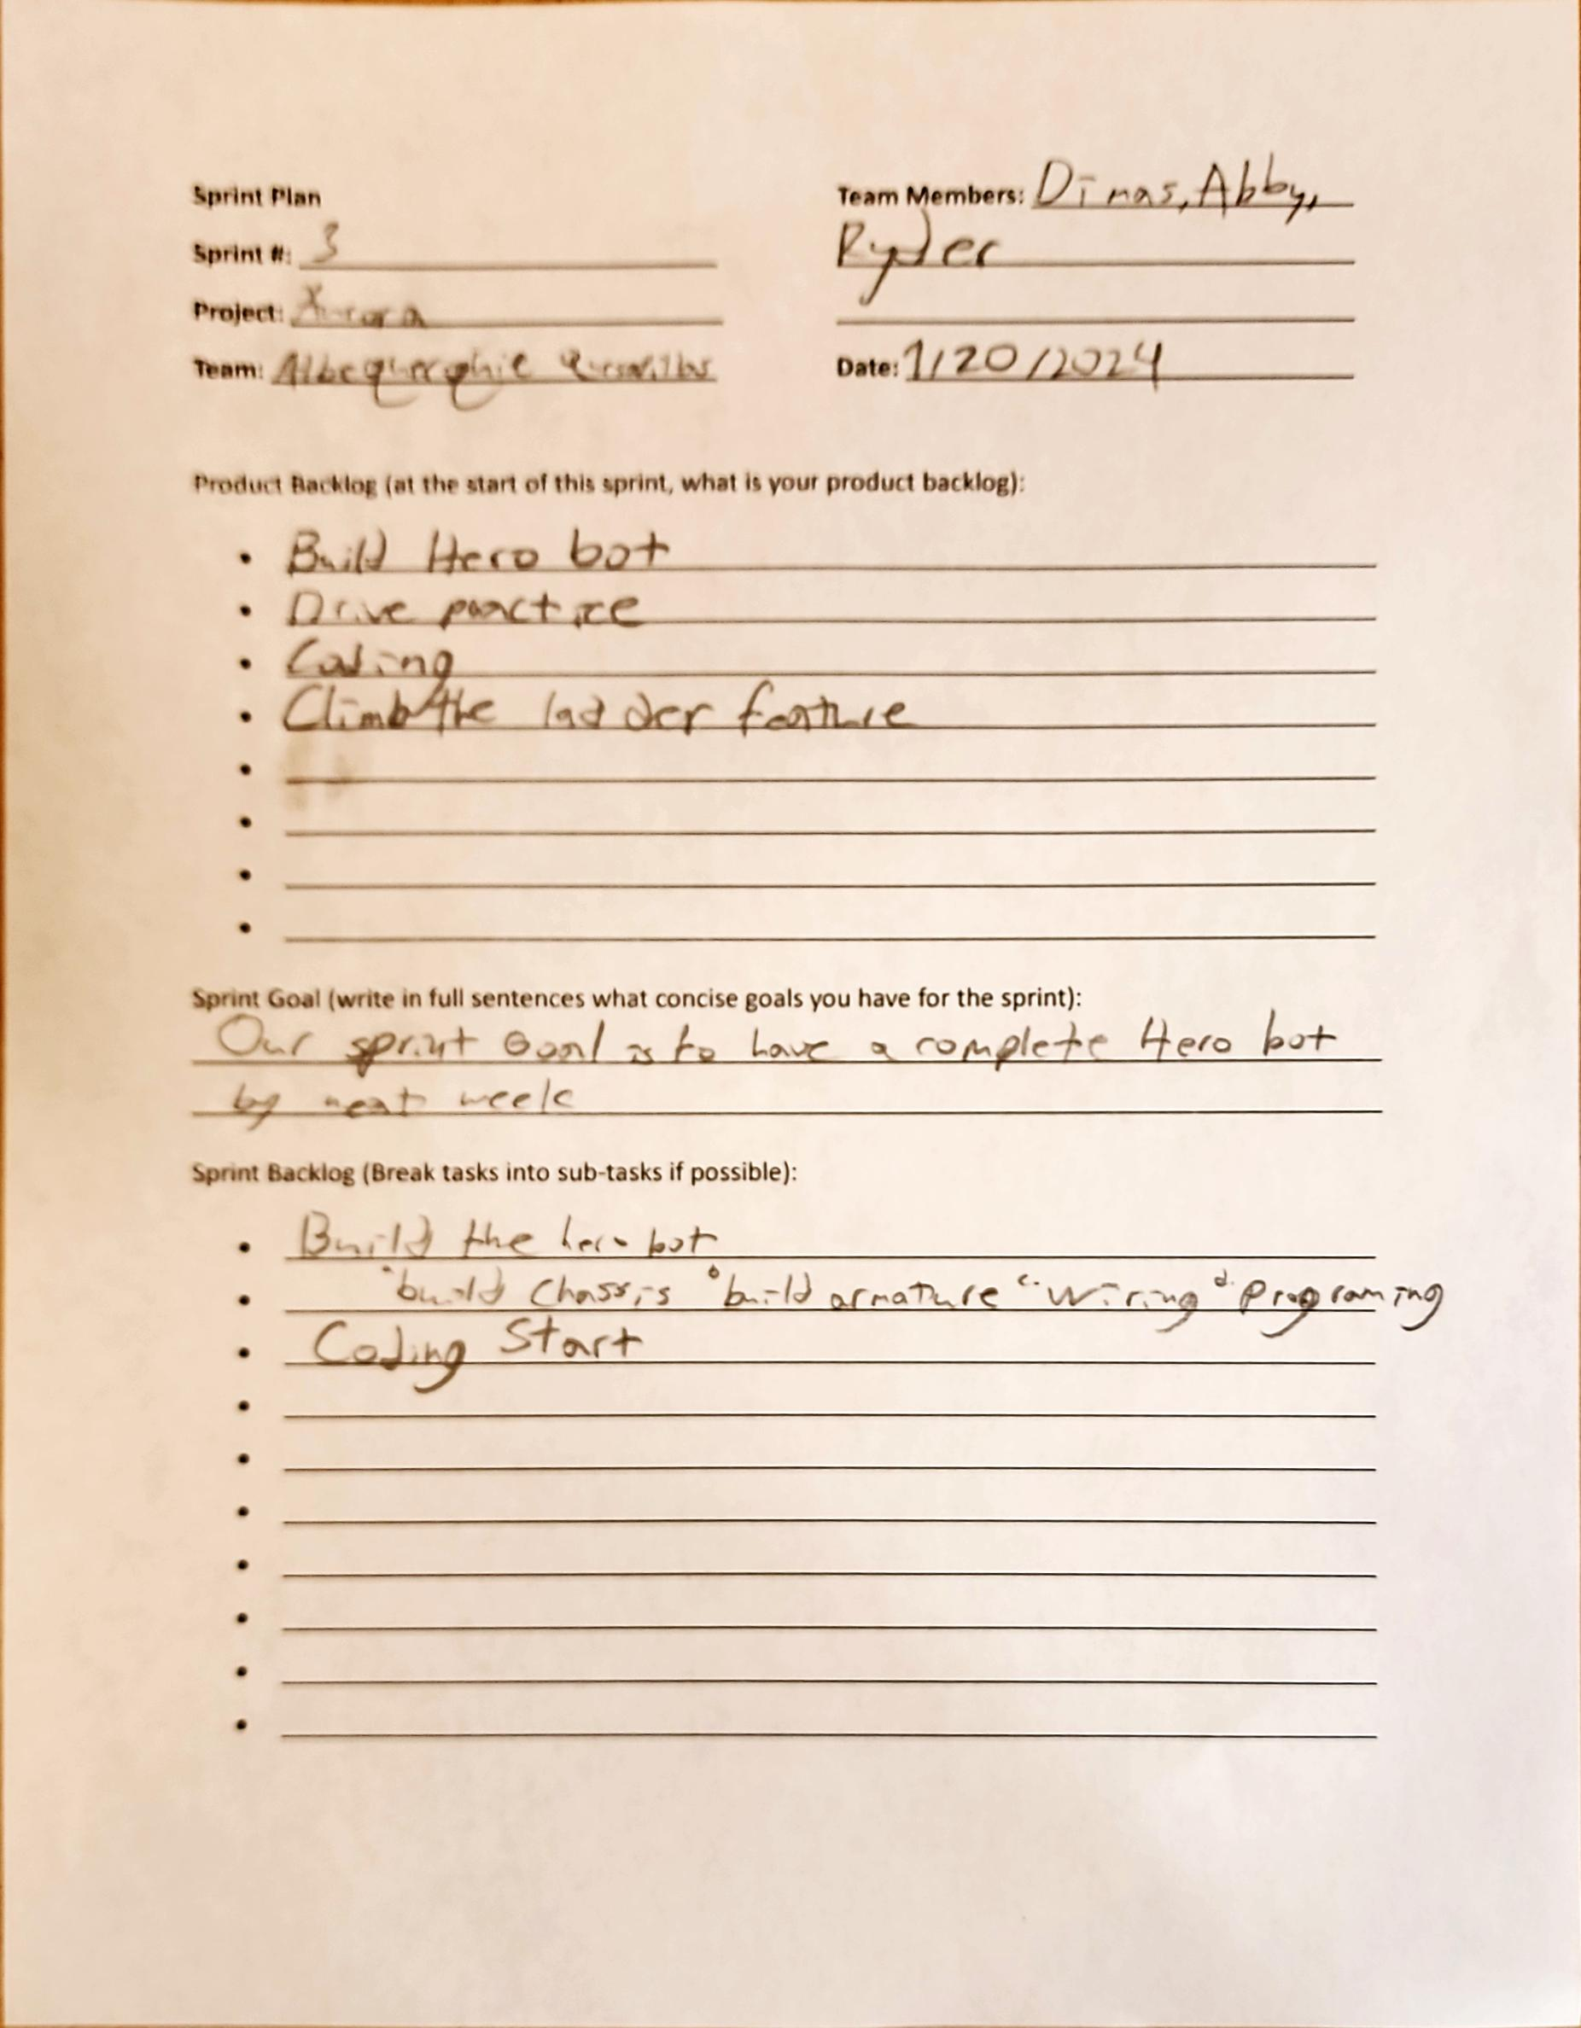
Project: Sprint Plan
Name: Abigail Way Date:10/21/24 Page: 47

Slide 58
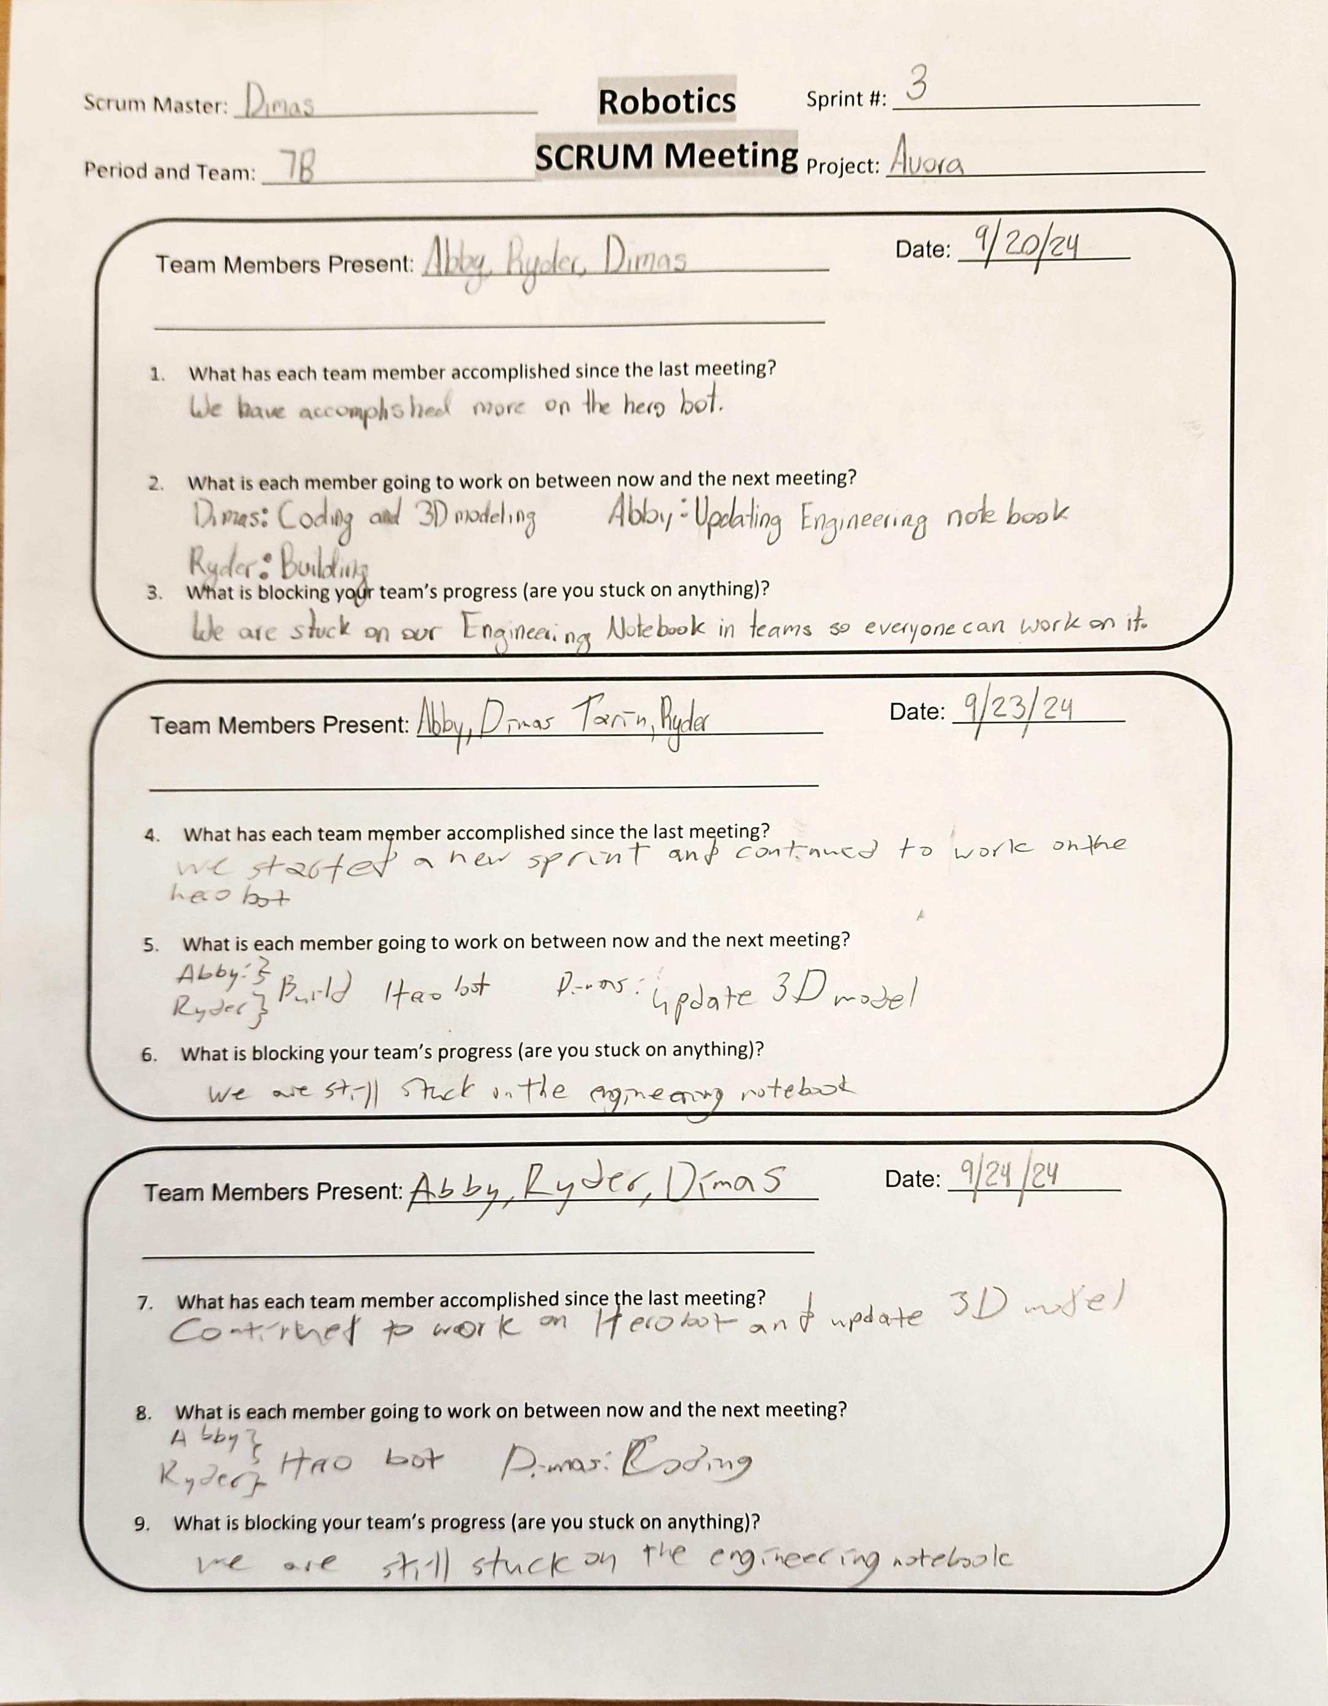
Project: Scrum Meeting
Name: Abigail Way Date:10/21/24 Page: 48

Slide 59
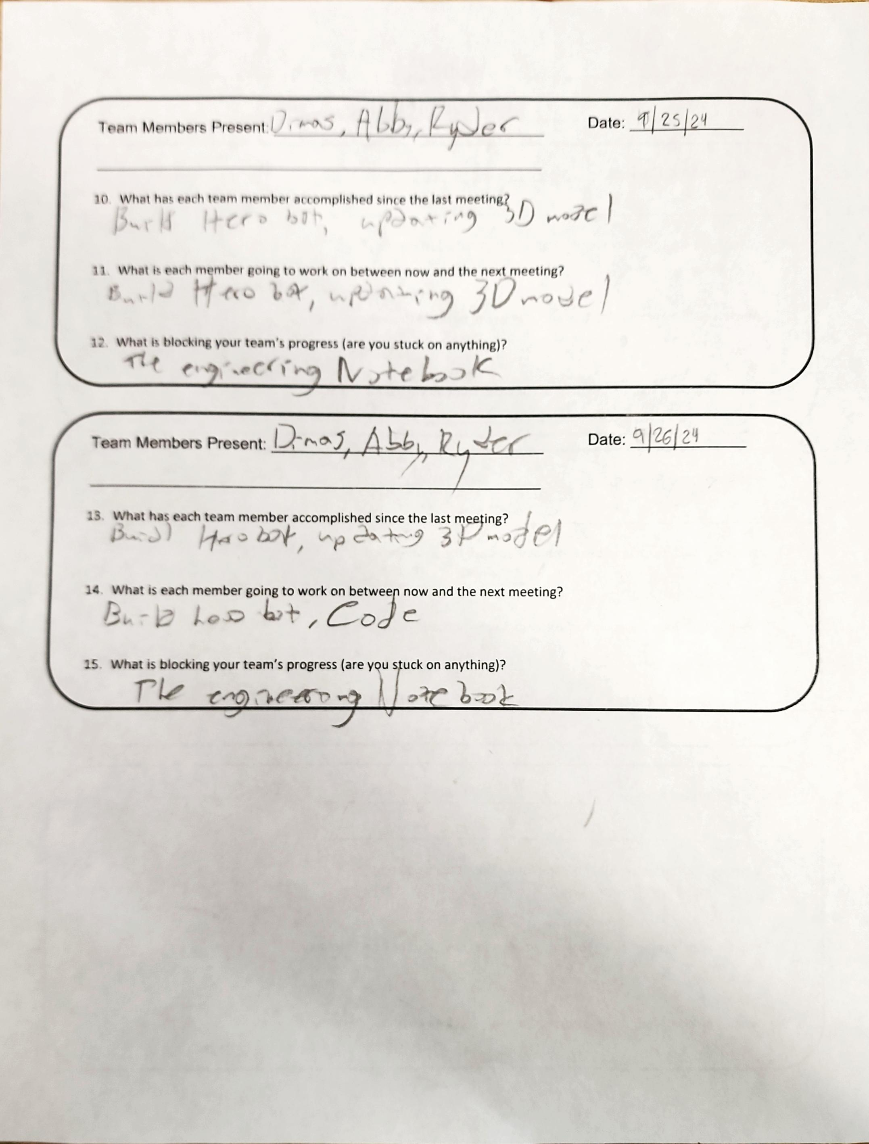
Project: Scrum Meeting
Name: Abigail Way Date:10/21/24 Page: 49

Slide 60
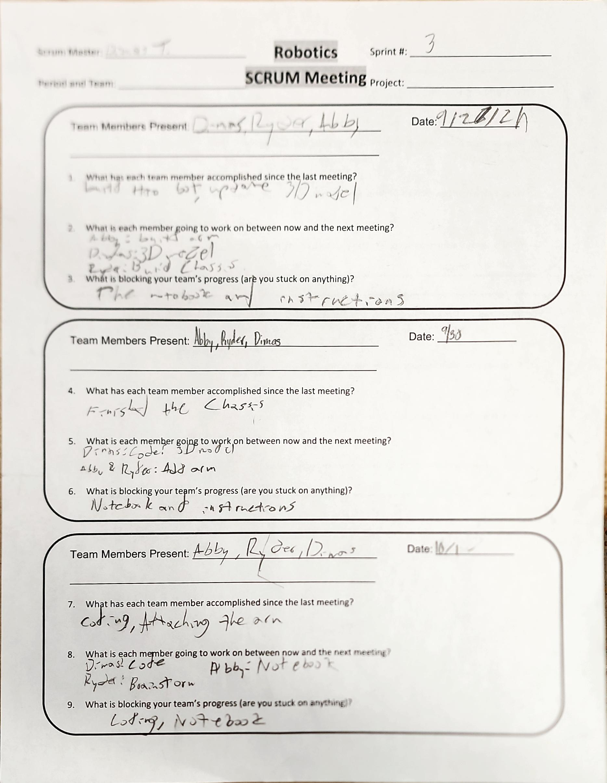
Project: Scrum Meeting
Name: Abigail Way Date:10/21/24 Page: 50

Slide 61
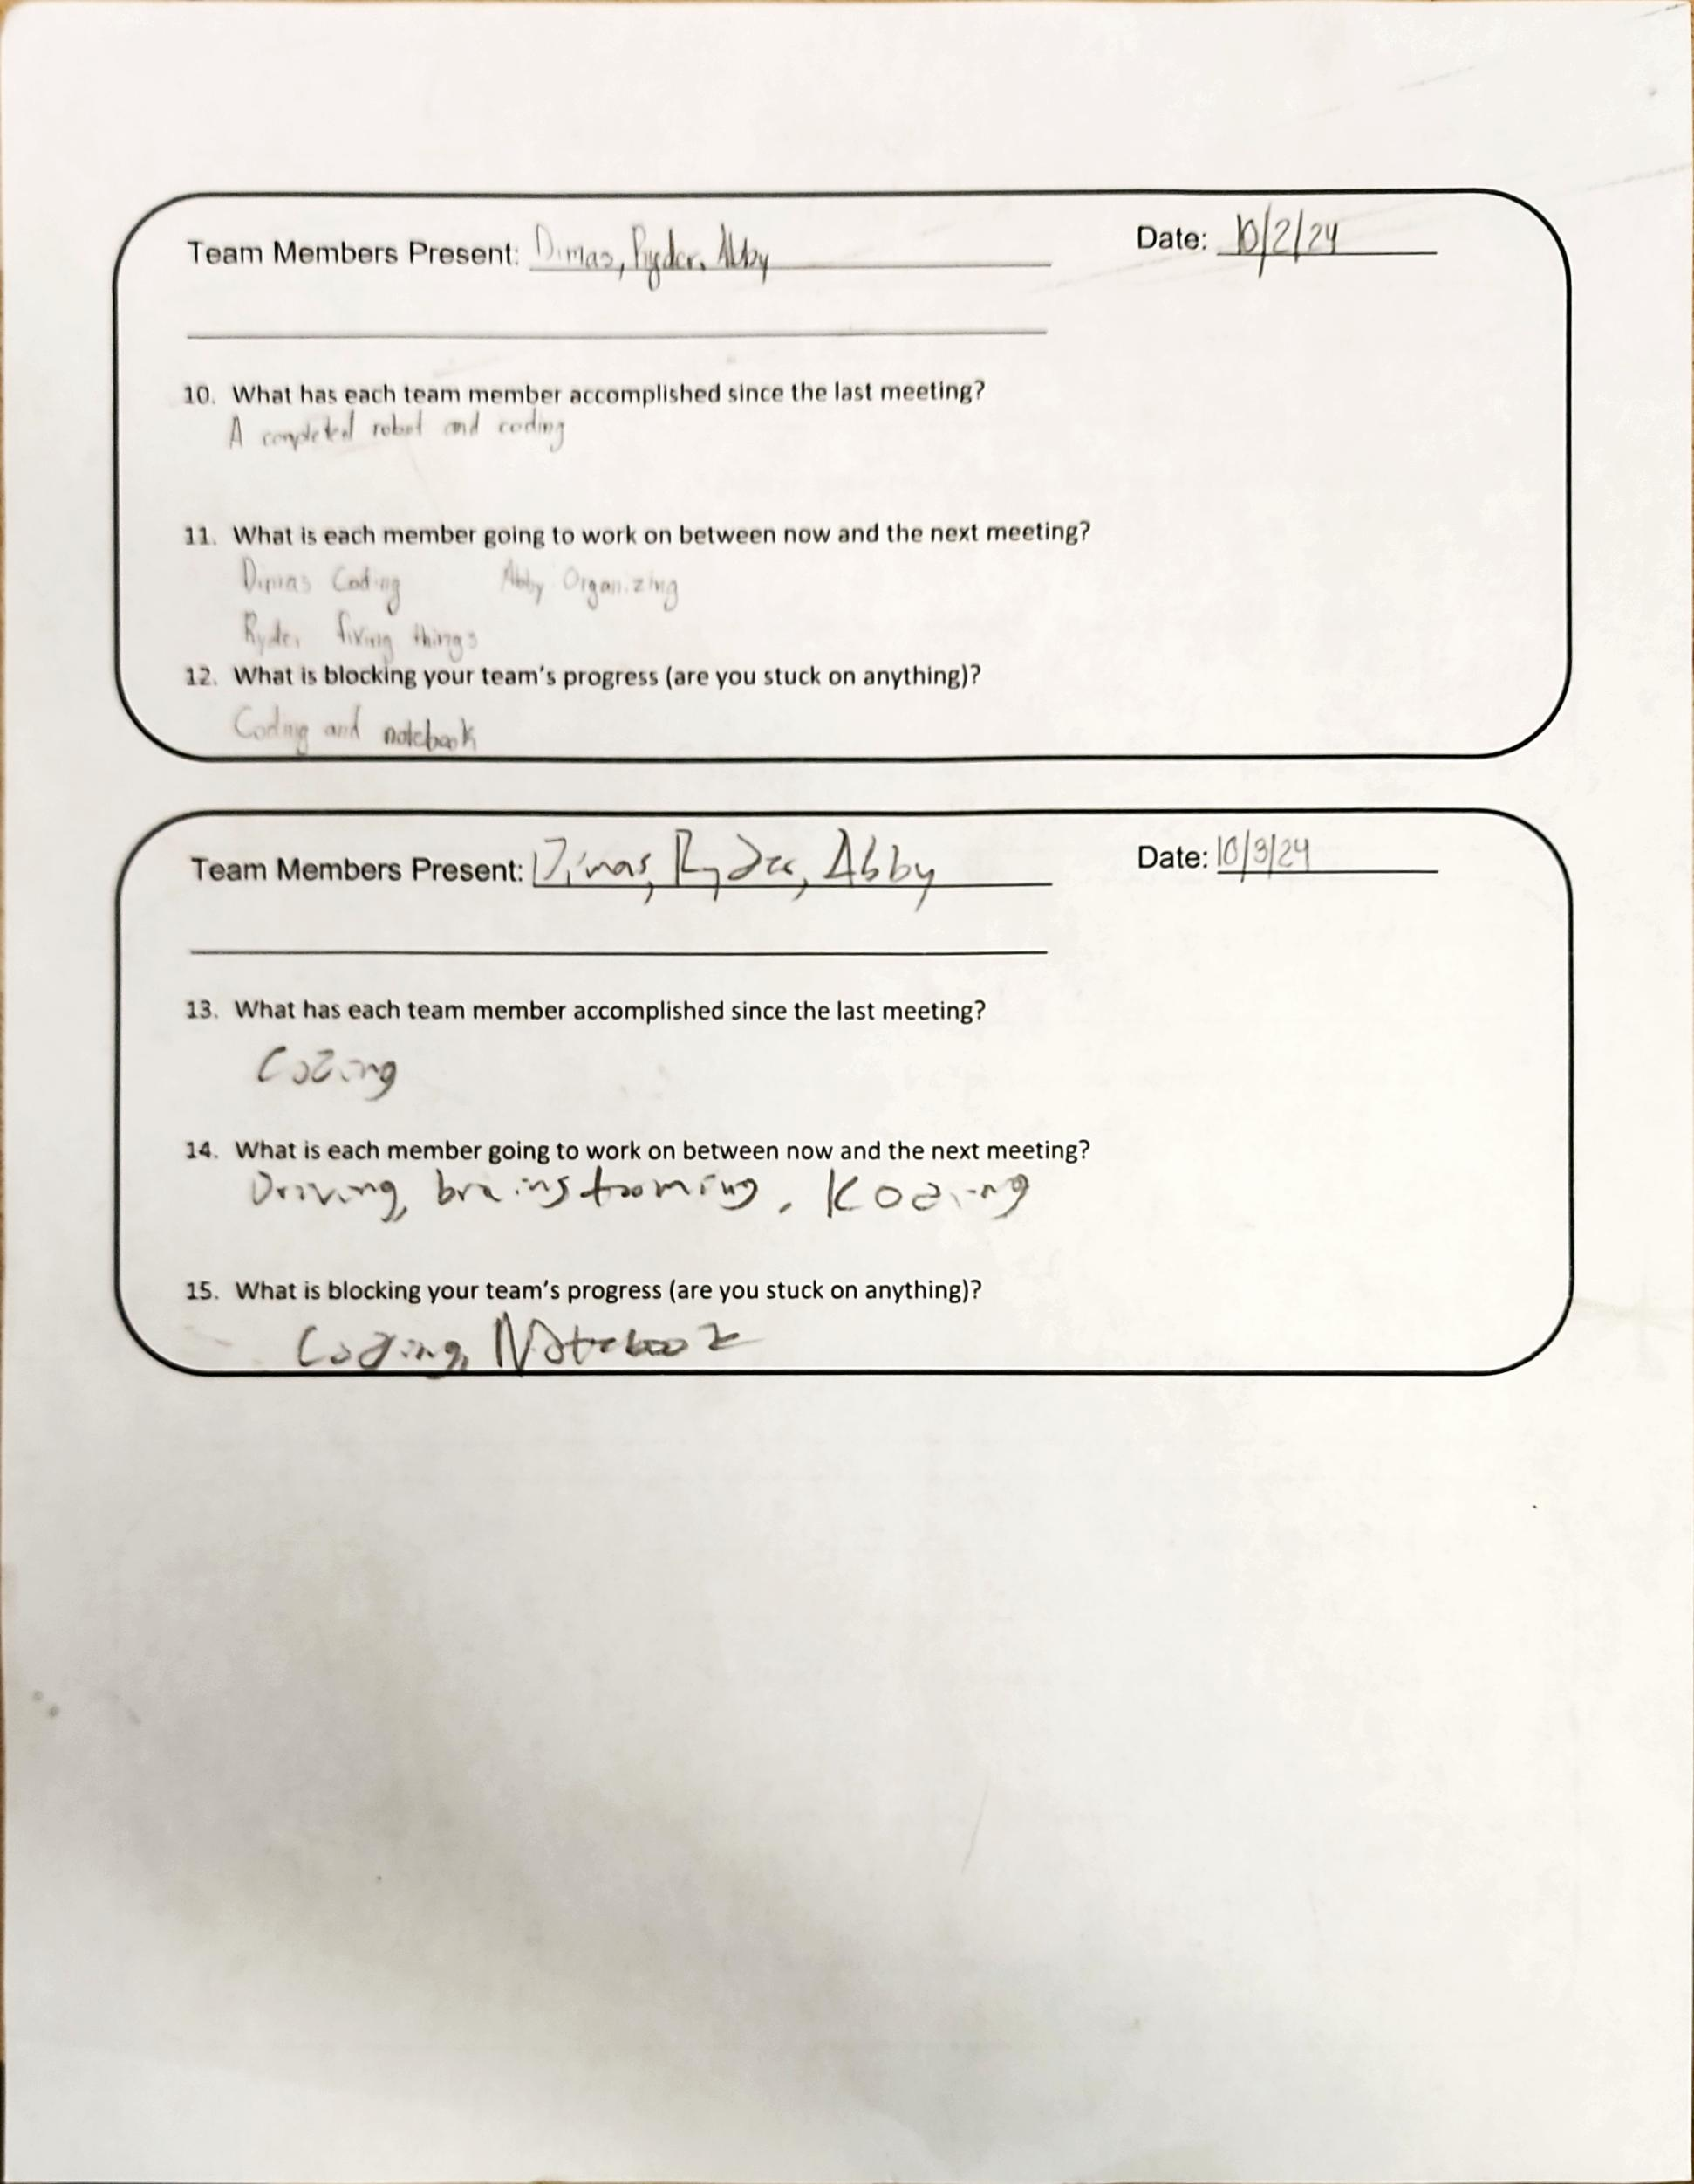
Project: Scrum Meeting
Name: Abigail Way Date:10/21/24 Page: 51

Slide 62
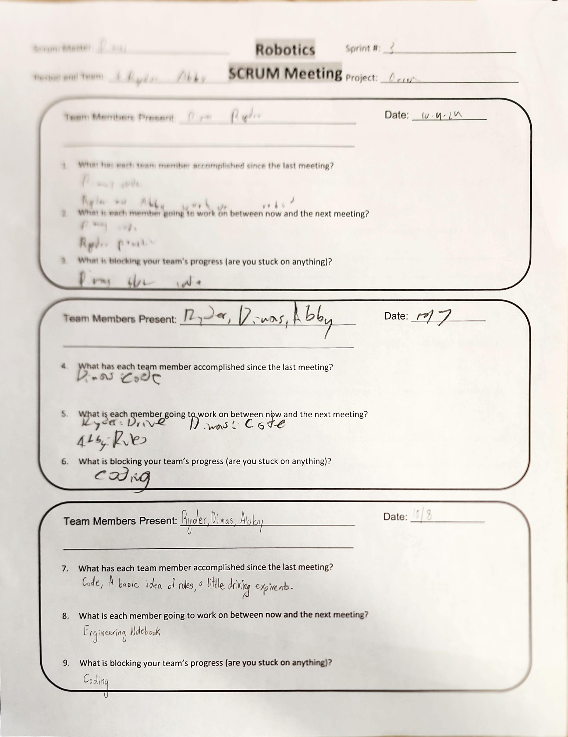
Project: Scrum Meeting
Name: Abigail Way Date:10/21/24 Page: 52

Slide 63
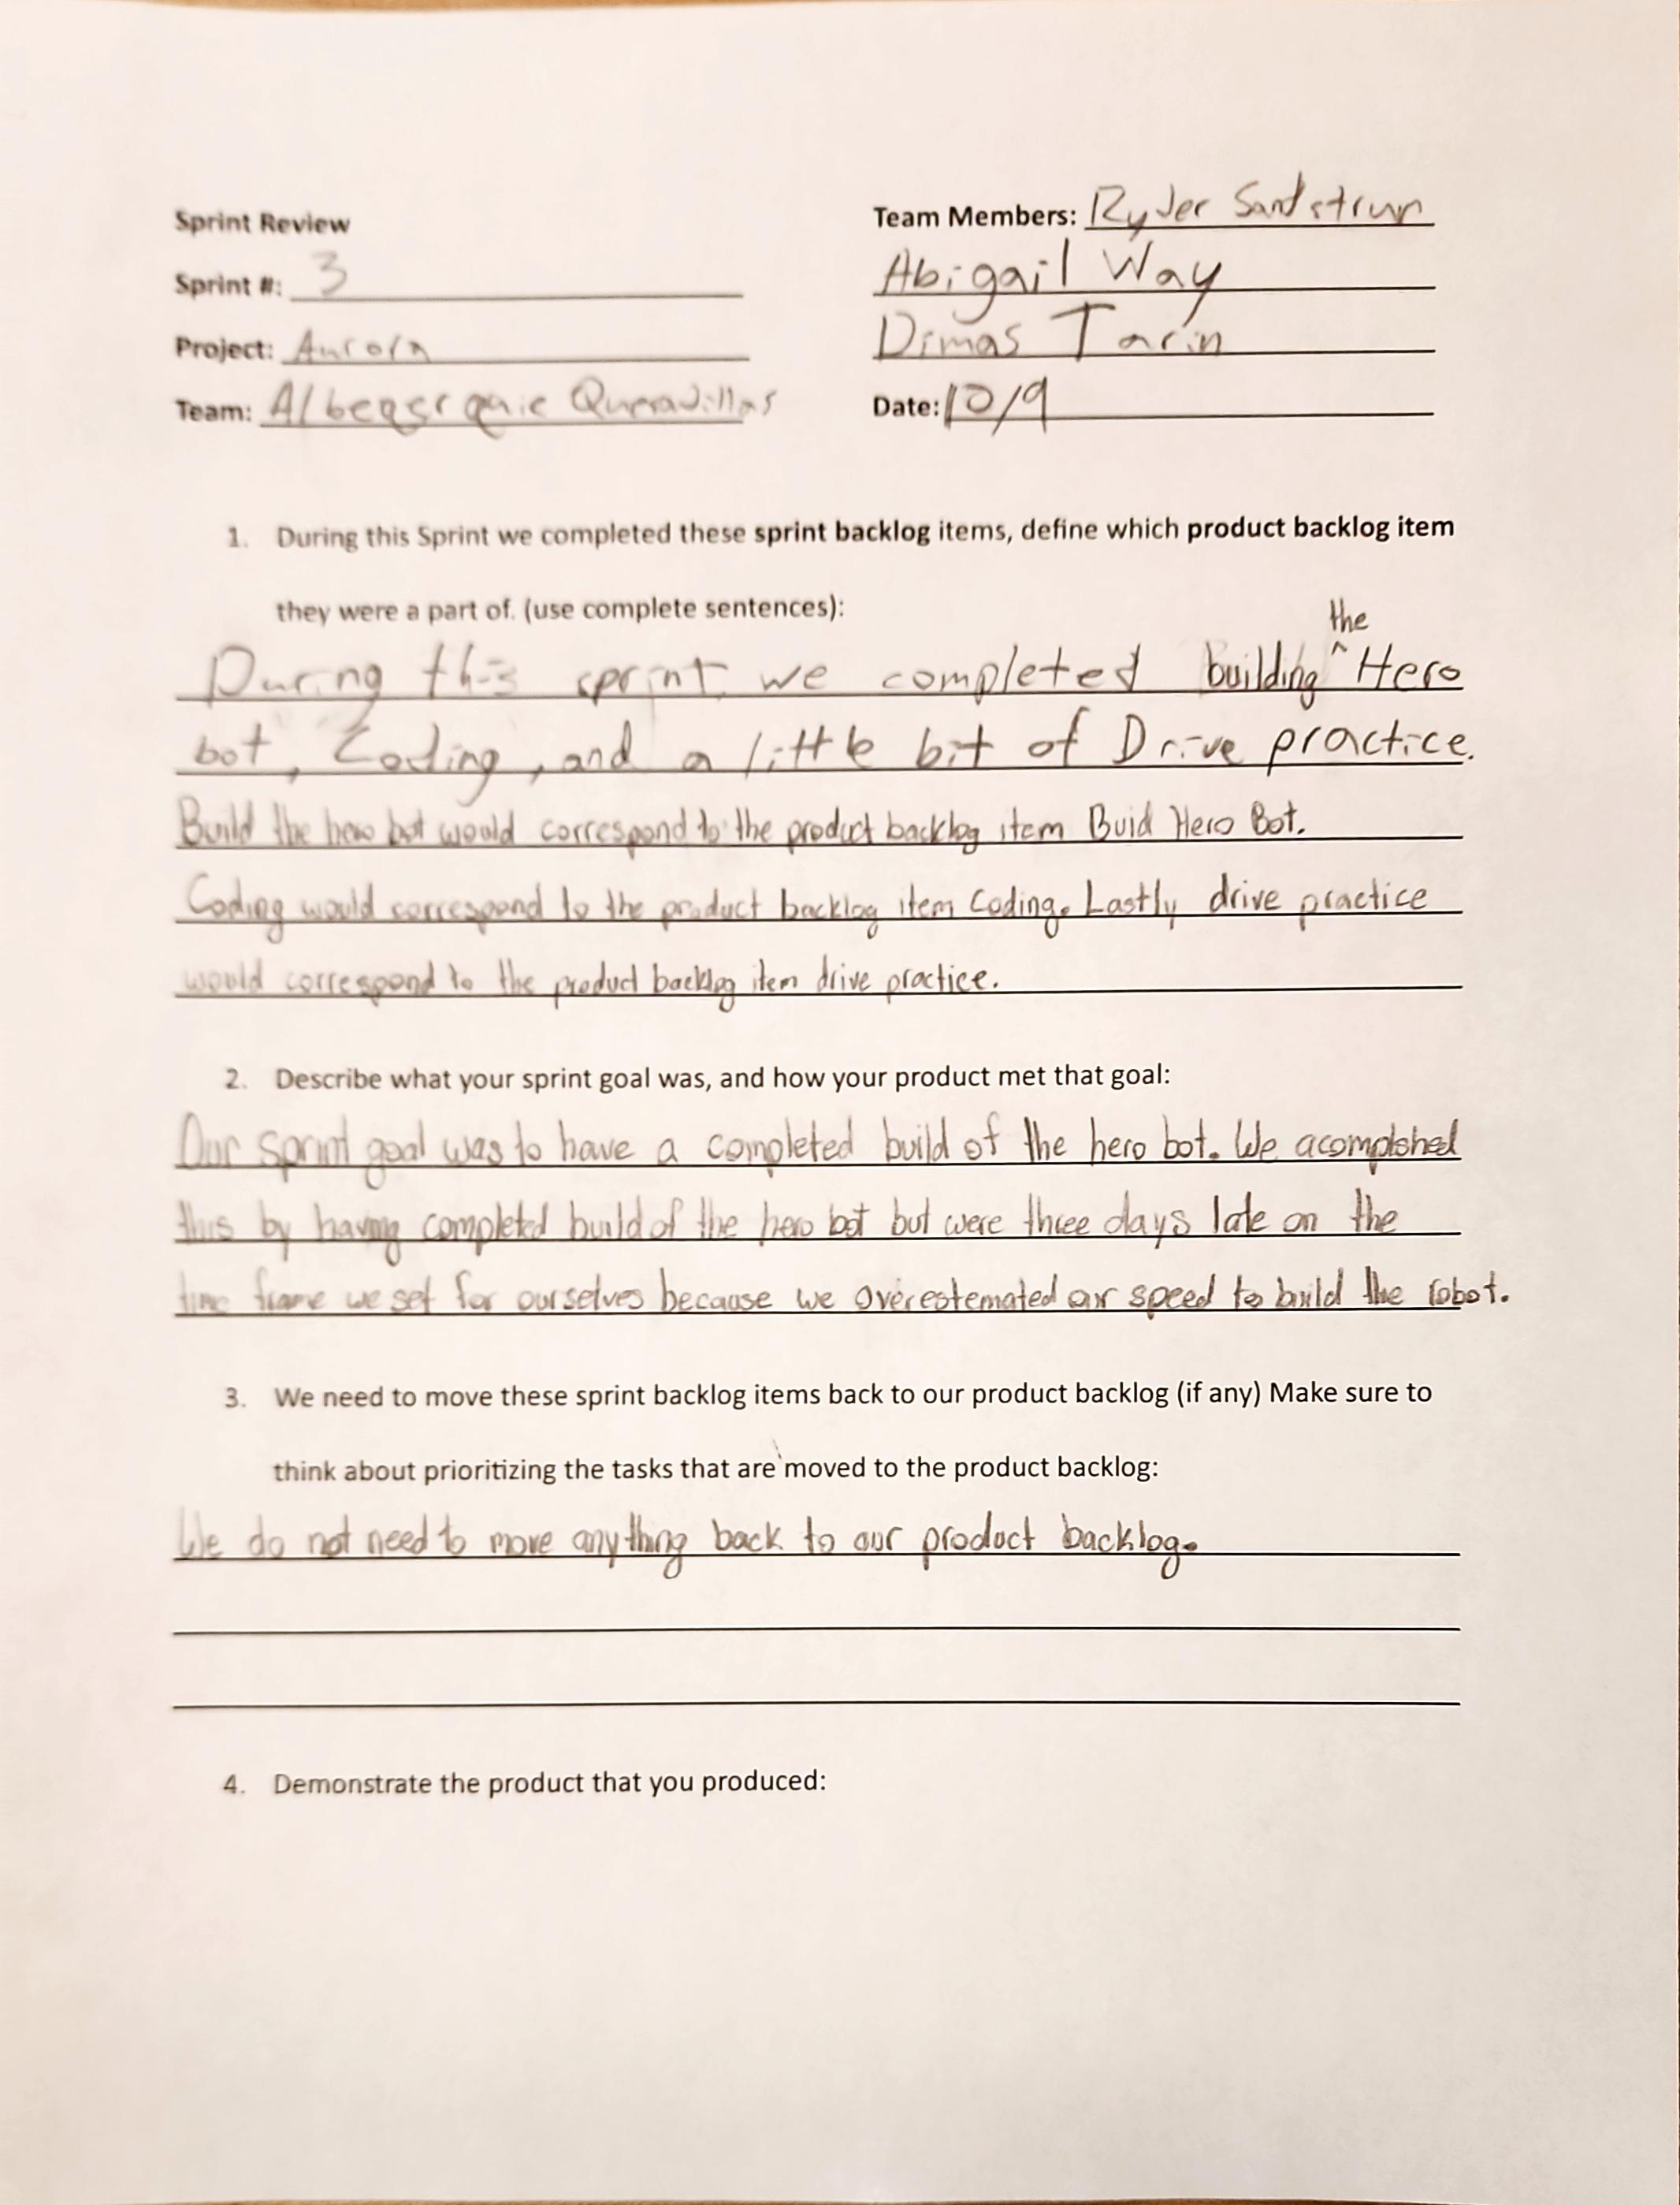
Project: Scrum Review
Name: Abigail Way Date:10/21/24 Page: 53

Slide 64
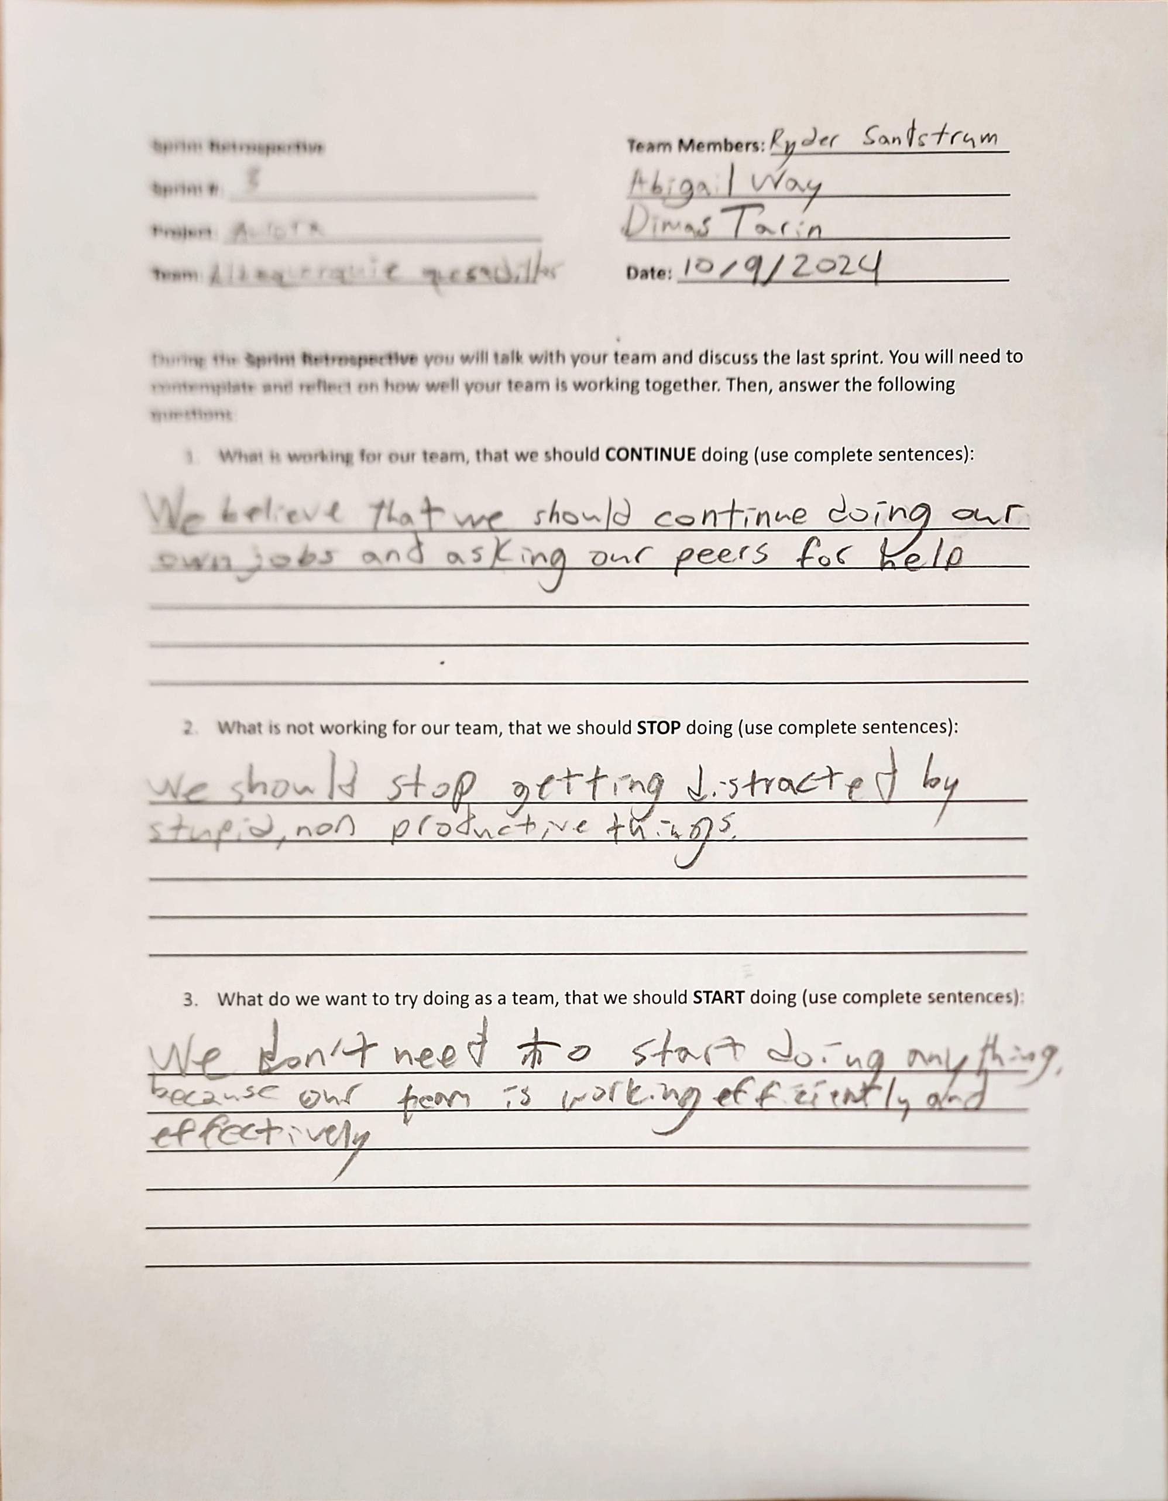
Project: Sprint Retrospective
Name: Abigail Way Date:10/21/24 Page: 54

Slide 65
Sprint Plan
This Sprint we are getting ready for our first competition on November 2. We will need to work on our code for an autonomous period. Along with that we will need to work on our driving skills and getting familiar with the rules.
Abigail Way
10/24/24
55

Slide 66
Scrum Meeting
Scrum Master: Dimas
Robotics
SCRUM Meeting
Sprint: 4
Team Members: Abby, Dimas,
Ryder
Project: Aurora
Team Members Present: Abby, Dimas, Ryder
Date: 10/22/24
What has each team member accomplished since the last meeting?
We have accomplish a basic code, a sense driving, and a competition ready engineering notebook.
What is each team member going to work on between now and the next meeting?
Ryder: Drive
Dimas: Code
Abby: Engineering notebook
What is blocking your team’s progress (are you stuck on anything)?
Our code is blocking our team’s progress.
Team Members Present: Abby, Dimas, Ryder
Date: 10/23/2024
What has each team member accomplished since the last meeting?
We have accomplish a basic code, an idea of driving, and a competition ready engineering notebook.
What is each team member going to work on between now and the next meeting?
Ryder: Drive
Dimas: Code
Abby: Get familiar with the rules
What is blocking your team’s progress (are you stuck on anything)?
Our code is blocking our team’s progress.
Abigail Way
10/24/2024 Page: 56

Slide 67
Scrum Meeting
Scrum Master: Dimas
Robotics
SCRUM Meeting
Sprint: 4
Team Members: Abby, Dimas,
Ryder
Project: Aurora
Team Members Present: Abby, Dimas, Ryder
Date:10/24/24
What has each team member accomplished since the last meeting?
We have accomplish a basic code, an idea of driving, and a competition ready engineering notebook.
What is each team member going to work on between now and the next meeting?
Ryder: Dive practice
Dimas: Code
Abby: Read the game manual
What is blocking your team’s progress (are you stuck on anything)?
Our code is blocking our team’s progress.
Team Members Present: Abby, Dimas, Ryder
Date: 10/25/24
What has each team member accomplished since the last meeting?
We have accomplish a basic code, an idea of driving, and a competition ready engineering notebook.
What is each team member going to work on between now and the next meeting?
Ryder: Drive
Dimas: Code
Abby: Read game manual
What is blocking your team’s progress (are you stuck on anything)?
Our code is blocking our team’s progress.
Abigail Way
10/24/2024 Page: 57

Slide 68
Scrum Meeting
Scrum Master: Dimas
Robotics
SCRUM Meeting
Sprint: 4
Team Members: Abby, Dimas,
Ryder
Project: Aurora
Team Members Present: Abby, Dimas, Ryder
Date: 10/28/24
What has each team member accomplished since the last meeting?
We have accomplish a completed basic code, a sense of driving and rules.
What is each team member going to work on between now and the next meeting?
Ryder: Drive
Dimas: Code
Abby: Read rules
What is blocking your team’s progress (are you stuck on anything)?
Our code is blocking our team’s progress.
Team Members Present: Abby, Dimas, Ryder
Date: 10/29/24
What has each team member accomplished since the last meeting?
We have accomplish a completed code, A sense of driving rules.
What is each team member going to work on between now and the next meeting?
Ryder: Drive
Dimas: Code and draw
Abby: Finnish updating engineering notebook
What is blocking your team’s progress (are you stuck on anything)?
We were currently not stuck on anything.
Abigail Way
10/29/24 Page: 58

Slide 69
Scrum Meeting
Scrum Master: Dimas
Robotics
SCRUM Meeting
Sprint: 4
Team Members: Abby, Dimas,
Ryder
Project: Aurora
Team Members Present: Abby, Dimas, Ryder
Date: 10/30/24
What has each team member accomplished since the last meeting?
We have accomplish a completed basic code, a sense of driving and rules.
What is each team member going to work on between now and the next meeting?
Ryder: Drive
Dimas: Work on driving
Abby: Engineering notebook
What is blocking your team’s progress (are you stuck on anything)?
Our code is blocking our team’s progress along with our flaps not staying up.
Team Members Present: Abby, Dimas, Ryder
Date: 10/31/24
What has each team member accomplished since the last meeting?
We have accomplish a completed basic code, a sense of driving and rules.
What is each team member going to work on between now and the next meeting?
Ryder: Fix length of robot
Dimas: Code
Abby: Fix length of robot
What is blocking your team’s progress (are you stuck on anything)?
Our code is blocking our team’s progress.
Abigail Way
10/31/24 Page:59

Slide 70
Scrum Meeting
Scrum Master: Abby
Robotics
SCRUM Meeting
Sprint: 4/5
Team Members: Abby, Dimas,
Ryder, Augie, Ryker, Mike
Project:
Team Members Present: Abby, Dimas,
Ryder, Augie, Ryker, Mike
Date: 11/1
What has each team member accomplished since the last meeting?
A completed robot
What is each team member going to work on between now and the next meeting?
Prep For Competion
What is blocking your team’s progress (are you stuck on anything)?
Nothing
Team Members Present: Abby, Dimas,
Ryder, Ryker, Mike
Date: 11/4
What has each team member accomplished since the last meeting?
A first Competion under our belt
What is each team member going to work on between now and the next meeting?
Competion Debrief
What is blocking your team’s progress (are you stuck on anything)?
Nothing
Abigail Way
Page: 61

Slide 71
Scrum Meeting
Scrum Master: Abby
Robotics
SCRUM Meeting
Sprint: 5
Team Members: Abby, Dimas,
Ryder, Augie, Ryker, Mike
Project:
Team Members Present: Abby, Dimas,
Ryder, Augie, Ryker, Mike
Date: 11/5/24
What has each team member accomplished since the last meeting?
We have accomplish a full new team and a tun of new ideas for a robot.
What is each team member going to work on between now and the next meeting?
Everyone else: Take apart current robot and come up with bigger team rules
Abby: Engineering notebook
What is blocking your team’s progress (are you stuck on anything)?
We are not stuck on anything currently.
Team Members Present: Abby, Dimas,
Ryder, Augie, Ryker, Mike
Date: 11/6/24
What has each team member accomplished since the last meeting?
We have accomplish big team rules that we all agreed upon
What is each team member going to work on between now and the next meeting?
Everyone: Sprint plan and start designing our robot (s)
What is blocking your team’s progress (are you stuck on anything)?
We and not stuck on anything currently.
Abigail Way
11/6/2024 Page:62

Slide 72
Scrum Meeting
Scrum Master: Abby
Robotics
SCRUM Meeting
Sprint: 5
Team Members: Abby, Dimas,
Ryder, Augie, Ryker, Mike
Project:
Team Members Present: Abby, Dimas,
Ryder, Augie, Ryker, Mike
Date: 11/7/24
What has each team member accomplished since the last meeting?
We have accomplish a full new team and a tun of new ideas for a robot.
What is each team member going to work on between now and the next meeting?
Everyone: work on build the vacuum robot.
What is blocking your team’s progress (are you stuck on anything)?
We are not stuck on anything currently.
Team Members Present: Abby, Dimas,
Ryder, Ryker, Mike
Date: 11/8/24
What has each team member accomplished since the last meeting?
We have accomplish a basic robot design.
What is each team member going to work on between now and the next meeting?
Everyone: work on building the vacuum robot.
What is blocking your team’s progress (are you stuck on anything)?
We and not stuck on anything currently.
Abigail Way
11/8/24 Page: 63

Slide 73
Scrum Meeting
Scrum Master: Abby
Robotics
SCRUM Meeting
Sprint: 5
Team Members: Abby, Dimas,
Ryder, Augie, Ryker, Mike
Project:
Team Members Present: Abby, Dimas,
Ryder, Augie, Ryker, Mike
Date: 11/11/24
What has each team member accomplished since the last meeting?
We have accomplish a basic robot design.
What is each team member going to work on between now and the next meeting?
Abby: Note book and sort Augie: Build
Dimas: Build Ryker: Build
Ryder: Build Mike: Build
What is blocking your team’s progress (are you stuck on anything)?
We are currently not stuck on anything.
Team Members Present: Abby, Dimas,
Ryder, Ryker, Mike
Date: 11/12/24
What has each team member accomplished since the last meeting?
We have accomplish a basic robot design and a half completed base.
What is each team member going to work on between now and the next meeting?
Abby: Engineering note book Augie: Build
Dimas: Build Ryker: Build
Ryder: Build Mike: Build
What is blocking your team’s progress (are you stuck on anything)?
We are currently not stuck on anything.
Abigail Way
11/12/24 Page: 64

Slide 74
Scrum Meeting
Scrum Master: Abby
Robotics
SCRUM Meeting
Sprint: 5
Team Members: Abby, Dimas,
Ryder, Augie, Ryker, Mike
Project:
Team Members Present: Abby, Dimas,
Ryder, Augie, Ryker, Mike
Date: 11/13/24
What has each team member accomplished since the last meeting?
We have accomplish a half- completed base.
What is each team member going to work on between now and the next meeting?
Abby: Engineering Notebook Augie: Build
Dimas: Code Ryker: Build
Ryder: Build Mike: Build
What is blocking your team’s progress (are you stuck on anything)?
We are not stuck on anything
Team Members Present: Abby, Dimas,
Ryder, Ryker, Mike
Date: 11/14/24
What has each team member accomplished since the last meeting?
We have accomplish half completed base
What is each team member going to work on between now and the next meeting?
Abby: build 1 Augie: build 1
Dimas: build 2 Ryker: build 2
Ryder: build 1 Mike: build 1
What is blocking your team’s progress (are you stuck on anything)?
We are
Abigail Way
11/13/24 Page: 65

Slide 75
Scrum Meeting
Scrum Master: Abby
Robotics
SCRUM Meeting
Sprint: 5
Team Members: Abby, Dimas,
Ryder, Augie, Ryker, Mike
Project:
Team Members Present: Abby, Dimas,
Ryder, Augie, Ryker, Mike
Date: 11/15/24
What has each team member accomplished since the last meeting?
We have accomplish two half completed bases.
What is each team member going to work on between now and the next meeting?
Everyone; Build and design
What is blocking your team’s progress (are you stuck on anything)?
We are not stuck on anything.
Team Members Present: Abby, Dimas,
Ryder, Ryker, Mike
Date:11/18/24
What has each team member accomplished since the last meeting?
We have accomplished building more of our bases
What is each team member going to work on between now and the next meeting?
Abby: Build Augie: build
Dimas:build Ryker:build
Ryder:build Mike:build
What is blocking your team’s progress (are you stuck on anything)?
We are not stuck on anything
Abigail Way & Dimas!!!!!!!
Page: 66

Slide 76
Scrum Meeting
Scrum Master: Abby
Robotics
SCRUM Meeting
Sprint: 5
Team Members: Abby, Dimas,
Ryder, Augie, Ryker, Mike
Project:
Team Members Present: Abby, Dimas,
Ryder, Augie, Ryker, Mike
Date:11/19/24
What has each team member accomplished since the last meeting?
We have accomplished more building
What is each team member going to work on between now and the next meeting?
Abby:build bot 1 Augie:build 1
Dimas:build bot 1 Ryker:build 1
Ryder:build bot 1 Mike:build 1
What is blocking your team’s progress (are you stuck on anything)?
We are not stuck on anything
Team Members Present: Abby, Dimas,
Ryder, Mike
Date: 11/20/24
What has each team member accomplished since the last meeting?
We have accomplished more building
What is each team member going to work on between now and the next meeting?
Abby:build 1 Augie: build 1
Dimas: build 2 Ryker: build 2
Ryder: Mike: build 1
What is blocking your team’s progress (are you stuck on anything)?
We are waiting on some parts, but we’re going along without them
Dimas Tarin
Page: 67

Slide 77
Scrum Meeting
Scrum Master: Abby
Robotics
SCRUM Meeting
Sprint: 5
Team Members: Abby, Dimas,
Ryder, Augie, Ryker, Mike
Project:
Team Members Present: Abby, Dimas,
Ryder, Augie, , Mike
Date: 11/21/24
What has each team member accomplished since the last meeting?
We have accomplished more building
What is each team member going to work on between now and the next meeting?
Abby: build 1 Augie: build 1
Dimas: build 2 Ryker: build 2
Ryder: Mike: build 1
What is blocking your team’s progress (are you stuck on anything)?
We are stuck on waiting for parts to come
Team Members Present: Abby, Dimas,
, Ryker, Mike
Date: 11/22/24
What has each team member accomplished since the last meeting?
We have accomplished more building
What is each team member going to work on between now and the next meeting?
Abby: build 1 Augie: build 1
Dimas: build 1 Ryker: nothing
Ryder: Mike: nothing
What is blocking your team’s progress (are you stuck on anything)?
We are still waiting for parts
Dimas again
Page: 68
Notes:
71

Slide 78
Scrum Meeting
Scrum Master: Abby
Robotics
SCRUM Meeting
Sprint: 5
Team Members: Abby, Dimas,
Ryder, Augie, Ryker, Mike
Project: Borealis I
Team Members Present: Abby, Dimas,
Ryder, Augie, Ryker
Date:12/2/24
What has each team member accomplished since the last meeting?
We have accomplished more building
What is each team member going to work on between now and the next meeting?
Abby: Build Augie: build 1
Dimas: code Ryker: build 2
Ryder: Mike: build 1
What is blocking your team’s progress (are you stuck on anything)?
We are stuck on waiting for parts to come
Team Members Present: Abby, Dimas,
Ryder, Ryker, Mike
Date: 12/3/2024
What has each team member accomplished since the last meeting?
We have accomplished more building
What is each team member going to work on between now and the next meeting?
Abby:Build 2 Augie: build 2
Dimas:Notebook/ coding Ryker:build 1
Ryder:build 1 Mike: build 1
What is blocking your team’s progress (are you stuck on anything)?
We are still waiting for parts
Dimas!!!!!!!
Page: 69

Slide 79
Scrum Meeting
Scrum Master: Abby
Robotics
SCRUM Meeting
Sprint: 5
Team Members: Abby, Dimas,
Ryder, Augie, Ryker, Mike
Project: borealis
Team Members Present: Abby, Dimas,
Ryder, Augie, Ryker, Mike
Date:12/4/24
What has each team member accomplished since the last meeting?
We’ve been building the robot and Dimas has been coding
What is each team member going to work on between now and the next meeting?
Abby: build Augie:build 1
Dimas:coding/notebooking Ryker:build 1/ doing nothing
Ryder:build 1 Mike:coding/goofing off
What is blocking your team’s progress (are you stuck on anything)?
We are waiting for parts, but we have given up on their arrival in time. Defeat is immenent
Team Members Present: Abby, Dimas, Ryker, Mike
Date: 12/5/2024
What has each team member accomplished since the last meeting?
More Building
What is each team member going to work on between now and the next meeting?
Abby: build 1 Augie:build 1
Dimas: coding/notebook Ryker: drive
Ryder: Mike: read the rules
What is blocking your team’s progress (are you stuck on anything)?
Same as last time
Dimas
Page: 70

Slide 80
Scrum Meeting
Scrum Master: Abby
Robotics
SCRUM Meeting
Sprint:
Team Members: Abby, Dimas,
Ryder, Augie, Ryker, Mike
Project:
Team Members Present: Abby, Dimas,
Ryder, Augie, Ryker,
Date: 12/6/2024
What has each team member accomplished since the last meeting?
Build.
What is each team member going to work on between now and the next meeting?
Abby: english homework Augie: building
Dimas: coding Ryker: whatever abby says
Ryder: griping Mike: dead
What is blocking your team’s progress (are you stuck on anything)?
Team mates not getting along
Team Members Present: Abby, Dimas,
Ryder, Ryker, Mike
Date: 12/9/24
What has each team member accomplished since the last meeting?
What is each team member going to work on between now and the next meeting?
Abby: Build Augie:Build
Dimas: Build Ryker: Build
Ryder: Build Mike: Code
What is blocking your team’s progress (are you stuck on anything)?
Parts still not arived
Page: 71

Slide 81
Scrum Meeting
Scrum Master: Abby
Robotics
SCRUM Meeting
Sprint:
Team Members: Abby, Dimas,
Ryder, Augie, Ryker, Mike
Project:
Team Members Present: Abby, Dimas,
Ryder, Augie, Ryker, Mike
Date: 12/10/24
What has each team member accomplished since the last meeting?
A mostly completed Robot
What is each team member going to work on between now and the next meeting?
Abby: Build Augie: Build
Dimas:Build Ryker: Code?
Ryder: Build Mike: Code
What is blocking your team’s progress (are you stuck on anything)?
Team Members Present: Abby, Dimas,
Ryder, Ryker, Mike
Date: 10/11
What has each team member accomplished since the last meeting?
A mostly completed robot
What is each team member going to work on between now and the next meeting?
Abby: Scrum things Augie: Build
Dimas: Build Ryker:
Ryder: Build Mike: Code
What is blocking your team’s progress (are you stuck on anything)?
Bot having enough time
Page: 72

Slide 82
Scrum Meeting
Scrum Master: Abby
Robotics
SCRUM Meeting
Sprint:
Team Members: Abby, Dimas,
Ryder, Augie, Ryker, Mike
Project:
Team Members Present: Abby, Dimas,
Ryder, Augie, Ryker, Mike
Date: 12/13/24
What has each team member accomplished since the last meeting?
A completed working robot.
What is each team member going to work on between now and the next meeting?
Everyone: Working on sprint review and retrospective.
What is blocking your team’s progress (are you stuck on anything)?
We are not stuck on anything.
Abigail Way
Page: 73

Slide 83
Scrum Meeting
Scrum Master: Abby
Robotics
SCRUM Meeting
Sprint:
Team Members: Abby, Dimas,
Ryder, Augie, Ryker, Mike
Project:
Team Members Present: Abby, Dimas,
Ryder, Augie, Ryker, Mike
Date: 1/7/25
What has each team member accomplished since the last meeting?
We have accomplished a completed sprint review and retrospective.
What is each team member going to work on between now and the next meeting?
Abby: Build Augie: Build
Dimas: Code Ryker: Read rules
Ryder: Build Mike: Code
What is blocking your team’s progress (are you stuck on anything)?
A not working robot
Team Members Present: Abby, Dimas,
Ryder, Ryker, Mike
Date: 1/8/25
What has each team member accomplished since the last meeting?
What is each team member going to work on between now and the next meeting?
Abby: Augie:
Dimas: Ryker:
Ryder: Mike:
What is blocking your team’s progress (are you stuck on anything)?
Page: 74

Slide 84
Scrum Meeting
Scrum Master: Abby
Robotics
SCRUM Meeting
Sprint:
Team Members: Abby, Dimas,
Ryder, Augie, Ryker, Mike
Project:
Team Members Present: Abby, Dimas,
Ryder, Augie, Ryker, Mike
Date: 1/9/25
What has each team member accomplished since the last meeting?
A completed robot.
What is each team member going to work on between now and the next meeting?
Abby: Notebook, competition prep Augie: 2nd robot
Dimas: Test code Ryker:
Ryder: Drive Mike: Code
What is blocking your team’s progress (are you stuck on anything)?
Pneumatics not working
Team Members Present: Abby, Dimas,
Ryder, Ryker, Mike
Date: 1/20/25
What has each team member accomplished since the last meeting?
What is each team member going to work on between now and the next meeting?
Abby: Augie:
Dimas: Ryker:
Ryder: Mike:
What is blocking your team’s progress (are you stuck on anything)?
Page: 75

Slide 85
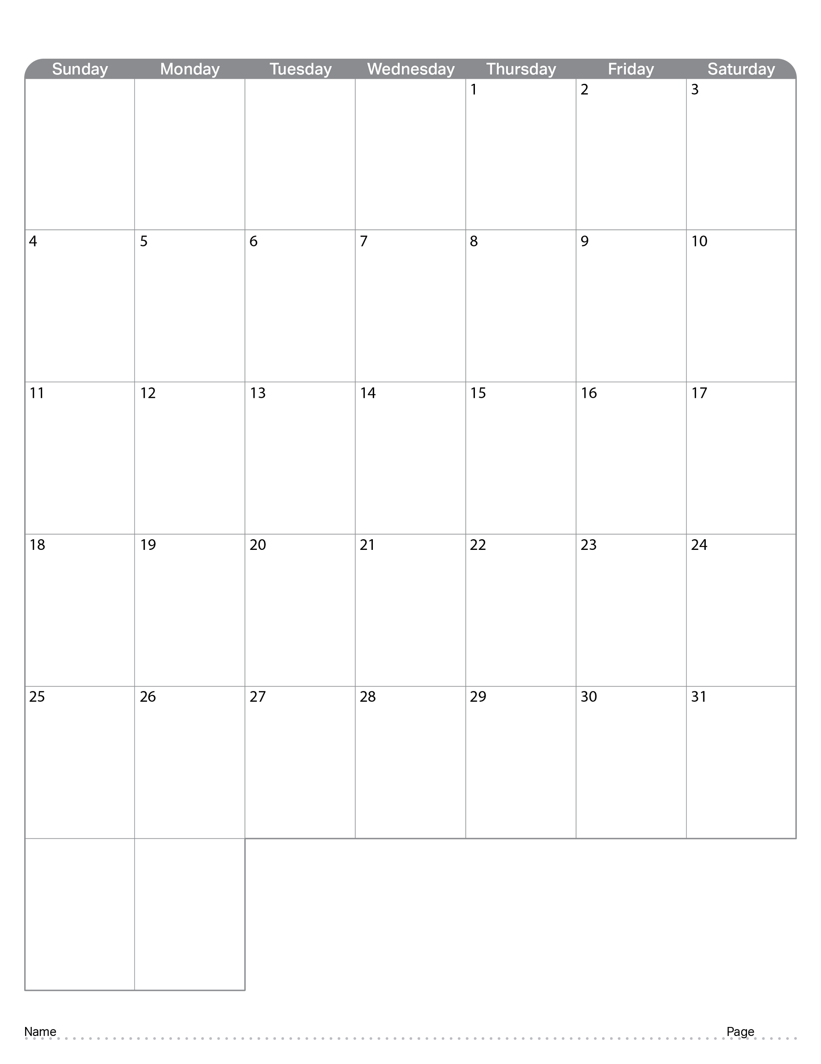
August 2024
 |  | Went through Engineering Notebook | Started coming up with robot ideas | Worked on first conveyor belt prototype as well as watching a video about award winning Engineering Notebook. | Worked on base by taking apart claw bot as well as scrum test
Abigail Way
79

Slide 86

September 2024
 | NO SCHOOL | NO SCHOOL | Worked on base | Continue to work on base and drawings. | Continue to work on base and drawings.
 | Sprint Retrospective, and Sprint Review | Started Sprint 2 | Continued working on base, 3D modeling, and updated Notebook | Coding, Updated Notebook, Continued working on base | Continued working on base, 3D modeling, and updated Notebook
 | Continued working on base, 3D modeling, and updated Notebook | Coding, Updated Notebook, Continued working on base | Continued working on base, 3D modeling, and updated Notebook | Coding, Updated Notebook, Continued working on base | Continued working on base, 3D modeling, and updated Notebook
 | Continued working on base, 3D modeling, and updated Notebook | Coding, Updated Notebook, Continued working on base | Continued working on base, 3D modeling, and updated Notebook | Coding, Updated Notebook, Continued working on base | Continued working on base, 3D modeling, and updated Notebook
 | Continued working on base, 3D modeling, and updated Notebook
Abigail Way
80

Slide 87

October 2024
 |  | Code | Code | Code | Code
 | Code | Code, Drive, get a sense of rules | Code, Drive, get a sense of rules | Half Day No Class | Half Day Code, Drive, Engineering Notebook
 | No School | No School | No School | No School | No School
 | Code, Drive, Engineering Notebook | Code, Drive, get a sense of rules | Code, Drive, get a sense of rules | Prepare for competition. Code, Drive, get a sense of rules | Prepare for competition. Code, Drive, get a sense of rules
 | Prepare for competition. Code, Drive, get a sense of rules | Prepare for competition. Code, Drive, get a sense of rules | Prepare for competition. Code, Drive, get a sense of rules | Prepare for competition. Code, Drive, get a sense of rules
Abigail Way
81

Slide 88

November 2024
 |  |  |  |  | No School | Competition
 | Competition debrief | Team Rules | Sprint Plan and design new robot | Work on Building a vacuum robot | Work on Building a vacuum robot
 | Work on Building a vacuum robot | Work on Building a vacuum robot | Work on Building a vacuum robot | Work on Building a vacuum robot | Work on Building a vacuum robot
 | Work on Building a vacuum robot | Work on Building a vacuum robot | Work on Building a vacuum robot | Work on Building a vacuum robot | Work on Building a vacuum robot
 | No School | No School | No School | No School | No School
82

Slide 89

December 2024
 | Work on Building a vacuum robot | Work on Building a vacuum robot | Work on Building a vacuum robot | Work on Building a vacuum robot | Work on Building a vacuum robot
 | Work on Building a vacuum robot | Work on Building a vacuum robot | Work on Building a vacuum robot | Work on Building a vacuum robot | Sprint review and Retrospective
 | No School | No School | No School | No School | No School
 | No School | No School | No School | No School | No School
 | No School | No School
83

Slide 90

January 2025
 |  |  | No School | No School | No School
 | No School | Competion Prep.
 | No School
84

Slide 91

February 2025
 |  |  |  |  | No School
 | No School

Slide 92

March 2025
 |  |  |  | Half Day | Half Day
 | No School | No School | No School | No School | No School

Slide 93

April 2025
 |  |  |  |  | No School

Slide 94

May 2025

Slide 95

Resources
engineering.vex.com
notebooking.vex.com
coding.vex.com
Judging Rubric for Notebooks
vex.com
roboticseducation.org
V5RC 2024-2025 Game - Rules & Game Video
Send suggestions and comments about these Digital Notebooks and Digital Parts
to notebooks@vex.com

Slide 96
Scrum Meeting
Scrum Master: Abby
Robotics
SCRUM Meeting
Sprint:
Team Members: Abby, Dimas,
Ryder, Augie, Ryker, Mike
Project:
Team Members Present: Abby, Dimas,
Ryder, Augie, Ryker, Mike
Date:
What has each team member accomplished since the last meeting?
What is each team member going to work on between now and the next meeting?
Abby: Augie:
Dimas: Ryker:
Ryder: Mike:
What is blocking your team’s progress (are you stuck on anything)?
Team Members Present: Abby, Dimas,
Ryder, Ryker, Mike
Date:
What has each team member accomplished since the last meeting?
What is each team member going to work on between now and the next meeting?
Abby: Augie:
Dimas: Ryker:
Ryder: Mike:
What is blocking your team’s progress (are you stuck on anything)?
Do not use this is the duplicate that we use to copy paste
Page: 51

